Slide 1
Enduring Legacies Native Cases Project

Slide 2
Introduction
Agenda overview
Who’s here
Faculty case mentors
Flash drive
Additional resources
Restaurants, facilities

Slide 3
Six workshop goals
Overview of Enduring Legacies Native Cases Initiative & other resources
Introduction to case method
Experience doing cases
Consider important topics in your area
Consider ways to teach & assess cases
Plan for the future development & use of cases
Notes:
Meet terrific colleagues

Slide 4
Why Cases? Why Native Cases?
Barbara Leigh Smith
The Evergreen State College

Slide 5
Session Overview
Why cases?
Why Native cases ?
What is a teaching case?
Our approach to reform
Core practices of effective teaching & learning
Our pedagogical approach: An Indigenous Pedagogy
Impact of cases
Related work & resources

Slide 6
Our Initiative
Curriculum Development: Interdisciplinary Native Cases with teaching notes. 100+ cases
Faculty development: annual summer institutes & other workshops & presentations
Dissemination
Notes:
We’ve produced about 90 cases thus far. The initiative has been going since 2005. Our cases can be downloaded and used by anyone at no cost. Detailed teaching notes are also available. Used online and in face to face classes

Slide 7
Why Cases? Need for effective education for all
Declining graduation rates, low retention
US falling behind other nations
The perfect storm: divergent skill distributions, changing economy, demographic trends (ETS)
Issues in STEM fields: pipeline, active learning
For all? Not there yet-- education especially failing students of color and Native students

Slide 8
Why Native Cases?
Increase student engagement & success
Fill curriculum voids & inaccuracies especially of the place where we live
87% of state history standards inaccurate
Expand literature from a Native perspective
Meet tribal needs in era of community revitalization and self-determination
Create a vehicle to share information between tribes on common dilemmas & solutions
Notes:
Alaska is at the forefront on issues such as climate change, sustainability of natural resources, food security and a host of other topics. Research indicates that cases develop sensitivity to interrelationships and connections in complex situations such as those found here in Alaska. Cases are a proven methodology for student engagement and development of their problem solving skills.
Our goals in using cases are based on 3 overall objectives: to increase students success (point 1), to create curriculum content in light of what’s available/not available (points 2-3 above), and third, to address needs at this particular time and place (point 4-5). We think there’s a real readiness for this.

Slide 9
Historical Roots
Harvard U. early leader of case method to promote problem solving. Used widely across disciplines
Premise: Real world problems and engaging teaching methods motivate students and promote higher order reasoning
Notes:
Why should case studies be used as a teaching tool?
The main point here is the focus on creating a problem solving environment for students to explore options and solutions across a broad range of disciplines. Cases are a proven methodology for student engagement and developing problem solving skills in students.
In essence, cases are a story with an important educational message.

Slide 10
What is a teaching case?
A case is a significant story of a real, often unresolved issue--that can trigger curiosity, debate, and further research.
Effective cases involve controversy, conflicts or puzzling situations. They have enough tension to invite discussion and problem solving.
Notes:
As we move the discussion forward to the various forms of case studies, it is important to note that case studies is a form of telling or sharing the story of a significant issue in a manner that allows you to explores connections in a complex situation.

Slide 11
Our Approach to Ed Reform: Connect & Collaborate
Connected to the community & experts outside the academy
Research-based: uses best practices
Interdisciplinary
Connected to related reform efforts in our state in sustainability, K-12 tribal sovereignty curriculum effort, STEM reform & other active learning & curriculum restructuring efforts
Stay the course-long term commitment

Slide 12
Related Efforts
Since Time Immemorial (STI)
Alaska Native Knowledge Network

Slide 13
High Impact Practices “Educationally purposeful”*
Learning communities
Service learning/Community based learning
Writing intensive courses
Collaborative assignments & projects
Undergraduate research
Diversity/global courses
1st Year experience courses
Capstone courses
*Assoc of American Colleges & Universities

Slide 14
Curriculum Restructuring
High impact best practices
Flipped classroom
Learning communities
Professional development with follow-up

Slide 15
Situating Cases
Target open space in curriculum
Go for the critical required courses
Scale up around the course—not just a single class and teacher
Build momentum, feedback loops, a culture of
continuous improvement

Slide 16
Core practices of effective teaching & learning

Slide 17
An Indigenous Pedagogy: Three educational theories
Native Cases
Project
Collaborative learning
Problem-based learning
Place-based learning
Indigenous Knowledge and Protocols

Slide 18
Institutional Approaches

Slide 19
A Powerful approach to learning
Active, collaborative learning well validated by research
Develops multiple skills + content knowledge
Student engagement key. Increases motivation.
Makes learning relevant
Recognize student knowledge
Dissolves myth of silent “minority” students
Notes:
There is considerable research demonstrating the power of “active” learning in classrooms and cases and problem based learning are often one form of active learning. We especially like the way cases can join active learning with problem solving around important real-world issues. It’s a really effective way of indigenizing the curriculum.

Slide 20
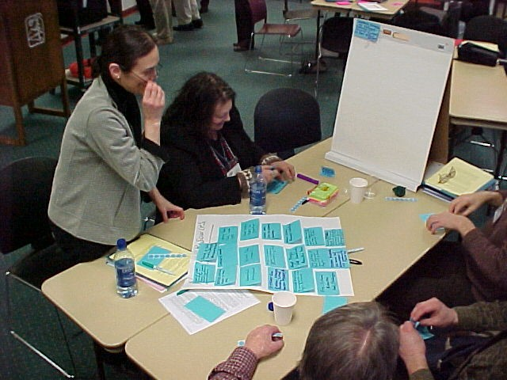
Choosing case topics
Start with a story or key concept/issues in your field and/or big issues in the world.
Native Advisory Board helped us identify topics.
Our emphasis is on science & social science cases with an overall interdisciplinary approach
What are your important topics?
Notes:
At the start of the project we convened a large group for an all day brainstorming. We continue to involve Indian leaders and communities in issue identification as well as our students. There’s hidden literature to draw upon everywhere.

Slide 21
Our case topics
Sovereignty/treaty rights*
Cultural preservation/renewal
Intergovernmental relations
Education*
Leadership*
Economic development
Indian enrollment & Indian identity
Climate change
Sustainability
Salmon*
Energy
Water/forestry
Housing
Land
Health-diabetes, alcoholism, substance abuse, suicide, innovation & success
Notes:
The overall issue of tribal sovereignty and treaty rights is prominent in nearly all of our cases as an overall theme. A number of our cases are what I would call foundational cases that tell the story of longstanding critical issues.

Slide 22
Ways to assess impact
Start with your goals & learning outcomes
What to assess: student learning, content, perceptions, motivation, attitudes, engagement, clinical skills/tasks, attendance, retention, grades & completion rates
Assessment usually based on work students produce
Many vehicles: Surveys, exams, position papers, reflection questions, journals, portfolios, before/after measures, peer evaluations

Slide 23
What our Native students say (N=55. Battlegrounds Class)
The cases addressed important issues in my community - 95%
I learned new things from students in my group – 91%
Cases improve critical thinking skills - 100%
Cases increased my understanding of important concepts such as citizenship, sovereignty, and identity - 100%
Notes:
We are now in our eighth year of using cases and students consistently point to this as a very strong feature of our curriculum. We know that more than 80 other colleges and universities are also using them with good success.

Slide 24
Faculty views of impact of cases (N=66. Smith 2010)
View issues from multiple perspectives-97%
Become more engaged-93%
Develop stronger critical thinking skills-90%
Gain a better grasp of practical applications-89%
Strengthen their communication skills-85%
Build positive peer-to-peer relations-78%
Gain confidence working in groups-71%
They also indicated their students may find the format challenging-61%
Notes:
We recently did a survey of faculty who had attended our summer institute or workshops and learned a great deal about how our cases are being used. 90% say they used our cases after the institute. Most faculty use these in single sessions with the students reading the cases in advance. They are being used at all levels—from high schools to graduate schools.

Slide 25
Faculty views of Native cases impact (
Students gain understanding of important issues in Indian Country – 100% Agree
Native cases raise awareness of Non-Native students –100% Agree
Native cases enhance scientific curriculum for Native students – 93% Agree
Students feel curriculum is more culturally relevant – 83% Agree

Slide 26
Additional Resources
Enduring Legacies Native Cases website at http://nativecases.evergreen.edu
Center for Case Teaching in Science, SUNY Buffalo at http://science.cases.lib.buffalo.edu
University of Washington Electronic Hallway-public administration cases at www.hallway.evans.washington.edu
Teambasedlearning.org
University of Delaware PBL Clearinghouse for problem based learning at www.udel.edu/inst
Notes:
There are a small number of Alaska cases at various sites.
-Electronic Hallway has a case on drilling in the Arctic Wildlife Refuse and the role of the Gwich’in Tribes in this debate.
-Caseplace has a case on the Indian Health Service in Alaska that you may or may not find somewhat dated (1999)
-Ted has a number of relevant cases including one on Eskimo whale hunting and another on border disputes at Beringian Heritage Intl Park, a case on the Exxon Valdez, and ones on Alaska salmon

Slide 27
Additional Resources (cont.)
BioQUEST problem-based learning project in biology at http://bioquest.org
Alaska Native Knowledge Network at www.ankn.uaf.edu
Since Time Immemorial Curriculum (STI) www.Indian-ed.org
http://geriatrics.stanford.edu/ethnomed/
Colorado College course on scared sites at http://sites.coloradocollehe.edu/indigenoustraditions/

