Slide 1
Getting to Data Sovereignty
Dr. Malia Villegas
November 16, 2019

Slide 2
CONTEXT: Tribal Research Sovereignty
Tribal nations have sovereignty over research that happens on their lands and with their citizens
Urban populations
Emerged out of a history of community violation – genealogy
Arizona State University – Diabetes data is used for secondary study on schizophrenia, incest, and genetic origins
Center for Research on the Acts of Man – “Alcohol Plagues Eskimos”
Johns Hopkins Hospital – HeLa cells
US Public Health Service – Syphilis study
Preventing violation vs. advancing self-determination

Slide 3
Tribal Research Principles
Two-Sided Coin: Protect & Benefit
Research is not culturally neutral
Research must benefit Native people
Three pillars of Governance, Culture, Trust

Slide 4
Why is Data Sovereignty Important?
2020 Decennial Census
Interdisciplinary Solutions
Tribal evaluation
Cyber attacks
Tribes driving their own research & investments

Slide 5
Advancing the Work
Tribal Public Health Database (Reed weaving, MMA, prisoner code)
Survey of Tribal Data Practices
KidsCount Native Supplement
Research Futures Game

Slide 6
Measuring Strengths

Slide 7
Measuring Strengths

Slide 8
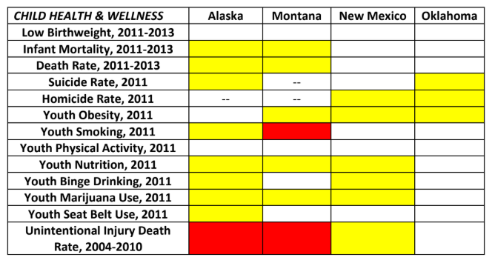
Measuring Strengths

Slide 9
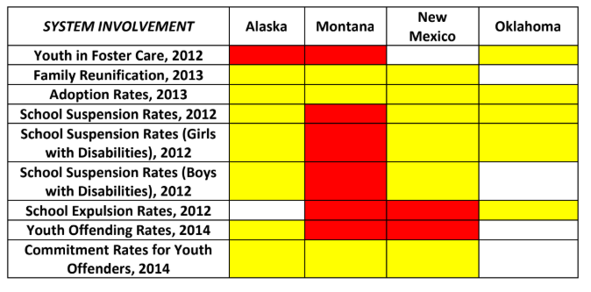
Measuring Strengths

Slide 10
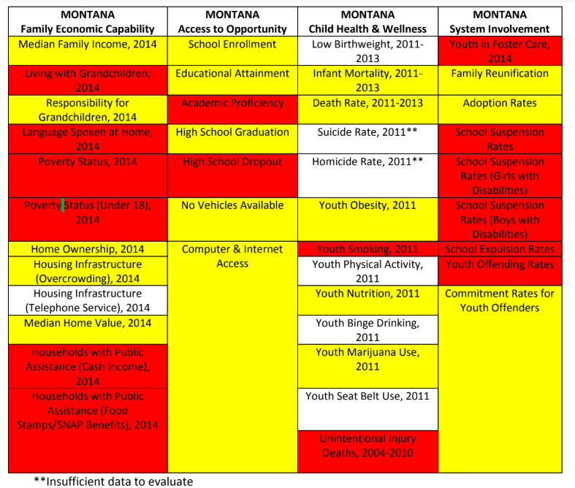
Measuring Strengths

Slide 12
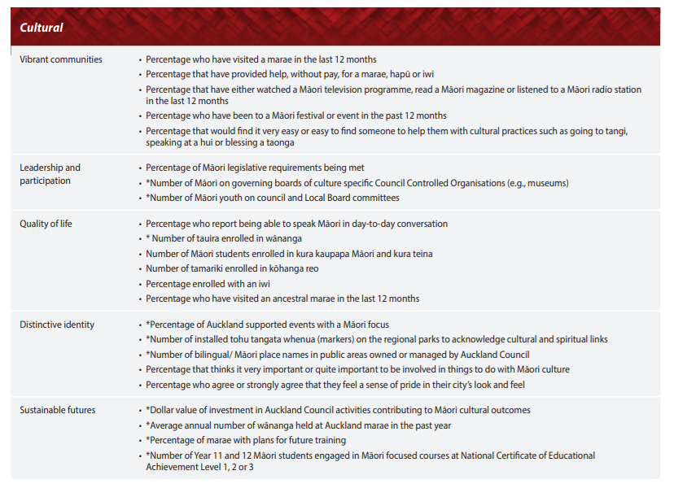

Slide 13
