Slide 1
The Evergreen State College
We offer 3 distinct graduate degree programs:
Master of Environmental Studies (MES)
*Contact: Andrea Martin at martina@evergreen.edu
Master in Teaching (MiT)
*Contact: Jazminne Bailey at baileyj@evergreen.edu
Master of Public Administration (MPA)
*Olympia Contact: Anna Rhoads at rhoadsa@evergreen.edu
*TG and Tacoma Contact: Puanani Nihoa at nihoap@evergreen.edu

Slide 2
Master’s in Public Administration (MPA)
Master’s in Public Administration (MPA) offers 3 different concentrations:
Public & Nonprofit Administration (PNA) at Olympia and Tacoma
Public Policy (PP) at Olympia and Tacoma
Tribal Governance (TG) at Olympia (Weekend Intensive)

Slide 3
You could earn your MPA degree in 2-years
By registering and successfully earning 10-credits each quarter for fall, winter, & spring quarters you can earn your graduate degree is just two years!
If you decide to take a slower pace in your graduate studies
Evergreen’s MPA program can be completed in 3-4 years on a part-time basis
You may consider trying a class or two to see if it would be a good fit for you
Register as a special student this is open to non-matriculated applicants and can register the week prior to the quarter
All credits successfully earned as a special student if accepted into the MPA program will go towards your graduate degree
Earn a graduate degree that’s within your budget~ currently we are among the most affordable graduate program in Washington

Slide 4
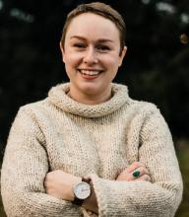
Careers after students earn their MPA degrees:
Brandon Anderson (2018) recently hired as the Legislative Director for the Society of Professional Engineering Employees in Aerospace (SPEEA). Brandon will partner with the national and regional Legislative & Public Affairs committees to represent SPEEA on several legislative issues at the state & federal level.
Program director for a college
Training specialist for a non-profit organization
Research Project Manager for a state agency
Public Affairs Manager for a non-profit agency
Senior Research Analyst
Executive Director for a non-profit
Urban Planner
Legislative Analyst
City Mayor
Director of Admissions
Assistant Director for a graduate program
Historic Preservation Planner
Budget Forecast Analyst
Samantha Porter (2017)
is a Legislative Analyst with the King County Council. I spoke with her about her background, how she uses the MPA in her current job and received some advice for current MPA students.

Slide 5
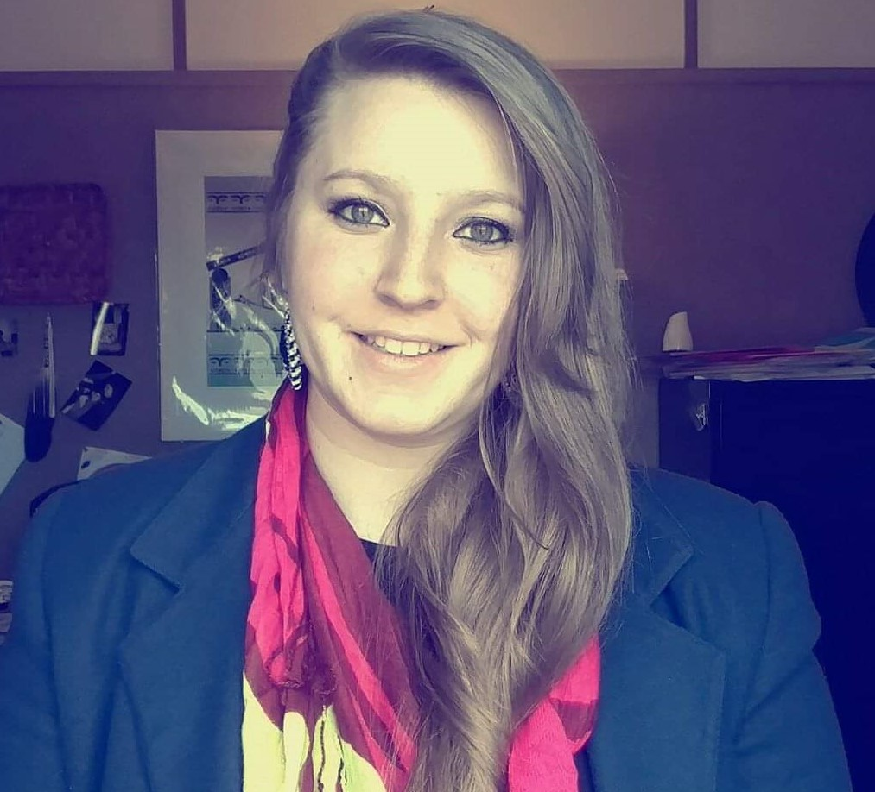
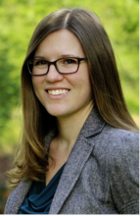
‘Be The Change’
Destiny Petroske (2016)
Dean of Academics & Distance Learning “I earned my associates degree from Northwest Indian College in Native Studies Leadership
Caitlyn Jekel (2014) Governor Inslee's New Senior Policy Labor Advisor
“I have regularly relied on my colleagues, faculty and students-from Evergreen's MPA program, with many engaged throughout state service, I expect to cross paths even more in this new role”.
Jekel, who was the former director for the Washington State Labor Council, AFL-CIO will perform policy planning, analysis, development and implementation consistent with the governor's priorities, and work closely with union organizations, businesses, state agencies and legislators on various labor issues.
Kristin Masteller (2012) makes the list of 40 under 40 in the Puget Sound Business Journal.
"My MPA and experience in the program definitely helped launch my career!” Masteller says.

Slide 6
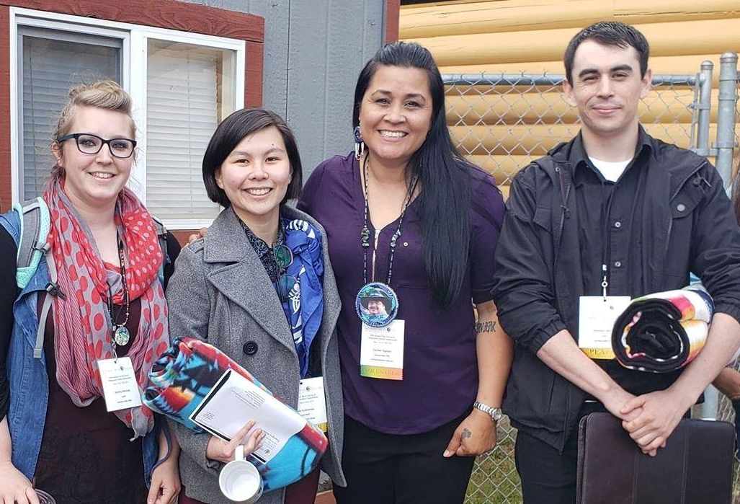
Our MPA Graduates
Presenting on a panel about Indigenous Research Methods were MPA Tribal Governance alumni: [L to R] Destiny Petroske, 2018 (Lummi), Kayla Kuboyama 2018 (Native Hawaiian), Carmen Tageant 2018 (Nooksack) & Brandon Morris 2018 (Lummi) Their research is about “Weaponizing Tradition: Threads of Resistance and Oppression”. It was wonderful to be a part of such an important event and see so many members of our MPA Tribal Governance family. Many thanks to NWIC and Lummi Nation for being gracious hosts and leaders in Indigenous research.
2018 Centennial Accord conference
2016 MPA Tribal Governance alumni: Kris Peters (Squaxin Island), Senator John McCoy (Tulalip), Alonah Greninger (Suquamish), Crystal Flores, and Peggan Frank

