Slide 1
MPA Scavenger Hunt
Teams of 5 in randomly assigned breakout rooms
You will have 10 minutes to locate the answers and complete the tasks!

Slide 2
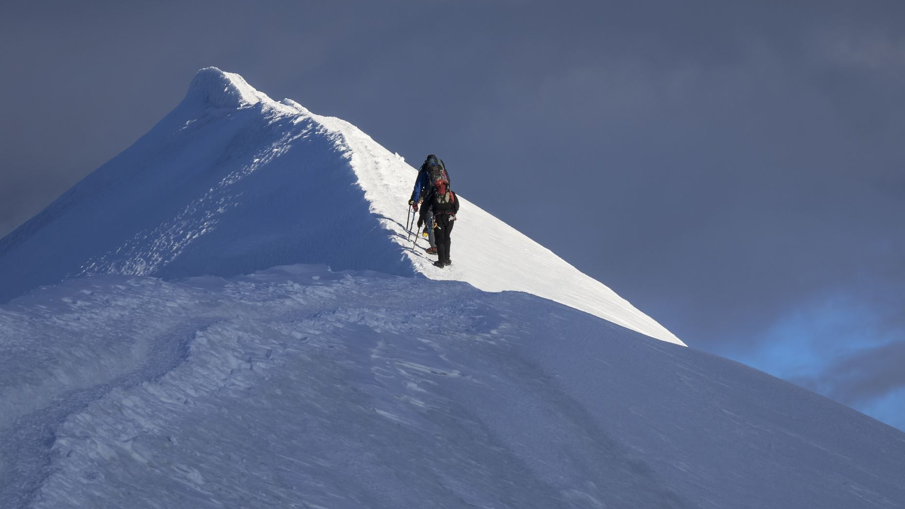
First Task:
Find the Scavenger Hunt Task List

Slide 3
Welcome Back!
Are there any answers or tasks you couldn’t complete?

Slide 4
What is the maximum number of credits you can take per quarter?
12
without approval from the Director

Slide 5
What is your favorite t-shirt for sale at the Bookstore? The staff voted on this one…

Slide 6
Where can you find the syllabus for your class?
Canvas page
https://www.evergreen.edu/mpa/coursesyllabi

Slide 7
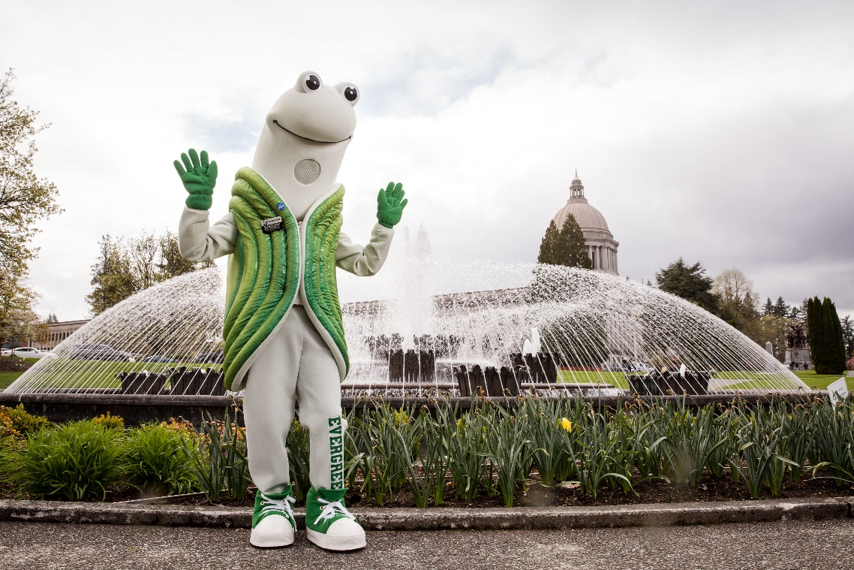
Find a picture of Speedy, Evergreen's mascot.

Slide 8
Find one of MPA's social media pages.

