Slide 1
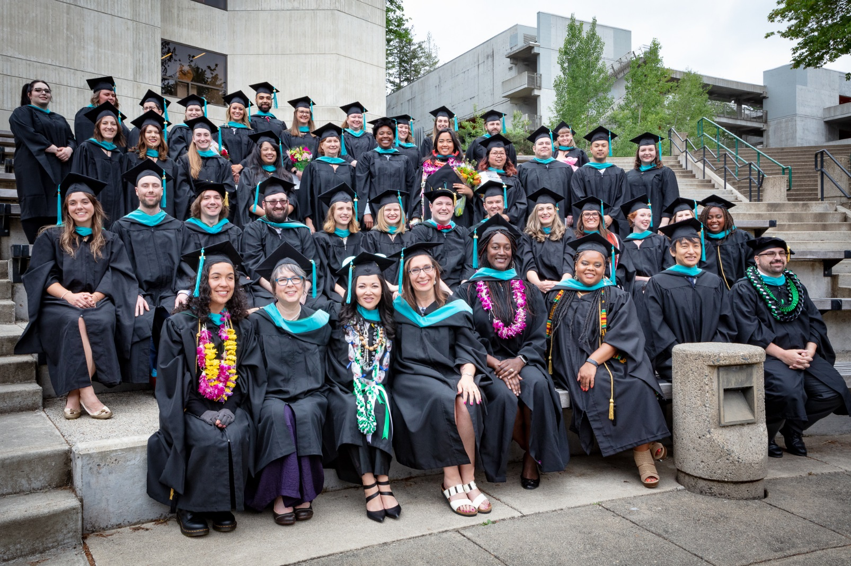
MPA 101 How to navigate Evergreen and graduate with your MPA!

Slide 2
MPA Staff
MPA Director – Michael Craw
MPA Assistant Directors
Marcia Zitzelman, PNAPP Olympia cohort
Puanani Nihoa, Tribal Governance/PNAPP Tacoma cohort
MPA Program Assistant – Dhara Katz

Slide 3
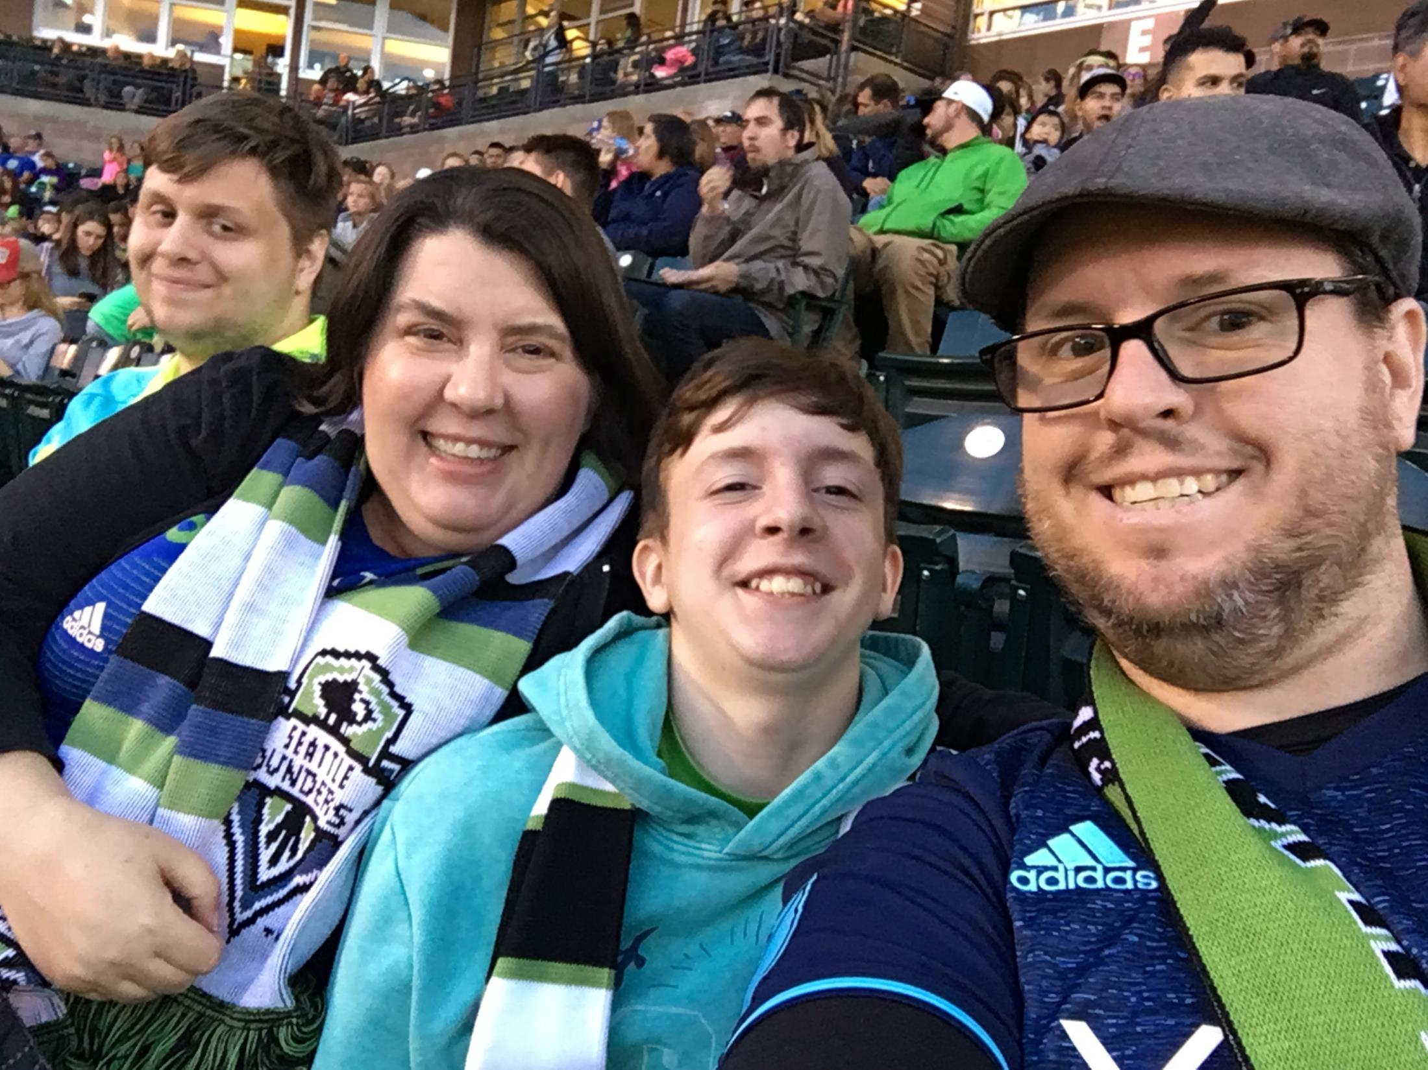
Notes:
Thanks so much for sharing about yourselves on the Introduction discussion.
We hope the MPA Orientation Canvas page can be a place where you continue to get information throughout the year and have a way to connect across cohorts with your peers in the Tribal Governance cohort.
It has been really awesome to see you all interacting and chatting before today’s orientation.
I thought I would also share a little bit about myself here since you all so generously shared in the Introductions.
I’ve worked at Evergreen since 2008, and finished by bachelor’s degree here while working full time. I also recently graduated from our MPA program, so I can relate to where you are at right now.
I have two kids, a dog and a cat, and I really love Disney!

Slide 4
My responsibilities as Assistant Director
Navigate
Questions & Referrals
Obstacles
Enrollment
Jobs/Internships
Graduation Planning
Communications
Advising
Notes:
Goal is to teach students to navigate Evergreen
MPA program and procedure questions
Info & referral when you don’t know where to go
Help you overcome obstacles and intercede when necessary
Registration and Course enrollment management
Advising & Degree requirements: “where am I in my program?”
Internship and job information and resources
Managing internal and external communications
Orientation and graduation planning

Slide 5
Navigating Evergreen
Canvas and my.evergreen.edu
Need to meet
w/ me?
E-mail faculty for office hours or to set-up an appointment
Call or e-mail me to set-up an appointment
Faculty Questions?

Slide 6
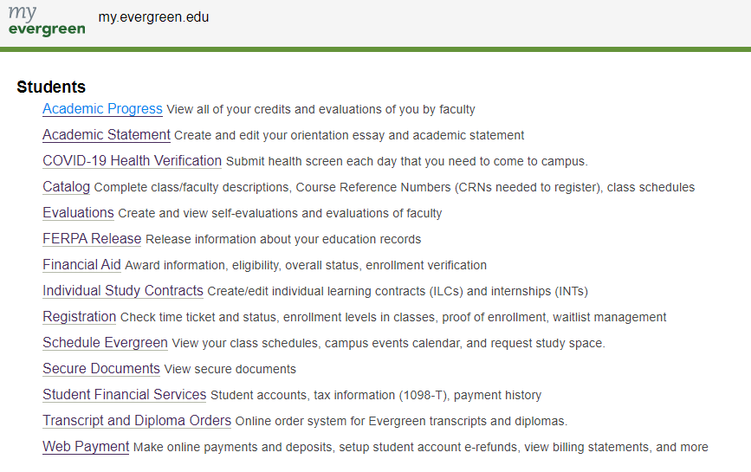
Notes:
Please DOUBLE-CHECK your registration! Your waitlist status may have changed

Slide 7
Navigating Evergreen
Parking is enforced Monday – Friday, 7 am to 9pm
Intercity Transit bus is free as an Evergreen student – use your ID to get around town or to class
Plan to bike to campus?
Register your bike with Police Services
Getting To and Around Campus

Slide 8
Campus Services
Under our current circumstances, every office and service is under altered hours of operation.
Please limit your trips to campus, and check out evergreen.edu/covid19/students for the most up to date information

Slide 9
Campus Services
If you must physically come to campus:
Call ahead to see if the office is open
Complete a Health Verification Form on my.evergreen.edu before you come to campus
Wear a mask or face covering
Follow social distancing protocols

Slide 10
Campus Services
Dining Options
Bookstore
Notes:
Food options are limited on campus, especially right now. Plan ahead
The Greenery is only TO GO
Monday - Friday:
8 am - 9 am - Breakfast
11 am - 1:30 pm - Lunch
5 pm - 6:30 pm - Dinner
Saturday & Sunday:
11 am - 1:30 pm - Brunch
5 pm - 6:30 - Dinner
Fall Bookstore hours:
The Bookstore is online orders only, but available for questions by phone M-Th 8am-4pm. Shipping for textbooks is only $3.99
You can also check out many textbooks at the library, buy/rent online, share…

Slide 11
Financial Aid and Scholarships
Most awards require you to complete the FAFSA or WAFSA before February 1.
Aid available includes:
Loans,
Grants,
Americorp Education Awards, and
MPA Scholarships
Notes:
Video on our Canvas page
Financial Aid available to graduate students:
Loans*
Need Grants*
AmeriCorps Education Awards
MPA Scholarships*
*To qualify for most awards, complete the FAFSA for before February 1

Slide 12
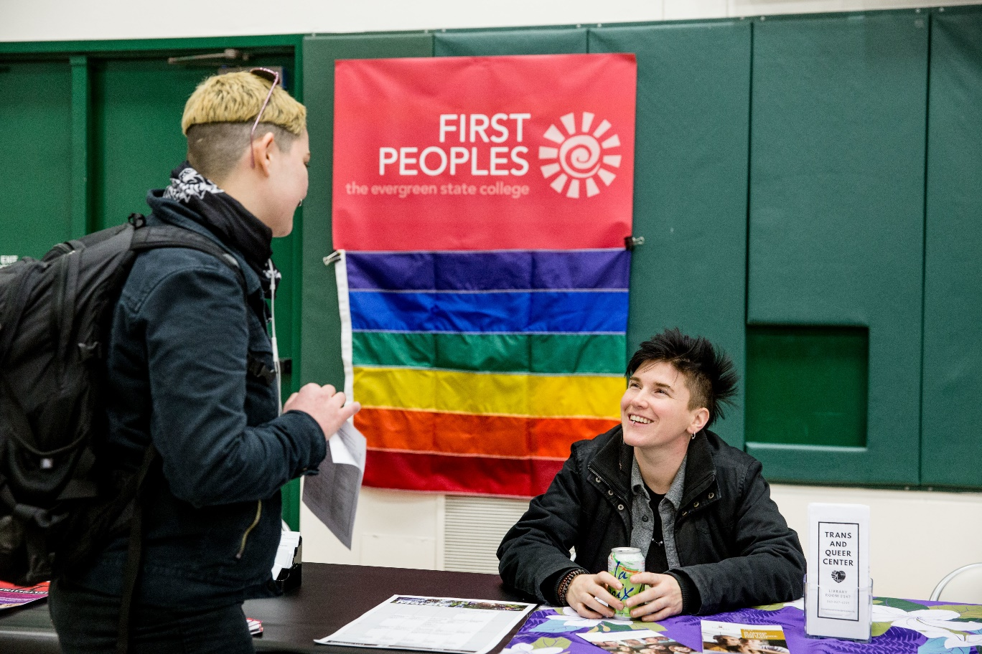
First Peoples Multicultural, Trans, and Queer Support Services
Offering support services for students of color and LGBTQ+ students on campus.
Bring your whole self to Evergreen!
Notes:
See video!

Slide 13
Student Wellness Services
We now have access to Therapist Assisted Online (TAO) Self Help.
Therapy anytime, anywhere for anxiety, depression and other common concerns on your mobile device or computer.
https://www.evergreen.edu/health/tao-self-help
We place strong emphasis on health education, helping students learn how to manage current health concerns and avoid future health problems.
Notes:
See video and don’t forget to submit your Immunization form!

Slide 14
Veterans Resource Center
Are you a veteran or dependent?
Contact the Veterans Resource Center
veterans@evergreen.edu
Notes:
See the video on our Canvas page
Question about your Veterans Benefits? Contact the Veterans Resource Center (veterans@evergreen.edu) 360-867-6254

Slide 15
Emergency Preparedness
Sign Up for Notifications at:
https://evergreen.omnilert.net/subscriber.php
Notes:
Sign up for Emergency Campus Notifications
Text or Email of delays, closures, or other emergencies
In case of an emergency/bad weather, visit Evergreen’s home page or call the main phone number 360-867-6000
Tacoma program follows the Tacoma School District closure schedule.
Police Services:
Emergency? Call 911! You can also reach Evergreen Police Services at 360-867-6140
Escort/Locked out of your car/jump-start: Call 360-867-6832

Slide 16
Student perks
Organic Farm Produce Stand – 50% Off!
Use the CRC (currently closed)
TOP Outdoor Program Rentals
Intercity Transit – free w/ Student ID
Notes:
The Organic Farm Produce Stand is 3pm – 6pm Tuesdays/Thursdays April – November. Students receive 50% off!
Use of the Constantino Recreation Center (CRC) and classes
TOP Outdoor Program Rentals (tent, backpack, sleeping bags, snowshoes, etc.)

Slide 17
Career & Internship Resources
MPA Job and Internship LinkedIn Page: https://www.linkedin.com/company/mpaevergreen/
MES Job and Internship Blog: http://blogs.evergreen.edu/mesweekly/
Notes:
Academic and Career Advising Services: offers mock interviews and resume help

Slide 18
Writing Assistant
Evergreenwritingassistant@gmail.com
Current MPA or MES graduate student – can help with writing process.

Slide 19
“PNAPP” Degree Requirements
Public & Nonprofit Administration |  | Public Policy
Prepare for careers as administrators in public or nonprofit organizations Coursework includes budgeting, strategic planning, human resources and information systems, public law, leadership and ethics, and multicultural competencies |  | Prepare for careers as a policy analyst, budget analyst, or evaluator Coursework includes understanding of various models of public policy, how to analyze current and proposed policies, and how to engage in policy development and advocacy
Degree Requirements Core courses + capstone Electives Total | 36 credits 24 credits 60 credits | Degree Requirements Core courses + capstone Foundations of Public Policy Advanced Research Methods Electives Total | 36 credits 4 credits 4 credits 16 credits 60 credits

Slide 20
Degree Requirements, cont.
Capstone
Concentration Courses
Electives
Internships
Individual Learning Contracts
Only in the Spring
Must have 40 credits before enrolling
Public Policy students must complete:
Foundations of PP and Advanced Research Methods
You can take up to six 2-credit MPA Courses
You can take a Tribal Governance course and electives at the Tacoma site.
May be required for graduation
Refer to your admissions letter
Great opportunity to study a topic of your choosing
Needs faculty sponsorship
Notes:
Capstone – must take a minimum of 40 credits before taking Capstone, only offered Spring term
Concentration courses – Public Policy concentration students will need to complete Foundations of Public Policy and Advanced Research Methods/Feminist Approaches to Measurement and Evaluation
Electives – Public policy take 16 elective credits; Public and Nonprofit Administration take 24 elective credits. You may take Tribal Governance concentration course for elective credit. You can take up to six 2-credit MPA courses. You may take MPA electives at Evergreen Tacoma site.
Internships – you may be required to complete an internship before you graduate, refer to your admissions letter.* Internships 2 – 4 credits. May begin Winter 2019
Individual Learning Contracts (ILCs) – A great opportunity to study a topic of your choosing/build your own curriculum, usually 2-4 credits. Need faculty sponsorship.

Slide 21
Degree planning
Notes:
This is a lot of information. We are here to help you plan the path to your degree!

Slide 22
How do narrative evaluations work?
Notes:
Moment of reflection
Similar to a performance review
Faculty will evaluate your work
You’ll write your own self-evaluation
You’ll also get to evaluate your faculty
How are you evaluated?
Evaluation of your completed assignments, classwork, and exams
How you approach your work
How you work with your fellow students
Objectives and preparation
Attendance record
Highlights of your skills and abilities
https://www.evergreen.edu/evaluations

Slide 23
Your to-do list:
Student Acknowledgement
Photo and Video Student Permission
Immunization Form
Orientation Evaluation
Notes:
These items are on your Canvas page under Modules
Acknowledgment Form – MPA Student Handbook, Code of Conduct, Social Contract
Immunization form – turn in to the Health Center by Week 7. If you don’t, there will be a hold on your account and you won’t be able to register for Winter classes.
Photo and Video Permission Form
Orientation Evaluation

Slide 24
Saturday, October 17, 2020 | 1pm-5pm PDT Free admission, pre-event registration required

Slide 25
We’re so glad you are here!
Questions?
zitzelmm@evergreen.edu
360-338-5571
Office: Lab 1, 3020

