Slide 1
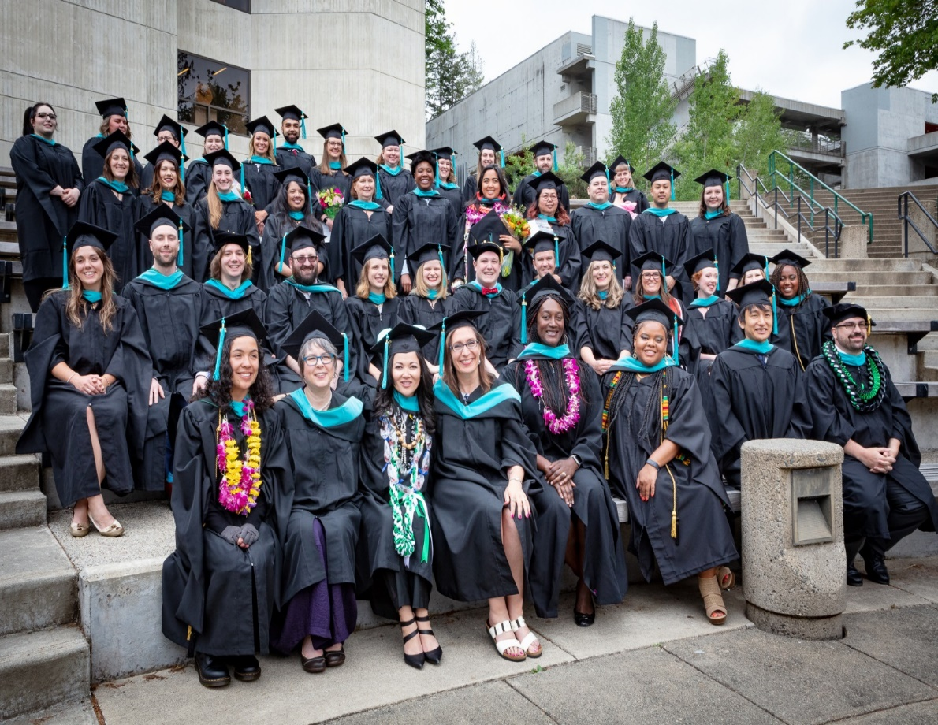
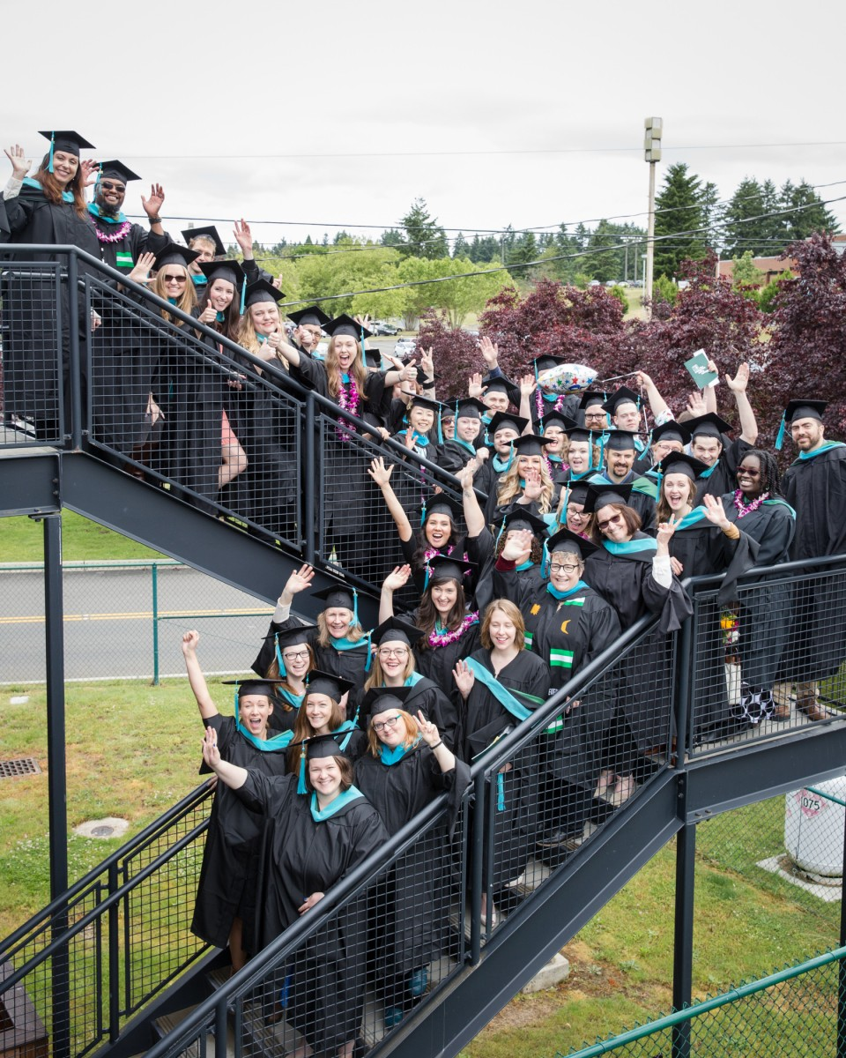
Welcome to Master’s in Public Administration 101 How to navigate Evergreen and graduate with your MPA!
MPA Class of 2018
MPA Class of 2017

Slide 2
MPA Staff
MPA Director – Michael Craw
MPA Assistant Directors
Puanani Nihoa, Public & Nonprofit Administration
and Public Policy (PNAPP) concentrations at Tacoma & Tribal Governance (TG)
Anna Rhoads, PNAPP Olympia cohort
MPA Program Assistant – Dhara Katz

Slide 3
Responsibilities as your Assistant Director
Guide you to navigate Evergreen MPA program
Offer information & refer you where to go when you’re not sure where to go
Steer you on your course & class schedule
Assist you in becoming an independent graduate student
Suggest internship, job information and other College resources
Plan for MPA orientation and graduation
Manage internal and external communications

Slide 4
Navigating Evergreen
You can access Canvas, your Evergreen e-mail, financial aid, pay tuition, course registration, evaluations, order transcripts, and other student tasks through my.evergreen.edu
For Records & Registration (R & R) assistance contact their office directly at: https://www.evergreen.edu/registration or by calling 360 867 6180
For Financial Aid (FA) concerns contact FA directly at: https://www.evergreen.edu/financialaid or call 360 867 6205
Need to meet with me? E-mail me to set-up an in-person or phone appointment 360 867 6202 (I typically will return your request within 48 hrs. usually sooner)
Any questions regarding in class work, assignments, schedules, booklists, and anything directly regarding course work you need to connect with faculty directly for office hours or to set-up an appointment. Their contact information is on their syllabus

Slide 5
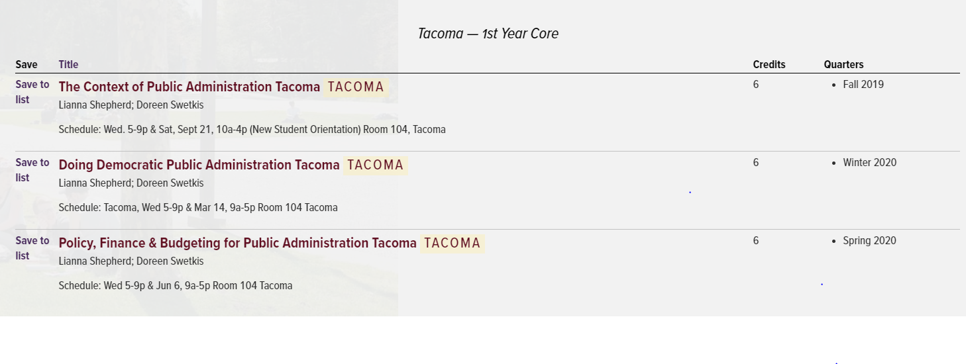
Advising and Guidance
All MPA students are required to take one Core course every quarter
Info. retrieved from: https://www.evergreen.edu/catalog/grad/mpa on 08/30/2019
The second year for MPA Tacoma students will be posted at a later date. Use the MPA catalog for your
class electives moving forward
No MPA student are required to register for any summer classes unless you elect to take a summer course
You will need MPA director’s approval if you plan to register for more than 12-credits per quarter
You can arrange to meet with our MPA director, your assistant director or your faculty for advising

Slide 6
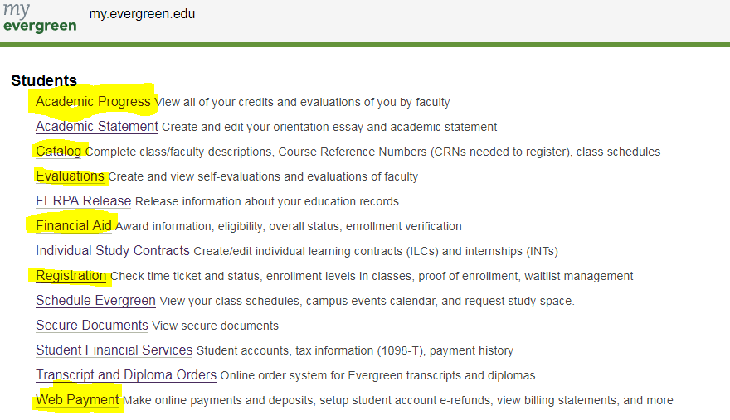
Use your ‘my.evergreen.edu’ account to find your personal information
regarding your progress, plans, and other necessities

Slide 7
Navigating Evergreen
Parking at the Tacoma site is free!
Parking at the Olympia campus has enforced parking regulations. Daily parking pass is $3.00/day Monday – Friday, 7 am to 9pm. Weekends are FREE (for those of you taking weekend classes at Olympia)
Fall Bookstore hours:
8am – 5:30 pm Monday – Thursday; Friday 8am – 5:00 pm
Buy/rent online here is a link to Evergreen’s Bookstore: https://www.evergreen-greener-bookstore.com/
Library
Monday - Thursday: 9 am - 6:45 pm; Friday: 9 am - 5 pm; Saturday: 12 pm - 5 pm and CLOSED on Sundays
You can also rent textbooks at the library: https://www.evergreen.edu/library/
If you decide to use TESC Bookstore or obtaining books through the Library you can arrange to have them sent from Olympia to the Tacoma site through our daily campus deliveries. Be sure to ask a Bookstore representative or Librarian worker that you want to arrange for books be delivered to Tacoma

Slide 8
Emergency Preparedness
Sign up for e2Campus text alerts (e2campus.net/my/evergreen)
In case of an emergency/bad weather, visit Evergreen’s home page or call the main phone number 360-867-6000
While at the Olympia site and need Police Services:
Evergreen Police Services at 360-867-6140; when on campus you can dial #6140
Want an escort leaving campus, locked out of your car or need a jump-start: Call 360-867-6832
During inclement weather the campus may close for safety purposes, signing up for text alerts allows you to know when the campus is closed. Your faculty will do their best to contact you as well.

Slide 9
Resources
Internship and ILC Assistance: contact Emily Gray, Internship Advisor and Coordinator (graye@evergreen.edu)
MPA Job and Internship LinkedIn Page: https://www.linkedin.com/company/mpaevergreen/
See MPA Facebook page: https://www.facebook.com/EvergreenMPA/
Check out our MPA blog: https://www.evergreen.edu/mpa/blog
MES Job and Internship Blog: http://blogs.evergreen.edu/mesweekly/
Graduate writing assistance
We will send out the writing assistance contact info. soon, we do not use the undergraduate writing assistant at the Tacoma site

Slide 10
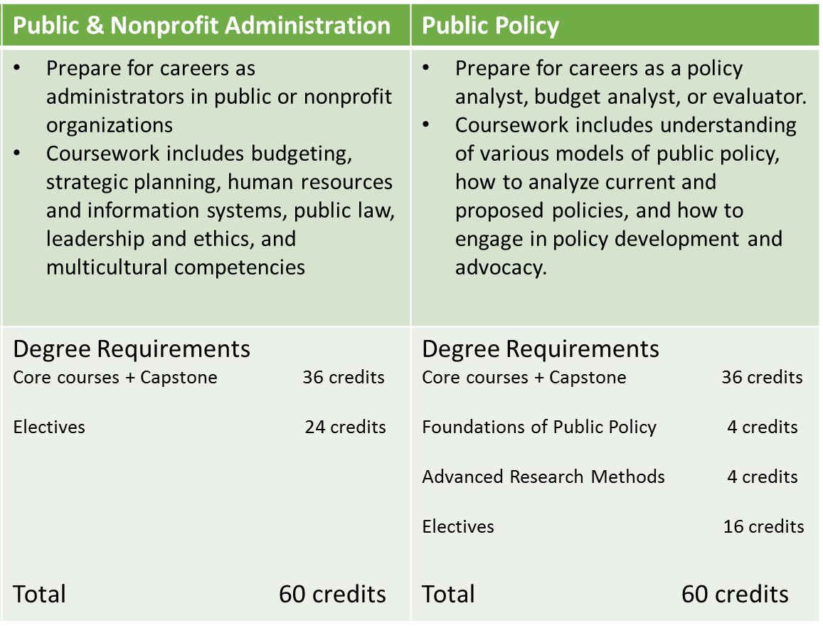
“PNAPP” Degree Requirements
*If you need to know
which concentration
you applied for on your
application, we’ve included that info. on your name tag “PP” meaning that you applied for the “Public Policy” concentration
Concentration courses –
Public Policy concentration
students will need to complete Foundations
of Public Policy and
Advanced Research Methods Feminist Approaches to Measurement and Evaluation

Slide 11
Degree Requirements, cont.
Capstone – must take a minimum of 40 credits before taking Capstone, only offered Spring term
Electives – Public policy take 16 credits; Public and Nonprofit Administration take 24 credits. You may take Tribal Governance concentration course for elective credit. You can take up to six 2-credit MPA courses. You may take MPA electives at Evergreen Tacoma site.
Internships – you may be required to complete an internship before you graduate, refer to your admissions letter.* Internships 2 – 4 credits. May begin Winter 2019
Individual Learning Contracts (ILCs) – A great opportunity to study a topic of your choosing/build your own curriculum, usually 2-4 credits. Need faculty sponsorship.

Slide 12
MPA Possibilities MPA alumni becoming the change
Enter a Federal field
Pursue State institutions
Engage in City agencies
County municipalities
Tribal entities
Law enforcement
Forecast Analyst
Legislative Liaison
Director of Admissions
Historic Preservation Planner
Senior Research Analyst
Executive Director for a non-profit
Research Manager
Public Affairs Manager
Lobbyist
Housing Division Manager
Sustainability Coordinator
Operations Manager
Registrar for College Institution
Assistant Director for a State Agency
Attorney at a Private Law Firm
Faculty at the College

Slide 13
How do narrative evaluations work?
Similar to a performance review
Faculty will evaluate your work
You’ll write your own self-evaluation
You’ll also get to evaluate your faculty
How are you evaluated?
Evaluation of your completed assignments, classwork, and exams
How you approach your work
How you work with your fellow students
Objectives and preparation
Attendance record
Highlights of your skills and abilities
https://www.evergreen.edu/evaluations

Slide 14
Financial Aid and Scholarships
Financial Aid available to graduate students:
Loans
Need Grants
AmeriCorps Education Awards
MPA Scholarships
Question about your Veterans Benefits? Contact the Veterans Resource Center (veterans@evergreen.edu) 360-867-6254

Slide 15
Your to-do list:
Read the MPA Handbook
Check your evergreen.edu email
Immunization form – turn in to the Health Center (or me) by the end of the Fall quarter. If you don’t, there will be a hold on your account and you won’t be able to register for Winter classes.

Slide 16
The Evergreen State College at Tacoma
Questions~
You can send any and all of your questions to your Assistant Director nihoap@evergreen.edu or you are welcome to call me as well 360-867-6202
You can also contact our MPA Director, Mike Craw at crawm@evergreen.edu

