Slide 1
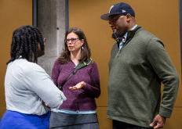
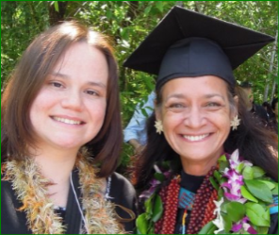
MPA 101
Ty Somerville, Assistant Director
Public & Nonprofit Administration and Public Policy Concentrations
PNAPP
&
Puanani Nihoa, Assistant Director
Tribal Governance Concentration
TG
Timieko & Ty
MPA-PNAPP Capstone
MPA-Tribal Governance
Notes:
Ty here is where you want to share a little about yourself with the group ;*)
*Puanani: I’m a non-traditional student earning my BA at TESC in 2004 & liked it so much here at TESC continued on as
an employee for several years until I decided to pursue my MPA in the Tribal Governance concentration.
Currently I’m the Assistant Director for the MPA-Tribal Governance concentration & the Tacoma MPA cohort

Slide 2
We are your support
Mandatory forms
TESC must have the following forms filled out and turned in to us today:
Measles immunization form – we have some form here for you to fill out otherwise you can find this form here: http://www.evergreen.edu/sites/default/files/health/docs/MeaslesForm.pdf on the second page of this pdf is the Measles Immunization Waiver, what ever you decide the College must have this form signed *IMPORTANT! If this form is not filled out there will be a Hold on your student account preventing you from registering for winter quarter. Please know that your MPA staff will deliver your signed forms to the Health Center for processing
Photo Permission form (see lavender sheet)– periodically throughout your
academic journey TESC will have the College photographer taking random
photographs of you. If anyone choses not to have their photo taken the College
photographer will respect your wish the photographer always ask before taking
your photo, MPA staff files your photo permission form in our files for
references purposes.

Slide 3
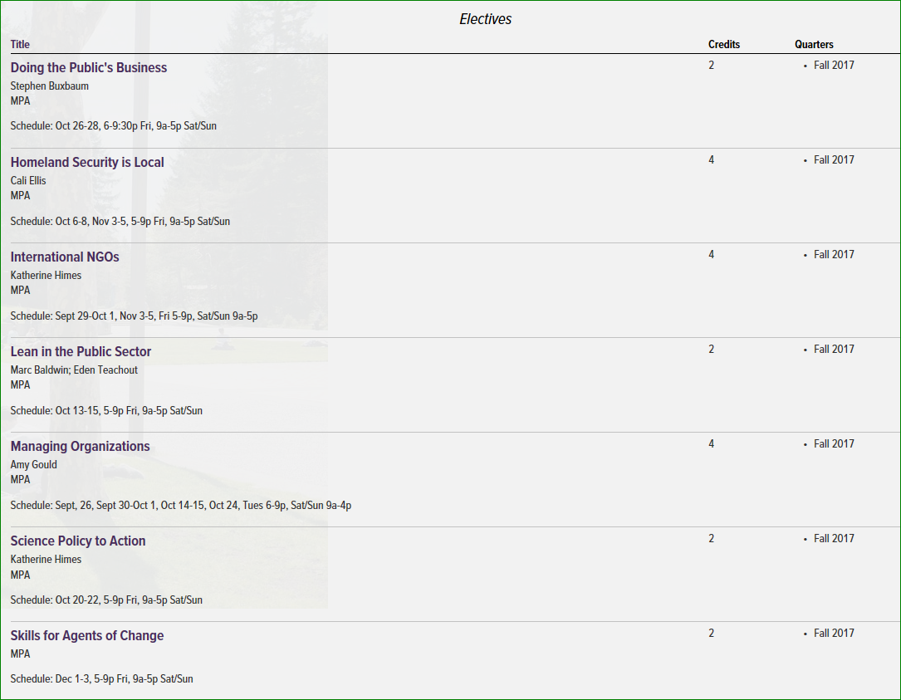
MPA full-time status is 8 graduate credits each quarter
All students must take a 6-credit core course each qtr. you have the option of registering for either a 2-credit or 4-credit elective not to exceed 12-credits per qtr.
Graduate studies offers 2 & 4 credit electives
Below is an example of a few of our MPA electives
*If you chose to register for more than 12-graduate credits for
the qtr. you will need to request permission from the MPA Director, Doreen Swetkis

Slide 4
Contracts
Great learning opportunity! You can start beginning Winter
2018 after completing 1 quarter of your CORE course

Slide 5
Official Transcripts must be submitted to Registration and Records no later than November 1st (as stated in

