Slide 1
Creating a Capstone Research Paper
Strategic Approach
Plagiarism
Example of an APA Formatted Paper
Helpful Links and Resources

Slide 2
Strategic Approach
Writing as a Process
Brainstorming and Developing a Working Thesis
Free-Writing
Create an Outline
Deeper Research, Revising the Outline
Writing the Paper
Revising the Paper

Slide 3
Writing as a Process Types of Writers: The Big Four
The Diver
The Patchworker
The Grand Planner
The Architect
(Creme & Lea, p.78)

Slide 4
The Diver
Jumps right in
Writes everything down
Then organizes work
Pro:
Often contains brilliant writing
Con:
Lacks structure and cohesion

Slide 5
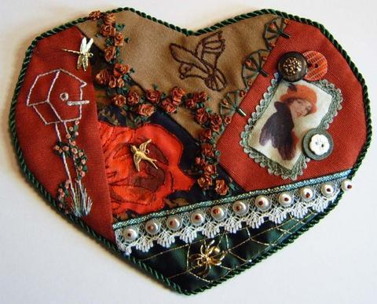
The Patchworker
Gathers information and
ideas from everywhere
Pro:
Makes innovative
connections
Con:
Difficult to create an
ordered progression

Slide 6
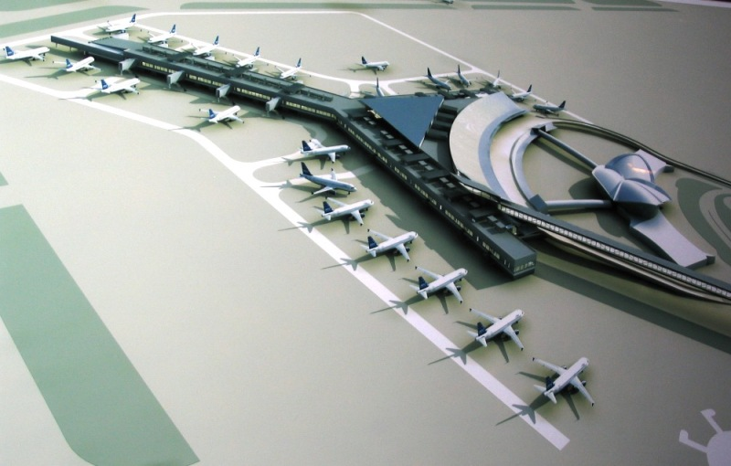
The Grand Planner
Visualizes entire completed
work in their head before
starting to write
Pro:
Not distracted, stays on
point through completion
Con:
May miss critical elements
in the details

Slide 7
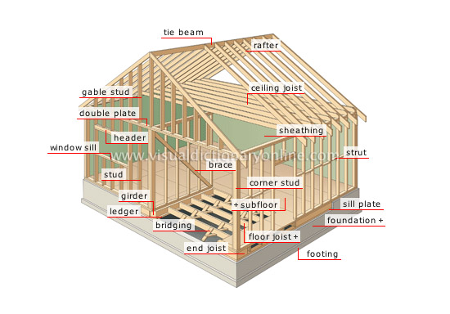
The Architect
Creates detailed plans,
outlines each step
Pro:
Highly organized and
detailed
Con:
Writing often feels dry
and mechanical
Which type of writer is most like you?
How can you gain from including other styles into your writing process?

Slide 8
Which type of writer is most like you?
Diver
Patchworker
Architect
Grand Planner
How can you gain from including other styles into your writing process?

Slide 9
Stages in the Writing Process
Prewriting
Drafting
Revising
Editing
Proofreading

Slide 10
Flow is Fluid
Prewriting
Drafting
Revising
Read/Reflect
Editing
Peer Review
Proof-reading

Slide 11
Brainstorming and Developing a Working Thesis
Brainstorming
Use to select a topic of interest
Use to begin exploring topic
Developing a Working Thesis
Appropriate in Scope (over/under broad)
Controversial
Interesting to You!

Slide 12
Pre-writing through Free-writing
Write about the topic
Findings, ideas, questions
Lists of key words
Note cards
Post-its
Do not worry about organization
Include questions that occur to you
Use free-write to create a working outline

Slide 13
Create a Working Outline
Identify key words, ideas, questions
Develop a list of questions
Arrange questions into topics and subtopics
Choose 3 or 4 main questions to serve as “trunk” topics
Arrange subtopics as branches from main trunk topics

Slide 14
The Working Outline
Working outline
Introduction~ an overview of the paper
History of Microbiology and food
Pre-history
Major events
Current industries
Food processing
Alcohol
Bread
Yoghurt
Food sterilization
Canning
Aseptic technique
Pathogens in Food
Meat industry
Fruit and Vegetable contamination
Prevention
IV. Future of food microbiology.
Conclusion~ Wrap it all up

Slide 15
Move to Deeper Research
Use topic keywords as a search guide
Create notes on information found
Include key idea descriptions and source information
Revise outline as you find more material

Slide 16
Working and Revised Outlines
Working outline
Introduction~ an overview of the paper
History of Microbiology and food
Pre-history
Major events
Current industries
Food processing
Alcohol
Bread
Yoghurt
Food sterilization
Canning
Asceptic technique
Pathogens in Food
Meat industry
Fruit and Vegetable contamination
Prevention
IV. Future of food microbiology
Conclusion~ Wrap it all up
Revised outline
Introduction~ an overview of the paper~ use statistic to hook readers History of Microbiology and food Pre-history Major events Important scientists/ contributors Pasteur Napoleon Current industries Food processing Alcohol Dairy Miscellaneous meats pickles tea/coffee Food sterilization Sterilization Pasteurization Sanitization Pathogens in Food Meat industry Fruit and Vegetable contamination Prevention Cutting edge research a. New technology for processed foods V. Conclusion~ Wrap it all up

Slide 17
Begin Writing Your First Draft
Use the most current outline
Build your framework
Write a draft of:
Abstract/Introduction
Conclusion
Use outline to identify major sections, subsections, and sub-subsections
Topic sentences for paragraphs
Transition sentences between paragraphs
Fill in the details to complete your draft

Slide 18
Abstract
What is an Abstract, and what belongs in it?
150-250 words, includes key words, written as a CONCISE single paragraph
The issue (and why we care about it)
Your methods/procedure/approach
How did you investigate the issue?
Limitations of the research
Findings
What did you learn/expose/create
Conclusion (thesis statement)
DOES NOT include discussion, anecdotes, quotations, etc.

Slide 19
Introduction
Generally one to two pages (can be longer)
Covers the same material, in the same order as the abstract, but elaborates on the details a little.
Detailed items are discussed in the same order as they are presented in the main body

Slide 20
The Body
Divided into Main Topics, Subtopics, Sub-subtopics, even Sub-sub-subtopics.
Divisions are called Headers
Make extensive use of Headers.
Help identify correlation of section to main topic
Create easily identified transitions
Eliminate wordy transitions

Slide 21
The Body (continued)
Offers clear discussion of the issue including:
History/background
Current situation
Theories, concepts, and opinions that support your argument
Acknowledgement of dissenting voices (with your counterargument)
Methods you employed, data collected, etc.
Results/analysis

Slide 22
Conclusion
A summation of major points
Suggestions for further inquiry
Restatement of significant findings

Slide 23
Finalizing Your Paper
Revise, Revise, Revise
Is your point clear?
Are your statements concise?
Is there logical flow and consistency?
Are grammar and spelling appropriate?
Have you used sufficient supporting evidence?
Are format and citations correct?

Slide 24
Libraries
LOVE YOUR LIBRARIAN
Card Catalog
Specific tips for TESC library websites
Library Search Engine
Search By Keyword
Search by Title or Author
Search Periodicals
Search Area Libraries Online

Slide 25
What is Plagiarism?
From TESC Student Advising Handbook
In academic writing you are often asked to draw on the work of other writers, composers, artists, speakers, or filmmakers when explaining or supporting your judgments. Academic ethics and fairness require you to properly cite these sources. If you represent a source's language, ideas, or images as your own even inadvertently you practice a form of academic dishonesty called plagiarism. Plagiarism is using a source's words, ideas, or images without acknowledging the original writer, composer, or artist. It can be as blatant as copying long passages from a source without quotation marks and proper citation. One of the most common forms is "mosaic plagiarism," the act of sprinkling borrowed phrases, partial sentences, or sentences within the paper without using quotation marks.

Slide 26
Cover Sheet
½ inch margin above header
TITLE has 50 character limit
Left registered
1 inch margin
Right registered
1 inch margin
Header with Running head: before TITLE, and page number on the right.
Centered on page
Title
Your name
Your school
Double spaced
12 pt. font
Times New Roman

Slide 27
Abstract Page
Header/ Title difference, Running head removed
Centered Section heading
No indent
1 inch margin
All around

Slide 28
Introduction Page
Centered title
½ inch
indented
paragraphs
Two spaces after periods

Slide 29
Body of the Paper
Left registered
bold subsection
Centered bold section title

Slide 30
Examples of In-text Citation
A similar failure situation is described in Learning a New Land (Suárez-Orozco, C., Suárez-Orozco, M., & Todorova, 2010). In the following quote, the author is referring to transitioning ELLs into English only classrooms too soon: “… without appropriate academic support, students often floundered, finding that their English reading and writing skills were simply not strong enough to succeed.” (p.170).
A theory attributed to Krashen (as cited in Mitchell, & Myles, 2004) posits that language acquisition is:
…the result of natural interaction with the language via meaningful communication, which sets in motion developmental processes akin to those outlined in first language acquisition, and that learning is the result of classroom experience, in which the learner is made to focus on form and to learn about the linguistic rules of the target language. (p.45)
Since people immersed in a new language’s culture spend much more time in a …
Gardner’s multiple intelligences refer to intelligence as existing in “eight independent dimensions of overall intelligence… these intelligences include linguistic, logical-mathematical, spatial, bodily kinesthetic, musical, interpersonal, intrapersonal, and naturalist” (as cited in Huerta, 2009, pp. 174-175).

Slide 31
Example of a Reference page

Slide 32
Helpful Research Web Sites
List of Internet Research Links: http://commfaculty.fullerton.edu/jreinard/internet.htm
Washing ton State Library: http://www.sos.wa.gov/library/catalog.aspx
Timberland Regional Library: http://www.trl.org/Pages/default.aspx
The Kheel Center for Labor‑Management Documentation & Archives http://www.ilr.cornell.edu/library/kheel/
Perseus Project http://www.perseus.tufts.edu/hopper/collections
International Institute of Social History http://www.iisg.nl
NYPL Digital Library Collection http://digital.nypl.org/
Schaumberg Center for Research in Black Culture http://www.nypl.org/research/sc/sc.html
American Memory http://memory.loc.gov
Daniel J. Evans Library (TESC Library) http://library.evergreen.edu/

Slide 33
Helpful Writing Resources
TESC Writing Center: http://www.evergreen.edu/writingcenter/
TESC Library Prepared Research Writing Resource: http://academic.evergreen.edu/curricular/stilllooking/reference/gettingstarted.htm
The Owl At Purdue: http://owl.english.purdue.edu/owl/

Slide 34
Visiting the Writing Center
Visit the Writing Center in Person
It is best to make an appointment
Drop ins are welcome
Come in for a meet and greet before you need help
Develop a working relationship with one tutor

Slide 35
Visiting the Writing Center
HOW TO SEND THE WRITING CENTER A PIECE OF WRITING FOR TUTOR FEEDBACK:
1. Send the material to evergreenowl@gmail.com.
2. Be sure you have filled out an Author’s Note and have in or attached it to the email. You can find an Author’s Note on the front page of The Writing Center’s web site (www.evergreen.edu/writingcenter), an all-purpose Author’s Note.
3. Be sure you have attached your essay/writing draft to the email.

Slide 36
Writing Center Information Website: http://www.evergreen.edu/writingcenter/home.htm
Contact
Olympia Location: Library 2304 Phone: (360) 867-6420
Primetime Location: Campus Housing, A Dorm, 2nd Floor Phone: (360) 867-6410
Tacoma Location: Room 124 Phone: (253) 867-3024
Hours
Olympia:
Mon-Thu 11 a.m. - 8 p.m. Fri and Sun 12 p.m. - 5 p.m.
Primetime in "A" Dorm:
Mon 6 p.m. - 9 p.m.
Tacoma:
Tue-Thu 2 p.m. - 6 p.m.

Slide 37
References
Creme, P. and Lea, R.L. 2003 Writing at University, a guide for students Second edition, Maidenhead: Open University Press

