Slide 1
Mapping the System: A Primer for Improvement at the Puyallup Tribal Treatment Center Daniel Felizardo
Notes:
I am a counselor
What organizational strucuture

Slide 2
The primary purpose of this project is to evaluate the current delivery system for consistency and inconsistency of processes, and to identify the benefits, threats and opportunities of the current work flow system used by staff and clients at the Puyallup Tribal Treatment Center.
A Current State Map

Slide 3
Substance Abuse
Major Public Health Issue in Indian Country
Significant Social, Health, Economic, Legal , Cultural Costs and Impacts
Treatable

Slide 4
People Who Enter and Complete Substance Abuse Treatment
Generally Positive Outcome
Stop using drugs, decrease their criminal activity, and improve their occupational, social, and psychological functioning
To reap the benefits individual must enter and complete Tx

Slide 5
NATIVE PREVALANCE
In 2002-2005, American Indians and Alaska Natives were more likely than members of other racial groups to have a past year illicit drug use disorder (5.0 vs. 2.9 percent) and alcohol (10.7 vs. 7.6) disorders.
1.6% or 43,000 AI/AN admitted into Tx 2009
Substance Abuse Mental Health Administration

Slide 6
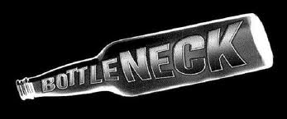
Statistics
19 million Americans need treatment
11% are able to access treatment
50% of those in treatment do not complete
There is a systemic problem
Substance Abuse and Mental Health Services Administration, 2002

Slide 7
Who Most Commonly Gets Blamed For This Systemic Problem
The Client

Slide 8
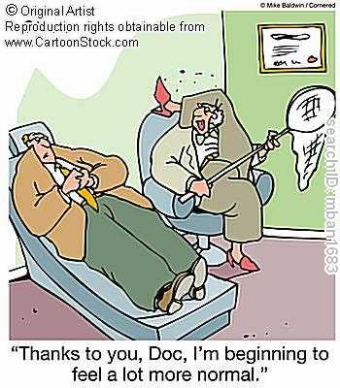
New Therapy… Little Systemic change

Slide 9
A Systems Thinking Orientation
Starting Assumptions
Everyone is acting as they should, given the system they are in
Your current system is perfectly designed to produce the results it is currently producing
To produce different results you must change the system
W. Edwards Deming

Slide 10
Defective Processes
Delivery System
…were a primary cause of poor quality health care
The Institute of Medicine 2004

Slide 11
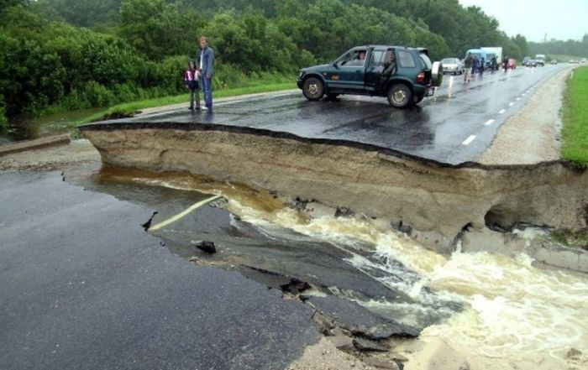
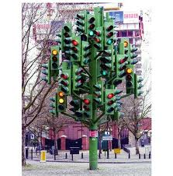
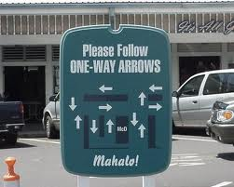
The Delivery System
Creates barriers to access and retention
Problematic Business Practices
Organizational Inefficiency
Missed Treatment Opportunities

Slide 12
Why Process Improvement?
Customers are served by processes
85% of customer related problems are caused by organizational processes
To better serve customers, organizations must improve processes

Slide 13
Models
Lean
Develop Standardized work
Reduce inefficiencies
NIATx
Client focused
Improve problem processes

Slide 14
The Journey
Client
Client

Slide 15
Focus Groups

Slide 16
Treatment Flow
Client Flow >>>
Staff Flow >>>

Slide 17
Primary Processes
Pre-Assessment
Assessment
Admission
Treatment
Discharge
Transfer

Slide 18
Individual Interviews

Slide 19
Assessment
With Client > Informed consent > GAIN-SS >TARGET > ASAM Assessment > UA > Release of Information > Assessment only
Without Client > Progress Note > HOPI > Mental Status Exam > GAF >TARGET > ASAM Assessment > Referent Correspondence > Service Assignment

Slide 20
Chart and Document Reviews

Slide 21
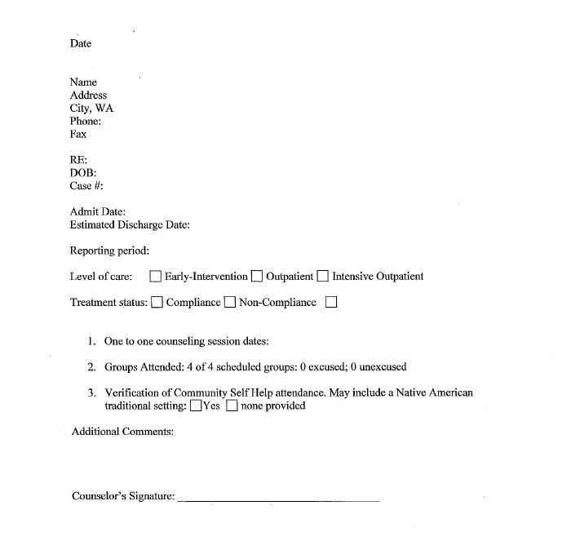
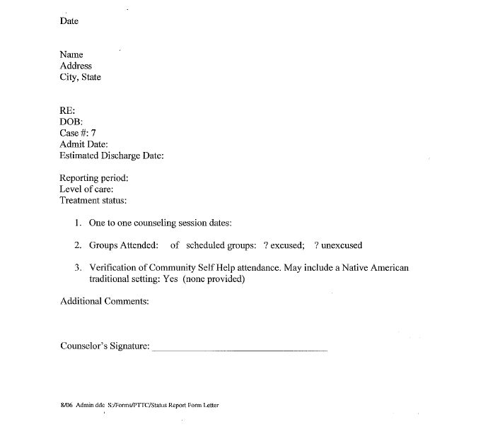
Status reports What do you notice

Slide 22
Walk Through Exercise

Slide 23
Walk Through
Inconsistent messages
Redundant questions and forms
Feels rushed
Closed ended questions
Long Wait times
Not engaging

Slide 24
Assessment Process

Slide 25
The Big Picture
Process | Standard | FrontDesk | C #1 | C #2 | C #3 | WAC | Regs.
Assessment | No

Slide 26
Recommendations
Present Results to Administration, Staff and New Program Manager
Prioritize Process
Involve the Client
Nominal Group Technique
Standardize
Process Improvement
Celebrate Success

Slide 27
The Big Job
Improve the
Delivery System
“Make them pay you for that”
Linda Moon Stumpff

