Slide 1
How to Cultivate Cooperatives With an Indigenous Lens
Landscaping a future for Sustainable Food Systems
Notes:
Close your eyes I want to tell you a secret…you all won the lottery mega millions, what are you going to do with your money? Well Wake up Reality is none of you won… We all dream about it, we plan out our dreams with out limits. This is what all indigenous organizations should do. This was the advise I found in one of my interviews, in the context of making the grassroots organizing achieve ultimate potential

Slide 2
Planning with SWOC
STRENGTHS
What links the land
and the people together?
How is Traditional Ecological
Knowledge Used?
How are stakeholders
empowered by a cooperative
approach?
WEAKNESSES
What are the
barriers? How does
an organization evaluate sustainability?
Challenges
Are economic, cultural, and ecological
needs being
met?
OPPORTUNITIES
What are possible outcomes
of a cooperative food system?
How can education address
the community’s needs?
Notes:
What is the potential of a sustainable food organization? These questions designed a SWOC analysis of the organizations and created a personal journey to sustainability.

Slide 3
Indigenous Food Systems
Cooperative principles
Sustainability principles
FOOD
IS
Grassroots Organizations
EVERYTHING
Traditional Ecological Knowledge
Notes:
Why does this matter Why do we care? Current situation why it needs to change theories that support argument Methods /data/ results/analysis http://www.un.org/esa/socdev/unpfii/documents/E_%20C_19_2009_CRP3_en.pdf

Slide 4
Case study: Exploring Examples of Local Food Systems
Partnerships
Case studies
Empowerment
Notes:
Looking at the local farm initives are the key to learning and applying best practices. I learned about the pros and cons to the USDA and the role they play in the picture of funding…Barriers were iinvestigated in the SWOC

Slide 5
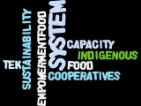

“The death of a traditional food system is the death of a nation…physically and culturally. We can and must restore practices that make us healthy and well as Indigenous peoples.” (Right to Food Security For Indigenous Peoples, 2006)
Notes:
My inspiration was discovered through a through examination of the current systems and to ask, what are the best (sustainable) practices. This framework would be created with a cooperative lens. Looking at indigenous food systems I realized that if we are all connected to the land than we are all connected to each other. Back to the collective vision, we see that this is a great mindset to motivate people because we may produce different answers but the principle remains the same, “If you build it they will come”

Slide 6
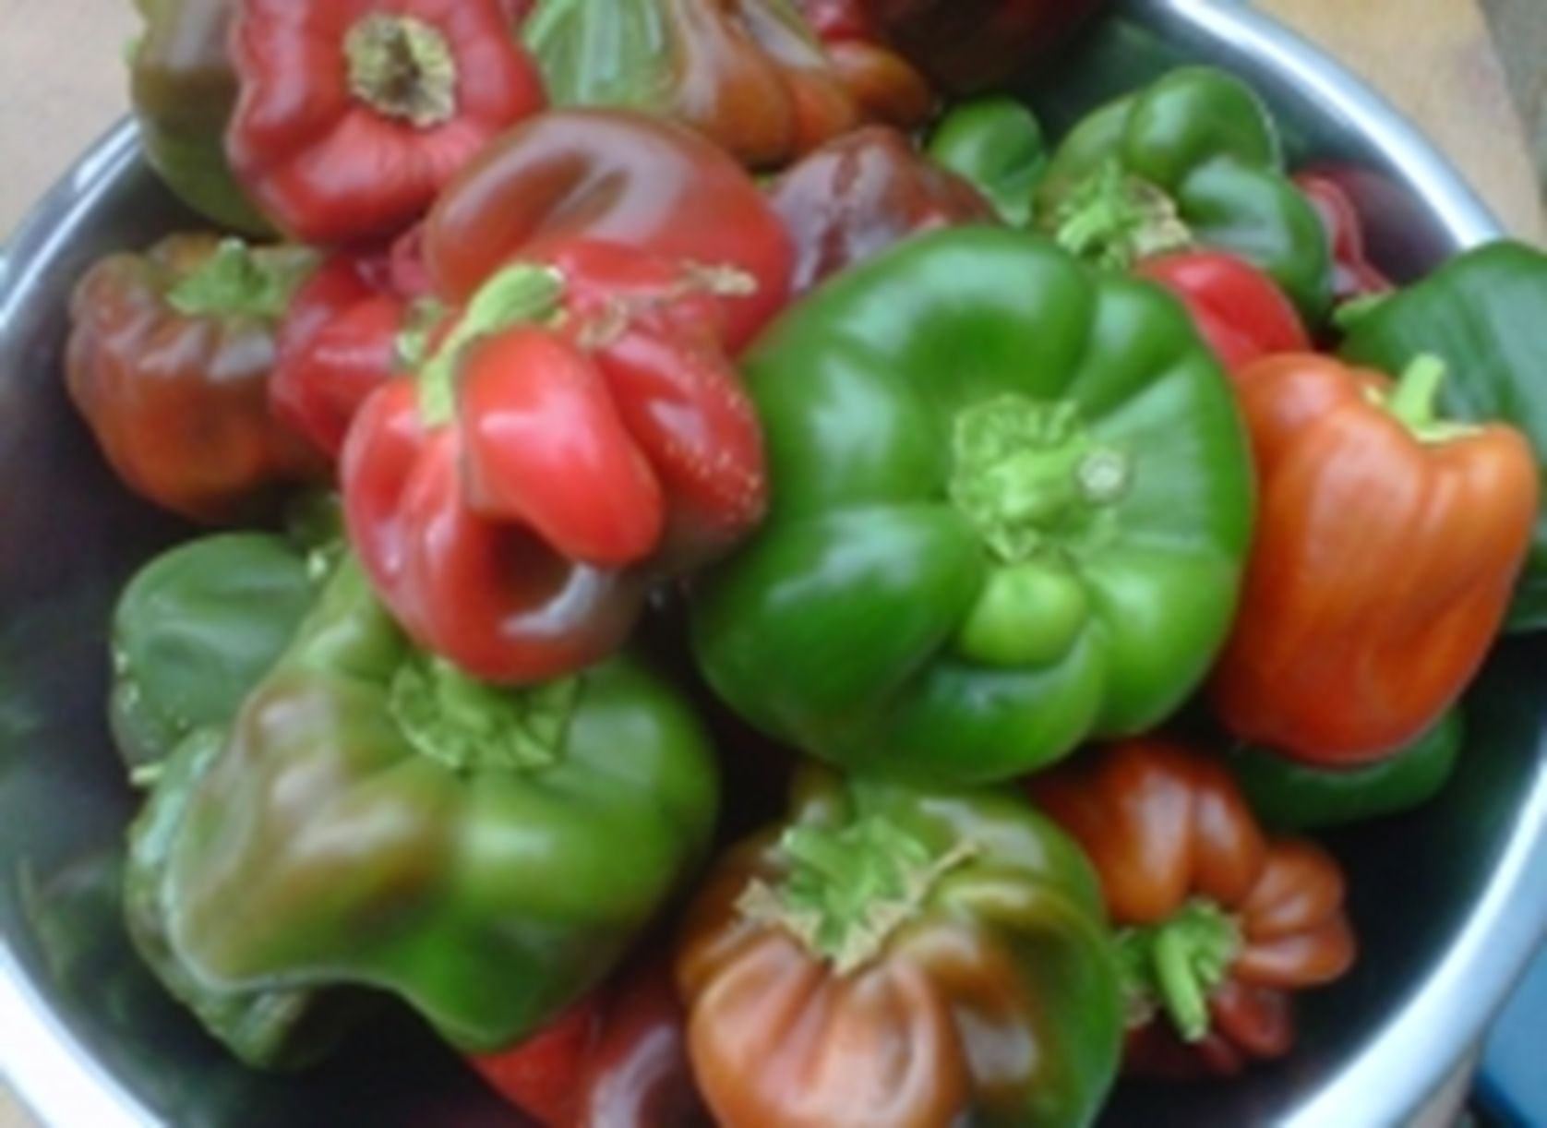
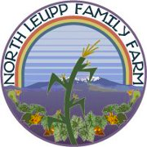
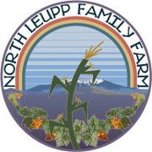

Slide 7
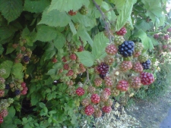
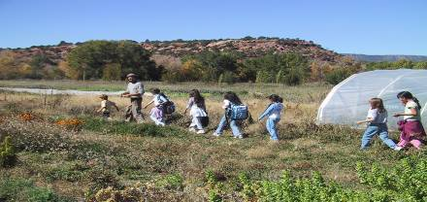
Farm to Table: Growing to meet the needs of local people through programs, partnerships and policy

Slide 8
Current System and theories that support what needs to change
Food systems
Relationship to land
responsibility
Empowerment
Capacity building
Triple Bottom line
Education
TEK
Partnerships among organizations and entrepreneurs
Notes:
The threats or barriers are money and or empowerment… a social capital is important and through cooperative this is a model that tmbodies the principles of an ideal sharing of ideas When I went to ONSBE the progress made in our break out groups was very important for the

Slide 9
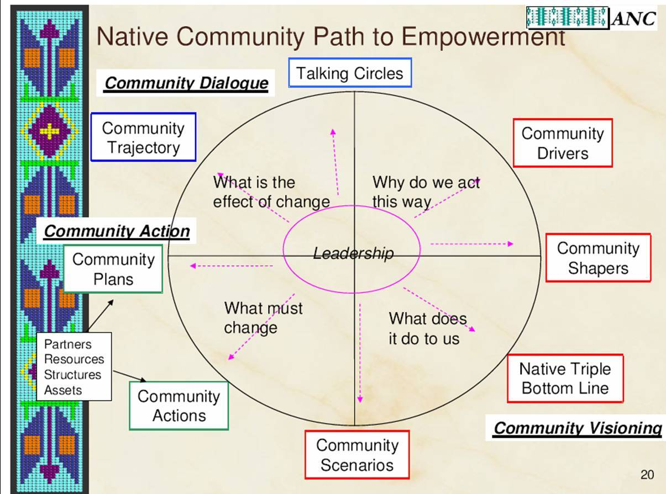
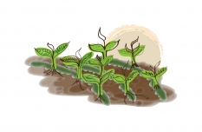

Slide 10
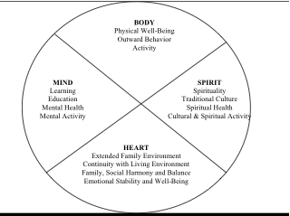
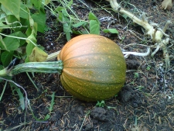

Slide 11
OUTPUTS:
Concept mapping Food Sovereignty Assessments,
Partnerships
Input: Sustainable Food Systems Planning
Outcomes: Farmers' Markets, CSA, Co-ops make important contribution to the local sustainability of the region through the support of local agriculture.

Slide 12
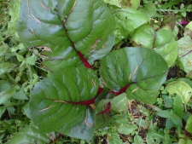
Thank you.

