Slide 1
Gender Differences in Educational Levels in Tribes and Its Effect on Economic Success
Mary Bahr
Masters of Public Administration
Tribal Governance Concentration

Slide 2
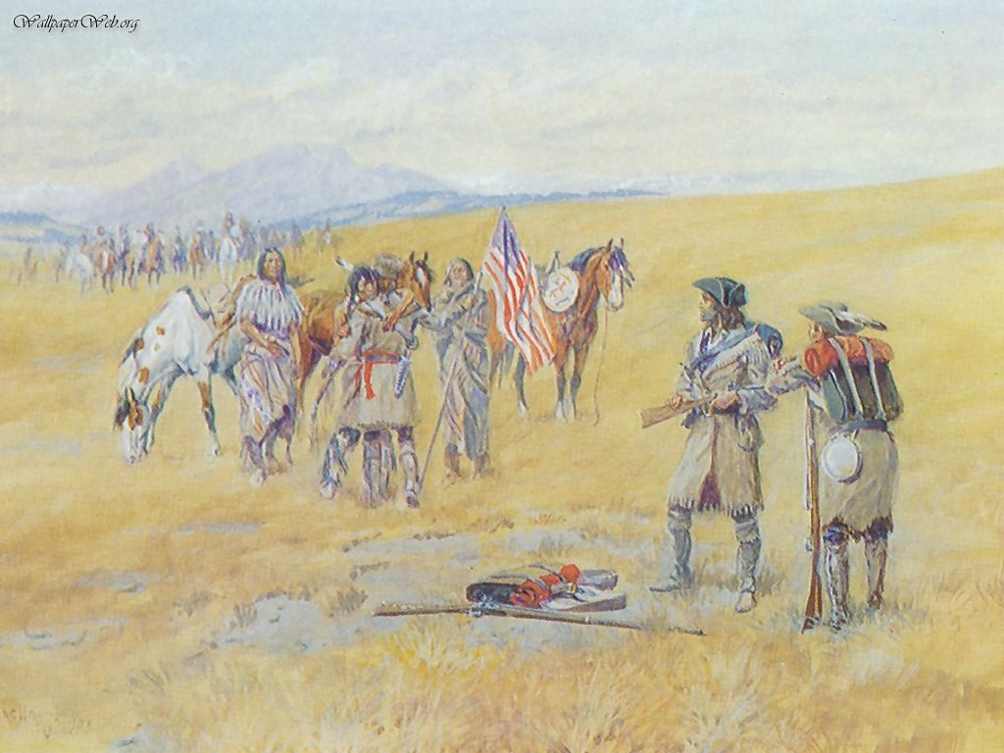
Native Americans and Colonization
Notes:
The advent of the reservation system has resulted in poverty for Native Americans
In 2011 poverty rate for Washington State was 11.3%
Poverty rate for Tribes was 23%
Poverty rate for Tribes in US was 31.2%

Slide 3
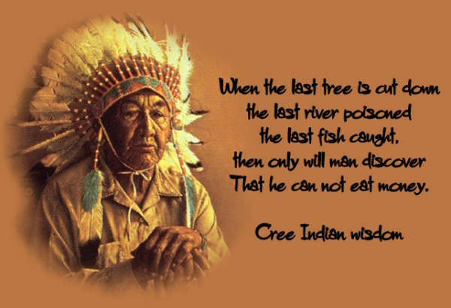
Unemployment in Indian Country
Notes:
In 2005, the American Indian Population Labor Force Report by the BIA stated that unemployment in Indian Country remained constant at 49% unemployed
These are pre-recession figures and include reservations in the East that can have an unemployment rate of 70%
In Washington State stats aren’t kept on Native unemployment only on counties. Currently the national average iw 8.1% and Washington state is slightly above at 8.3%

Slide 4
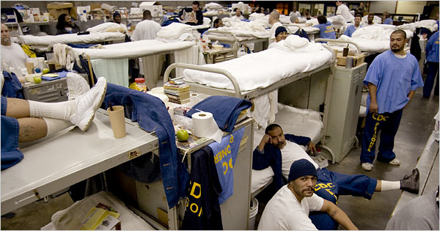
Incarceration Rates of Native Americans and the General Population
Notes:
Native Americans are sent to prison at a 38% rate higher than other Americans
This is important because generally exprisoners have a harder time finding jobs which means they may be unable to support their families

Slide 5
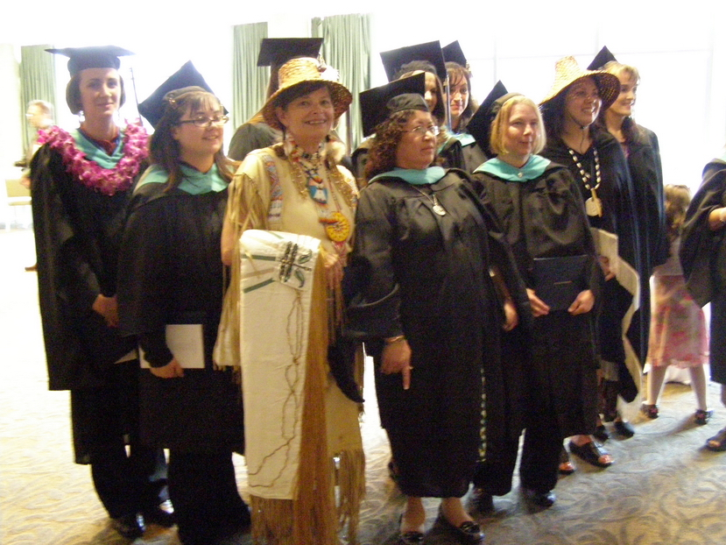
Education Levels of Tribal Members

Slide 6
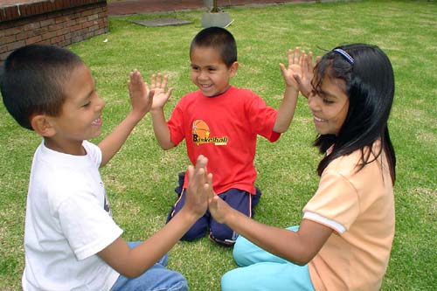
Temporary Aid to Needy Families

Slide 7

Tribal Businesses

Slide 8
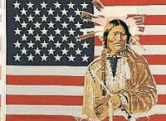
Native Americans and Research
Personal relationship with respondents is necessary for data collection when researching Native Americans
Small sample size makes it difficult to draw conclusions
Washington State fails to collect adequate data
Not even the Feds can collect adequate data on Native Americans
Data collection is important for determining policy

Slide 9
Woulda , Shoulda, Coulda
Tribes in other states
Contact educators
Research data is three years old

