Slide 1
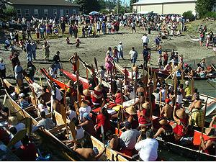
Tribal Enrollment/Indian Status Tribal Journeys
Tribal Cohort Capstone Project
Marie Natrall
Spring 2011

Slide 2
Introduction
Capstone has three components:
1. Tribal Enrollment/US Tribes
2. Indian Status/Canadian First Nations
3. Tribal Journeys
Increase of social interaction between American Indian and Canadian First Nation
Presentation is divided into three sections: Past, Present and Future

Slide 3
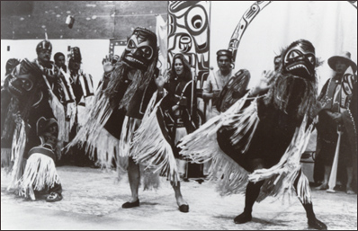
Past
Blood quantum: used in 1817-1871 to determine membership.
However, it wasn’t until the twentieth century that blood quantum was used in Federal Indian policy to define tribal membership.
Status Indian: created in 1876 First Indian Act.
1951: created central database of all registered Indians in Canada.
Canada joined confederation: July 1, 1867
US: 1776-US declared Independence and signed Declaration of Independence.
1783-Signing of Treaty of Paris, ended American Revolution and Great Britain recognized United States independence.

Slide 4
Present
Topic: Increase of social interaction of American Indians and Canadian First Nations
Question: Has there been an increase of children born to American Indian and Canadian First Nations as a result of meeting at the Tribal Journeys.
Research: Survey (Survey Monkey), 16 Questions, used Facebook and Directories for Washington State Tribes and Canadian First Nations.
Method: Historical comparative method: used because it considers how processes have changed over time and considers sensitivity of the historical and cultural contexts of both Native societies of the US and Canada.

Slide 5
Present-Survey Results
84 responses
82% identified being a member of a US Tribe or Canadian First Nation.
23 US Tribes; 11 First Nations
51.3% of response rate of knowing children born to AI/FN as a result of meeting at Tribal Journeys.
Children born: 1=27%, 2=18.9%, 3=21.6%, 4=40.5%
Increase of children born: SA=6.3%, Agree (46.3%), undecided (40.0%), Disagree (6.3%) & Strongly Agree (1.3%)
Increase of relationship/marriages: 8.8% (SA), 53.8% (A), 30% Undecided, 6.3% Disagreeing & 1.3% Strongly Disagreeing.

Slide 6
Present-More Results
Tribal Implications: Enrollment/Indian Status-Responses 14.8% (SA), 46.8% (A), 29.1% (Undecided), 7.6% Disagree & 2.5% (SD).
Increase of children born to AI/FN to continuation of tribal journeys: 23.1% (SA), 60.3% (A), 14.1% undecided, 1.3% Disagree & 1.3% strongly disagree.
Marriage out of AI/FN-if it will decrease Blood Quantum/Indian Status: 17.5% (SA), 33.8% (A), 21.3% undecided, 22.5% (DA) & 5% (SDA)

Slide 7
Future
Based on surveys, there has been an increase of children born to AI/FN due to increased social cultural social interaction at Tribal Journeys.
Results do not support that at this time, tribal enrollment and Indian Status is not a significant problem at this time, although 46.8% survey results agree that there are implications.
There were a lot of comments based on issues that arise when AI/FN have children.
Although not a big concern now, may be in one or two generations.
Variables: where children are raised, US or Canada, on rez or off-all factors to consider as well.

Slide 8
Future
Three Native societies that evolved post-colonization
1. Metis-products of marriages between Native people & Fur Traders in early 17th century. Population: 291,000, recognized as a part of Aboriginal group in Canada, but do not have Indian Status.
2. African American/Native American-inter-marrying occurred when slaves escaped slave masters.
3. Filipino/Native-call themselves Indipino. Mix of FN and Filipino farmers-Bainbridge Island.

Slide 9
Future Recommendations
Public forum for AI/FN to discuss tribal enrollment and Indian Status issues
Canada had a Citizenship conference last year in 2011 in Alberta to discuss this issue.
A FN citizenship Took Kit was created by a Native attorney.
Comment by Native attorney:
I am a lawyer and I practice Indian law. Laws regarding enrollment are a matter of sovereignty, so while I do agree that they need to be changed to recognize blood quantum from other Native tribes, that is a matter for each tribe to decide individually.

Slide 10
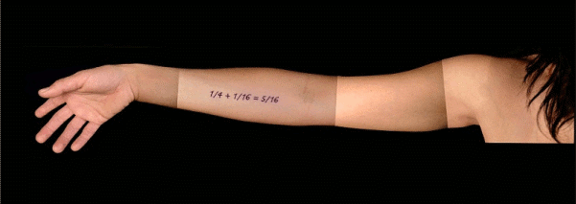
Future
According to Schmidt, “Over 60% of all American Indians are married to non-Indians.” (2011, p.6)
Also, “Congress has estimated by 2080, less than 8% of American Indians will have one-half or more Indian blood.” (Schmidt, 2001, p.6)

Slide 11
Future-UNDRIP
United Declaration of Rights of Indigenous Peoples (UNDRIP)
Between 2009 and 2010, US and Canada were signatories to UNDRIP.
Obama’s statement paraphrased is “putting action to meet these words.” (Hanson, 2011, para 20)
Canada’s comment: “By signing on, you default to this document by saying the only rights that play here are the rights of First Nations. And of coarse, in Canada, that’s inconsistent with our constitution.” (Handon, 2011, Para 21)
Significance of UNDRIP: Section 33-is right to determine identity and membership according to customs and traditions.

Slide 12
There should be no boundaries for the 2 countries for Aboriginals. It took a long time for my friend to gain citizenship to this country because he was born in Canada. His tribe is Stillaquamish. My children are unable to be enrolled in the Lummi Tribe due to that fact that I am Canadian.
Final Comments of Respondents
The US and Canadian Government need to rewrite laws allowing for a system to recognize blood quantum.
If you can trace your lineage to a tribal area, you are a citizen of that area, if we as FN people are to survive, we need to start to recognize our own people to help our Nations grow, if we do not then are only helping the Non-Aboriginal Government and communities breed out the Indian out of the child. We need to strengthen our communities.

Slide 13
Conclusion Colonization by Marie Natrall 11/9/10
Colonization is like a home invasion,
One minute you are at peace within your own settings and environment, feeling happy because everything you hold dear to you is within close proximity.
Then one day, an unwelcomed intruder enters your premises, takes without consent, everything in your home, including your family. As a result, the dynamics in your home are forever changed, because this intruder came with the intent to break up this home for his own benefit without repercussions of the devastating effects of his actions.
The family is left to rebuild whatever ruminants remain of the past, but also the trauma of such aftermath of home invasion. The threat of security, at risk and being exposed to outsiders is a concern, because if it happened once, who's to be sure it won't happen again?
The security of the home was penetrated by this invasion and will continually need rebuilding to put up walls again to regain trust and security.
We rebuild our minds to think of how to prevent such a future intrusion, but also how to defend against a future intrusion.
Emotionally, we feel sadness to rage with being violated in our own homes.
In our physical sense, we prepare to defend ourselves and be on guard, so it doesn't happen again.
We can refer this process of home invasion as colonization.

