Slide 1
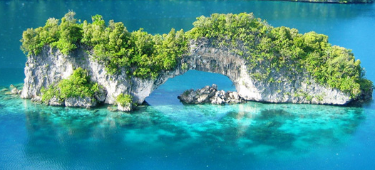
Palau
Public Administration in Palau
Public Policy Methods

Slide 2
Overview Of Timeline:
Spanish Occupation mid 1800's -1899
German Occupation 1899-1914
Japan Occupation 1914-1944
Us Trust Territory 1947-1981
1981-1994 Republic of Palau w/ Compact

Slide 3
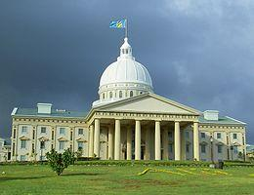
1994 Palau becomes an Independent nation

Slide 4
Political Set Up
Palau has presidential elections every 4 years and limited to two terms.
Palau has 16 governors- each representing one of the 16 states in Palau.
Palau also has 16 Council Chiefs that attempt to ensure that customs and traditional law are followed in governmental endeavors.

Slide 5
Economic Glance
There is a very low employment rate for the citizens of Palau. In original culture very little work was required because of the rich ecosystem of Palau. The majority of time was spent on aesthetics.
Unskilled laborers are often brought in from Bangladesh and other nations.
Of the Palauans that do work, over 50% are employees of government sector.

Slide 6
Current Situation
Heavily dependent on foreign aid
Facing economic collapse if aid is cut or reduced
Uncertainty about the future after the compact with the US ends.

Slide 7

Implementing Policies That Reflect The Public's Long Term Interests.

Slide 8
Palau's International Policies have been driven by its dependence
UN Resolution to lift embargo on Cuba and ease poverty on Cuban population:
185- Yes 3- No USA, Israel, Palau
2010 Palau voted against humanitarian aid into Gaza Strip.
http://www.radioaustralia.net.au/international/radio/onairhighlights/palau-supports-us-against-cuba-for-aid

Slide 9
Palau's Security
Palau has drawn a lot of criticisms from Cuba and the Middle East, and has become a regular focus of Al Jazeera News.
The Palaun Government now has international security concerns that have affected how they issue employment visas. A concern that did not exist before.

Slide 10

Road to Self-Reliance

Slide 11
Fiji's 20 year Road to Independence
In 2002 The Fiji Government administered a long term plan to build its economy and become self-sufficient.
Tax relief and Incentives to Fijian Owned Business'.
Fishing Rights Exclusive to Fijians giving them advantage in the industry.

Slide 12
Fiji's 20 year Road to Independence
20 year Coconut Oil Industry annual revenue 120 Million USD.
Fiji Tourism Industry Annual Revenue 300 Million USD.
Sugar Production: Large Sugar/Energy company that produces Ethanol by 2025 the combined turnover- 1 Billion USD.
Remittances 200 Million USD

Slide 13
Political Problems in Fiji
Multinational Corporations mingling in government affairs.
Multiple Military Coups.

Slide 14
Possibilities For Palau
Remittances from IT Sector- Training at Palau Community College.
Tourism
Fishing
Agriculture

Slide 15


