Slide 1
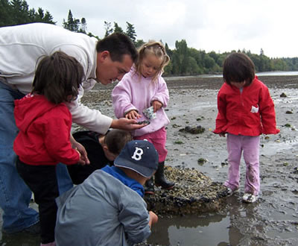
Sustaining a Tradition
Helping Tribal fishermen be successful into the future.
Notes:
KELLY

Slide 2
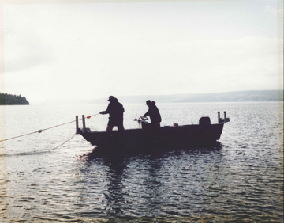
Story of the Tribal Fisher
Pre-treaty fishing
Fishing as a Treaty Right
Boldt Decision
Rafeedie Decision
Notes:
LORNA
The term “fisher” limited to finfish, and can be a harvester of any type of seafood.

Slide 3
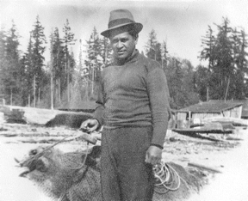
Introduction
An analysis of fishermen of a Tribe in Washington State.
An issue that is relevant & important to any Washington State Tribe and can easily be replicated.
Designed to support the commercial fisherman to achieve professional goals on and/or off the water.
Notes:
LORNA
The historical dependency on natural resources and harvesting seafood by Coastal Tribes makes all aspects of fishing important issues to study.

Slide 4
Research Question
What are the needs of fishermen in order to achieve a balanced and sustainable economic future and what kinds of programs and strategies are needed to support this objective?
Notes:
LORNA

Slide 5
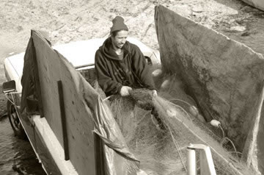
Commercial Harvesting at PGST
211 Tribal members had a taxable sale in 2011
91 Fishermen earned a gross income of $10,000 or higher
Geoduck, crab, clams, fish, oysters, shrimp
Implemented Fishermen Survey
Notes:
-Participant range was chosen to survey the most active fishermen
-47% completion rate

Slide 6
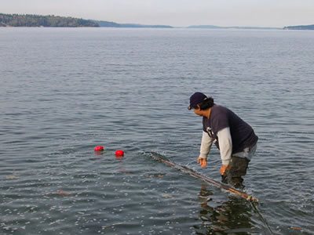
Survey Analysis: Fishers’ Background
Demographics
Education achievement
Family size, income
Species harvested
History of Reliance on Treaty Income
Notes:
KELLY
Insert data and hand out charts

Slide 7
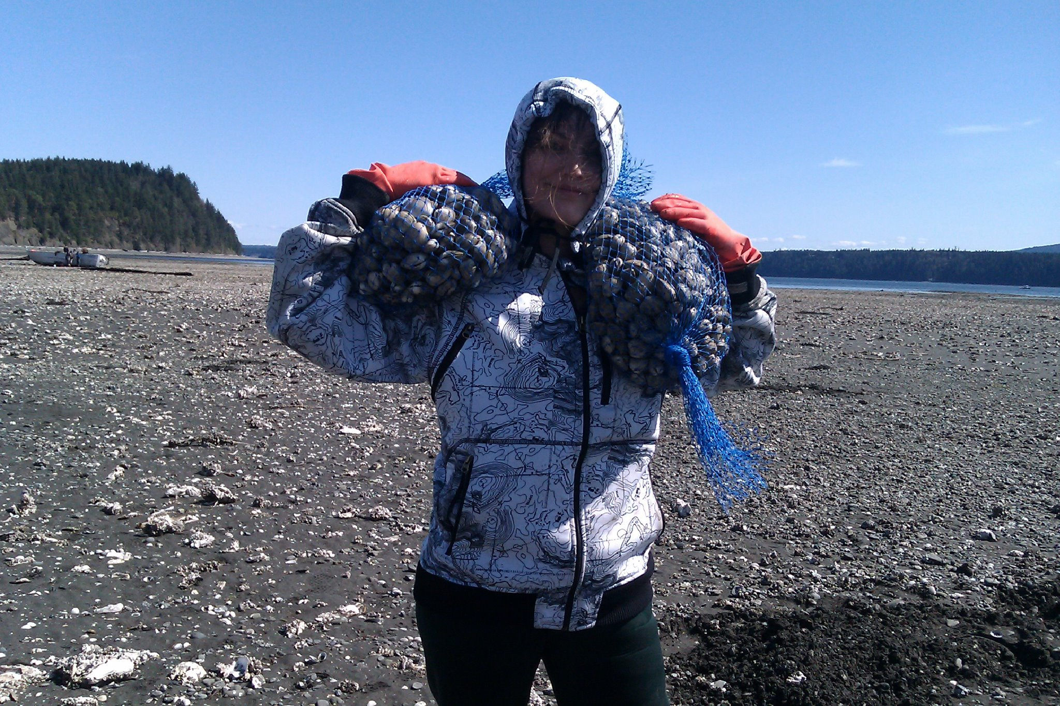
Survey Analysis: Fishers’ Opinions
Priority of NR Dept.
Efforts of Staff & Tribal Leadership
Reasons for Fishing
Drawbacks of Commercial Fishing
Notes:
KELLY
Insert Data

Slide 8
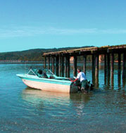
Survey Analysis: Fishers’ Future
Future Years as a Fisherman
Retirement
Social Security
Education/Training
Notes:
KELLY
DATA about future plans

Slide 9
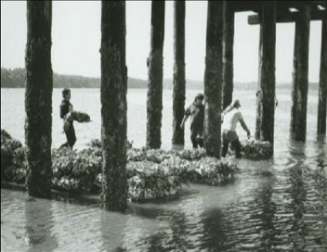
Summary of Recommendations
Improve communication with the community
Develop training/education plan
Notes:
Communication:
-Develop, Publicize Enhancement plan and efforts
-Develop plan to notify community more effectively
-Develop ways to get feedback and input from fishermen
Training and Education
-Marine Engine repair

Slide 10
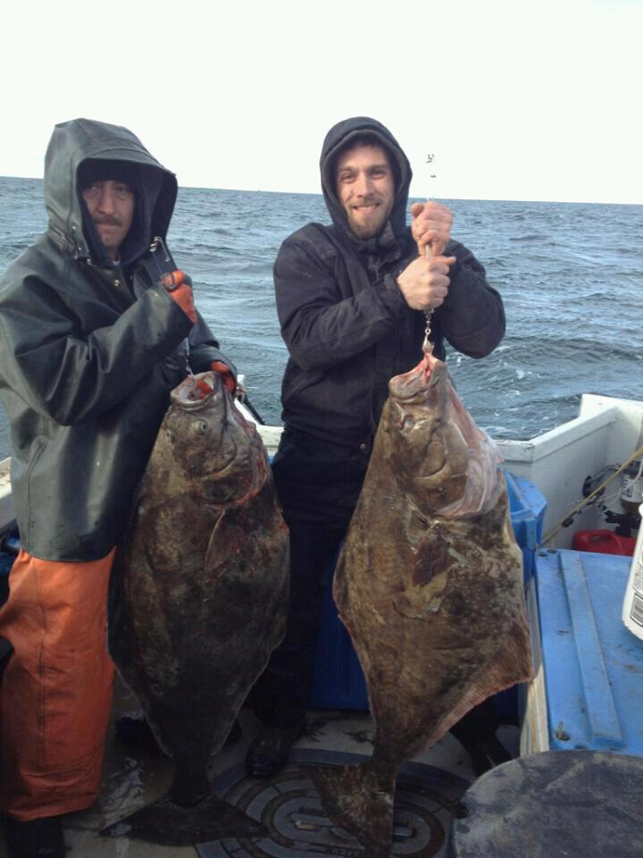
Summary of Recommendations
Develop system for short-term “opener” loans
Investigate personal retirement options for fishermen
Investigate and improve Tribal Fish Tax payment system
Notes:
-

Slide 11
Got Ducks?
Notes:
KELLY

