Slide 1
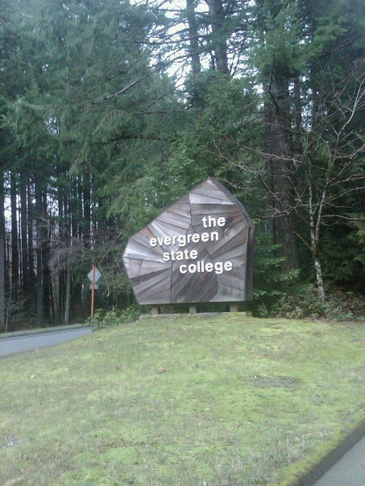
MPA Tribal Cohort Survival Guide
Our story begins with a journey…
by Kim Benally-Hood and Tracy James
Notes:
Introduce ourselves, what tribe we are from and work we have done in education so far (Swinomish and Squaxin, etc.)

Slide 2
The journey of a thousand miles begins with one step.
Two to three years ago many of us walked onto campus for the first time for orientation?
Some student may have had similar thoughts to ours.
Am I going the right way?
Ok, I found the Longhouse
Kind of scared to go in, I wonder if I will know anyone inside?
Longhouse orientation
Are all these people in the Tribal MPA program?
Where do I park? Where is the Longhouse?
Wow, what a beautiful building.
So I wonder who is all in the Tribal Cohort?
Notes:
The next three slides are the Inter-years first full day at Evergreen during orientation and into the night.

Slide 3
First Impressions
Tribal Cohort break out session
I wonder what families they are from and are we related?
Thoughts
Do I really have all the skills necessary to graduate?
Leaving the Longhouse and looking at the long road ahead
I wonder if I can do this for another three years?
Am I going to make it in this program?
I wonder what tribes they are from?
I don’t know anyone here in Olympia so where shall I stay tonight?

Slide 4
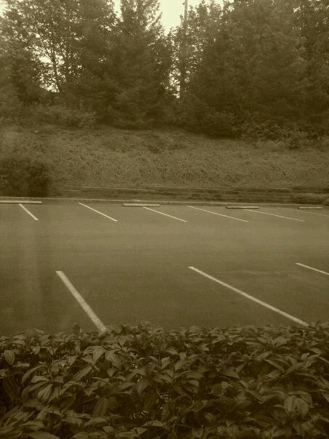
Reflections on the journey ahead
Homesickness
Loneliness
Intimidation
Friends
Family
Community
All of life is a journey,
which path we take,
what we look back on,
and what we look forward to
is up to us.
Notes:
I had a choice that night on which path to take. I called home and got support from my family who encouraged me to stay at school and keep going on the path that I had chosen.

Slide 5
Why Evergreen’s MPA-Tribal Program?
Tribal-centered Curriculum
Topic Areas: Tribal sovereignty, politics, budgets, treaties, economic development, law, management, employment policy, research, and administration relevant to Indian Country.
Instructors and Faculty
Native American faculty, Instructors, and Program staff
Cohort Model
Multigenerational learning environment.
Flexible curriculum allowing for personalized in-depth research.
All served as role models, advisors, mentors, etc.
Knowledgeable in Indian Country politics, administration, and pedagogy.
Relationships
Beneficial group learning among others who bring their talents, skills, experiences, culture, and knowledge into the classroom.

Slide 6
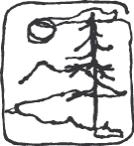
Guiding questions
Reflecting on the past three years, we started the journey with these questions:
Where are the other students?
Why did they leave the program?
What prevented us from dropping out?
What kept us going in school?
Support systems?
What factors contributed to our success?
What hardships were overcame?
What obstacles were navigated and maneuvered through?
How can we make our research relevant?
How can we apply our research?
How to give back?
What can we pass on to the next cohort?
Notes:
Talk to the audience (because some are family and may not understand the research process) and explain how we go through the process of research. Do a quick survey. How many of you believe you had all the academic skill necessary to complete this class after earning your bachelors degree?

Slide 7
Academically challenging
Read 50+ books
Completed 60 credit hours
Met over 20 hours for 4-6 weekends each quarter.
Wrote a multitude of seminar and research papers.
Completed research projects individually or in groups
Participated in seminar groups
On our way to finishing the capstone project!
Notes:
Our undergraduate work and skills helped to prepare us for graduate school and although it was challenging, it was not an obstacle in our ability to complete the coursework.

Slide 8
Why this project?
Success
History of Indian Ed
Low educational attainment rate
Negative
Prospective
Indigenous Ways of Knowing
Giving back
Federal/State Indian Ed Laws
Notes:
Now that we have given you a little brief history and a bit of context on our topic. Let us quickly share with you some of the books and previous research that initially helped to influence our project

Slide 9
Review of previous readings that have influenced our research
According to Linda Tuhiwaia Smith, Western and Indigenous styles of research are at odds. Western scientific research is too politically interested rather than neutral and objective. The Maori equivalent of the four directions of Indigenous research which include an agenda for self-determination with the elements of healing, decolonization, transformation, and mobilization (117). This type of indigenous methodology is what we are striving for in our research.
Appiah asks his readers to consider The Golden Rule of “Do not do to others what you do not want them to do to you” (60). After the initial research and seeing the negative perspectives about Indian education, we choose to research the positive aspects and successes of AI/AN students. Appiah atates the aim of cosmopolitanism is to understand that although we share the same vocabulary and identify values, we have different interpretations and give the same values different weights (66) .
Steven Newcomb discussed the importance of image-schemas.. “The human experience of individuating objects and the experience of grasping objects and holding onto them results in image-schema” (5). The “Conqueror” or dominant society has guided much of the research in Indian Country and has effectively created mind containers with negative images of Indians. In research, it is our intent to add positive image schemas to educated Indians.
Notes:
Literature review sections?

Slide 10
The use of an Indigenous research paradigm when studying Indigenous peoples requires a holistic use during the process and during the transmission of information (32). Wilson states when information is presented, it needs to be culturally appropriate by taking the role of storyteller rather than researcher. When the storyteller and listener understand the same experiences, view point, knowledge, values, beliefs, and assumptions, then they are better able to transmit the information that is relevant and specific to their lives.
And the Pursuit of Happiness was a great example of research that was not in the traditional format. It followed a year long cyclical timeline that told a visual artistic story.
This story format is similar to Indigenous forms of storytelling.
Our aim is to shift our research to focus on positive perspectives grounded in Native values and create a paradigm shift that allows our research to move toward a more indigenous centered education model allowing for a traditional transmission of knowledge.
The book states, “Transformational researchers reject the colonizing mission of schools . Some of the most interesting recent research has explored the roles of teacher and culture. Culturally responsive teachers are effective teachers who embrace Indigenous cultural norms: establish close personal ties with students, parents, and elders: are socially and politically consciensious: and attempt to arm student for an alienating world.”

Slide 11
Prior research, relevant ideas and concepts
From Where the Sun Rises
by Michael Pavel
Research report for OSPI 2008
Recommends that AI/AN culture, state tribal history, AI/AN government and language be taught in the K-12th grade classrooms.
Unmasking, Exposing, and Confronting: Critical Race Theory, Tribal Race Theory, and Multicultural Education
By Jeanette Haynes Writer
Research focuses on culturally responsive teachers who embrace Indigenous cultural norms and establishes close personal ties with students in order to prepare students to walk in two worlds.
Pathways for Native American Students
A Report on Colleges and Universities and Colleges in Washington State
Recommendation #5:
In order to increase student success their has to be a co-partnership of Natives and the Institution.
Surveys, meetings, and listening sessions need to take place to create a mutual understanding of both existing assets and needs.
Institutions must listen and pay attention to the needs of Native students and tribal communities.

Slide 12
breadth and depth
P
Participants: 200+ MPA Tribal graduates since program inception.
Topics: Curriculum, Policies, Evaluation, Student success/supports, Graduation rates, Holistic teaching, Culture/history/government in classroom, Community based learning, Pedagogy-diverse teaching/learning strategies/assessment, Native Values & attitudes
Passion = challenge in narrowing topic
Participants:
2012 Cohort
Topic: survey regarding graduate school experiences and positive advice to 2014 cohort.

Slide 13
How to survive graduate school: a guide for mpa tribal concentration students
Indigenous ways of knowing
Traditions
Promote Positive Image-Schema and persistence
Persistence
Social network supports
In school support system
Out of school support system
hózhó
Values
Thinking

Slide 14
HARMONY AND BEAUTY
“Decolonizing research is about centering Indigenous worldviews and articulating theory and research from our own [American Indian]
perspectives and for our own purposes.”
Navajo historian Jennifer Nez Denetdale in Reclaiming Dine History

Slide 15
Methodology
Indigenous
Western
Person
School
Community
Faculty & Staff
Co-workers
Extended family
Nuclear family
Mentor
Friends
Work
Elders
Person
School
Family
Euro-Centric
Work
Notes:
Problem, research question, and hypothesis

Slide 16
METHODOGY & METHOD
INDIGENOUS PARADIGM
GROUNDED THEORY
“theory needs to be
grounded or rooted in observation –
hence the term”
- Research Methods Knowledge Base
Walk on the path of
harmony and beauty
to old age
-Dine‘ Philosophy
METHOD:
Survey 2012 Tribal cohort graduating class
Survey distribution via surveymonkey.com

Slide 17
Challenges
Narrowing of our topic
Approval for HSR took longer than we anticipated
Trying not to influence
co-researchers
Avoiding overlap of research with Puanani, Jeff, and Jenny’s research project
Time, distance, and technological difficulties between research partners

Slide 18
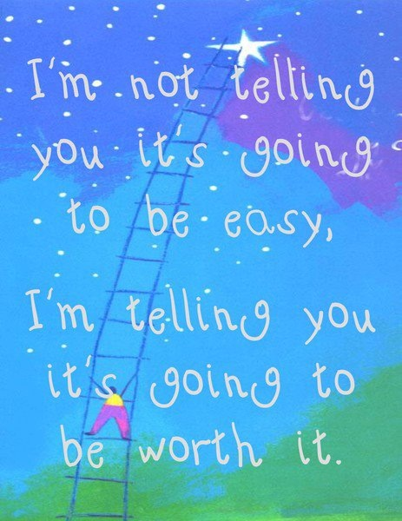
Giving back from which we have received
As our journey ends our main goal is…

Slide 19
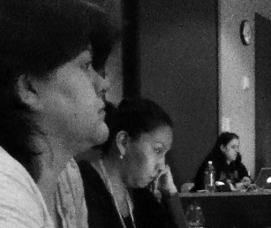
friendship and appreciation are a blessing
We are so often caught up in our destination that we forget to appreciate the journey, especially the goodness of the people we meet on the way. Appreciation is a wonderful feeling, don’t overlook it.
We (Kim and Tracy) have truly appreciate taking this journey with all of you.
Thank you for you time today and your friendships forever.
Notes:
Any questions?

