Slide 1
Community Consciousness: Personal and community sentiments concerning human remains AND Climate Change and Archaeology Contextualization of Climate Change, Archaeology, and the stewardship of human remains
Community Consciousness
Daniel Felizardo
Lillian Hendrickson &
Jenny Serpa,
Climate Change Contextualization By
Lillian Hendrickson
Notes:
Daniel-We are going to take a tour of our study. This tour is intended at student. We will be looking at the MPA Tribal and General cohort and museum professiona’ls sentiments concerning human remains. Along this tour we will we will be comparing the two populations. Just a little vocabulary for the tour. We will be referring to the MPA student respondants ents as Students and the Washington State Museum Professional respondents and Professional. Lets begin.

Slide 2
THERE ARE IMAGES OF HUMAN REMAINS

Slide 3
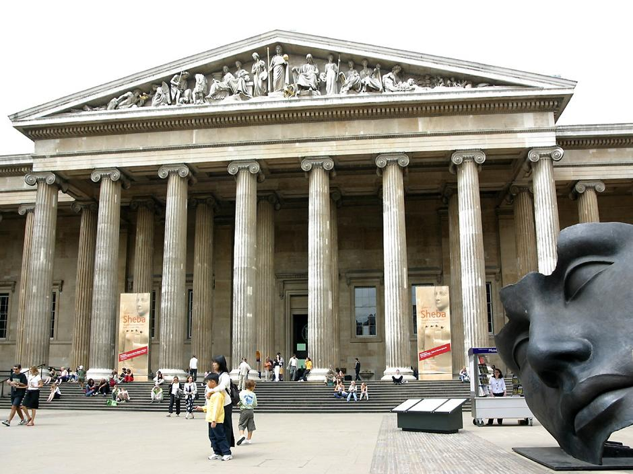
Welcome
95% of student respondents visited a museum
Notes:
Jenny-Our tour starts at the museum.

Slide 4
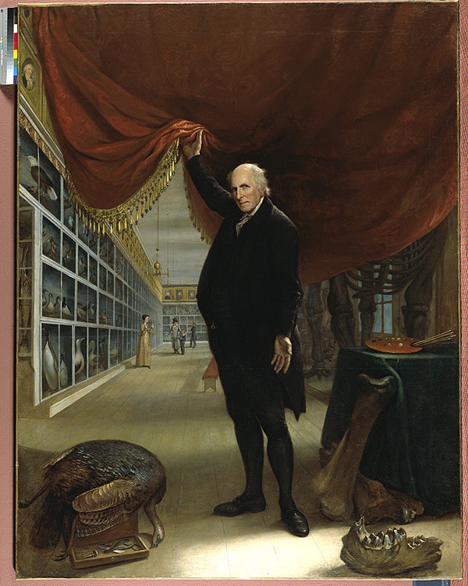
Expect to See Human Remains
66% MPA students DO NOT EXPECT TO SEE
60% HAVE
Notes:
Jenny- When going to a museum 66% MPA students DO NOT. We also measured professional expectations.

Slide 5
Expect to See Human Remains
95% Museum Professionals do NOT EXPECT
76% HAVE
Notes:
Jenny- When going to a museum 66% MPA students DO NOT. We also measured professional expectations.

Slide 6
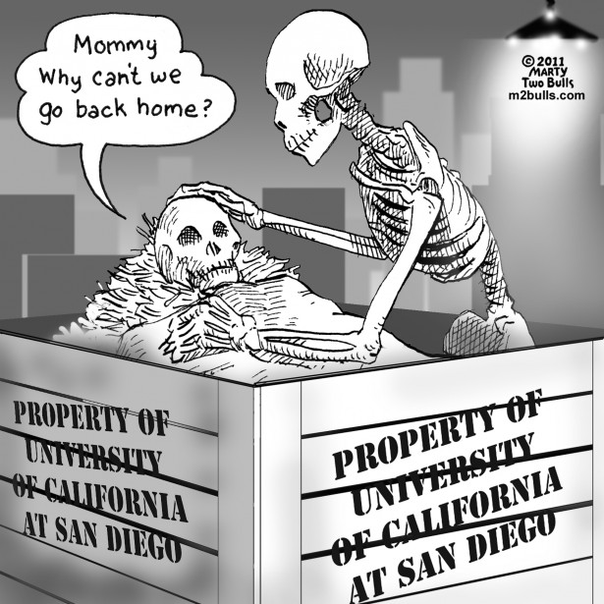
Do you think it is appropriate to keep human remains in museums
Less than 1/3 of students and professionals think so
Notes:
Jenny-Less than a third of students and professional believed human remains should be displayed in museum (student 32; professionals 26%)

Slide 7
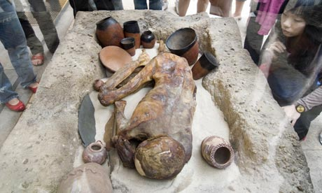
Do you think it is appropriate for human remains to be displayed in museums?
No: Students 36% and professionals 47%
Notes:
Lillie

Slide 8
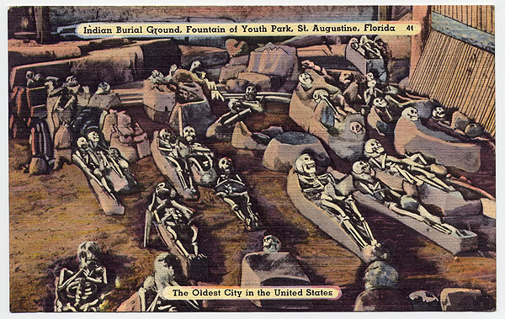
Majority of students believe displaying human remains in a museum helps the public to understand how people lived in the past
(65% vs. 35%)
Notes:
lillie

Slide 9
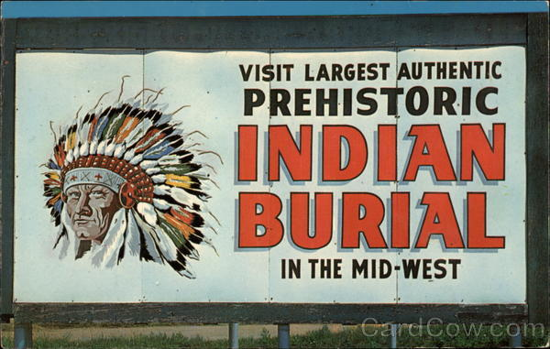
Majority of professionals believed displaying human remains appeals to sensationalism rather than intellectual curiosity. (60% vs. 39%)
Notes:
Lillie-While the majority of professional believed.

Slide 10
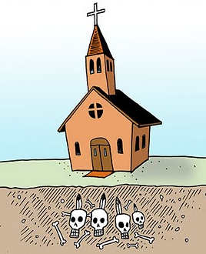
Should a person’s religion make a difference to how their remains are treated?
Professionals
50%
Yes
Students
85%
Yes
Notes:
Lillie- Here we see a difference in thinking about a persons religion and the treatment of human remains. 4 minutes

Slide 11
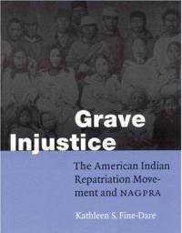
86% student have heard about repatriation
Notes:
Jenny-The return of human remains and associated funerary objects to its community of origin

Slide 12
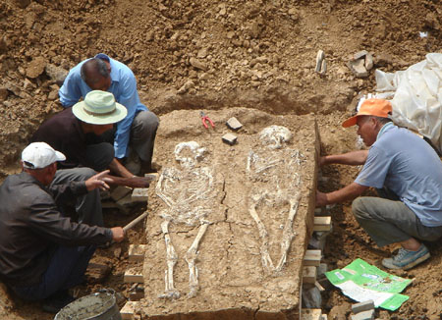
Majority of students and professionals believe human remains currently being excavated should be reburied (70% students vs. 78% professionals)
Notes:
Jenny

Slide 13
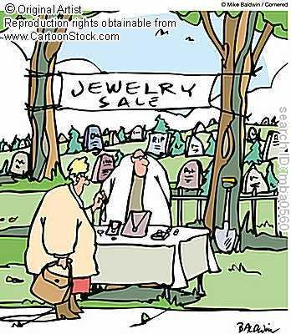
Significant difference between what students and professionals (64% vs. 30%) believe the manner in which the human remains were originally acquired should be considered during repatriation request
Notes:
Jenny

Slide 14
Current Laws
1980s: becomes a class C Felony to disturb American Indian graves knowingly (WSL RCW 68.60.010 Ch 27.44 RCW)
1990: NAGPRA only applies to Federal and Indian lands

Slide 15
Current Laws and Process in WA
State of Washington Law concerning discoveries made on State and Private Lands:
Discovery treated as homicide until law enforcement determines otherwise
Deptartment of Archaeology and Historic Preservation involved
DAHP will notify area Tribes of discovery

Slide 16
Current Laws and Process in WA
State of Washington Law concerning discoveries made on State and Private Lands:
State Physical Anthropologist required to make determination of Native ancestry based on section 106
WSL RCW 27.44.055
Proof of Cultural Affiliation

Slide 17
Current Laws and Process in WA
“Any archaeologist or interested person may copy or examine…the surface of any such cairn or grave, but no such record or archaeological material from any such cairn or grave may be removed unless the same shall be destined for reburial or perpetual preservation in a dully recognized archaeological repository and permission for scientific research and removal of specimens of such records and materials…has been granted by the State Historical Preservation Officer… Whenever a request for permission to remove records or materials is received the state historic preservation officer shall notify the affected Indian Tribe or Tribes.”

Slide 18
The FUTURE What does Climate Change have to do with it?
Altered Sea Levels
Thawed Permafrost
Erosion
Changes in water ways

Slide 19
threatened by sea level Rises
Notes:
Sea Level Rise Strategic Plan – Anne Arundel County, Maryland http://losttownsproject.org/projects/Sea%20Level%20Rise/SLR%20Cultural%20Resources%20Report.pdf

Slide 20
Notes:
Sea Level Rise Strategic Plan – Anne Arundel County, Maryland http://losttownsproject.org/projects/Sea%20Level%20Rise/SLR%20Cultural%20Resources%20Report.pdf

Slide 21
Notes:
Sea Level Rise Strategic Plan – Anne Arundel County, Maryland http://losttownsproject.org/projects/Sea%20Level%20Rise/SLR%20Cultural%20Resources%20Report.pdf

Slide 22
Threatened by Erosion

Slide 23
Threatened by rising Temperatures
Funerary items Achaemenid 5th Century B.C.E. (before common era) from Pazyryk Iran, the oldest dated pile carpet, from the largest burial mound in the region.
Notes:
Ancient Iranian Treasures in Central Asia are threatened by climate change. The News Section
of the Circle of Ancient Iranian Studies (CAIS). http://www.cais-soas.com/news/index.php?option=com_content&view=article&id=341:ancient-iranian-treasures-in-central-asia-are-threatened-by-climate-change&catid=58

Slide 24
Threatened by Mitigation of Climate Change or protection
Efforts to protect Moccasin bend and nearby American Indian burial grounds, but miscommunication causes tension between communities.
Notes:
Pam Sohn (2011).American Indians say remains desecrated at Moccasin Bend. Freetimespress.com http://www.timesfreepress.com/news/2011/jul/13/american-indians-say-remains-desecrated-moccasin-b/

Slide 25
effects Everyone Everywhere
Notes:
Credit: Kent Mountford Shoreline erosion threatens a graveyard on lower Hooper Island, MD. In the background is shoreline stone riprap placed to retard the Bay’s advance. http://www.bayjournal.com/image.cfm?row=1&article=3180

Slide 26
Museum Policies
Do museums have a repatriation policy?
Quotes from some of the professionals
Notes:
Jenny

Slide 27
Possible Solutions for the Future
Collaboration
Communication
Consultation
Education
Culturally Appropriate Displays
Repatriation
Better Laws / New Processes
Notes:
Jenny

