Slide 1
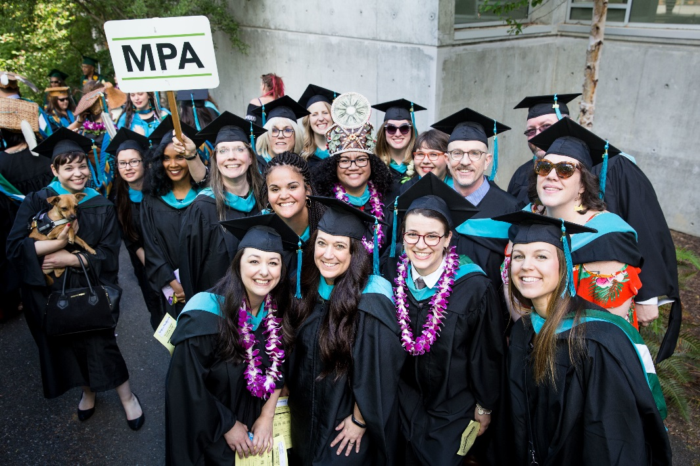
Master of Public Administration (MPA) Info Session
Thursday, September 19, 5:30-6:30 pm
Location: Olympia Timberland Library, Downtown Olympia
For more information: evergreen.edu/mpa

