Slide 1
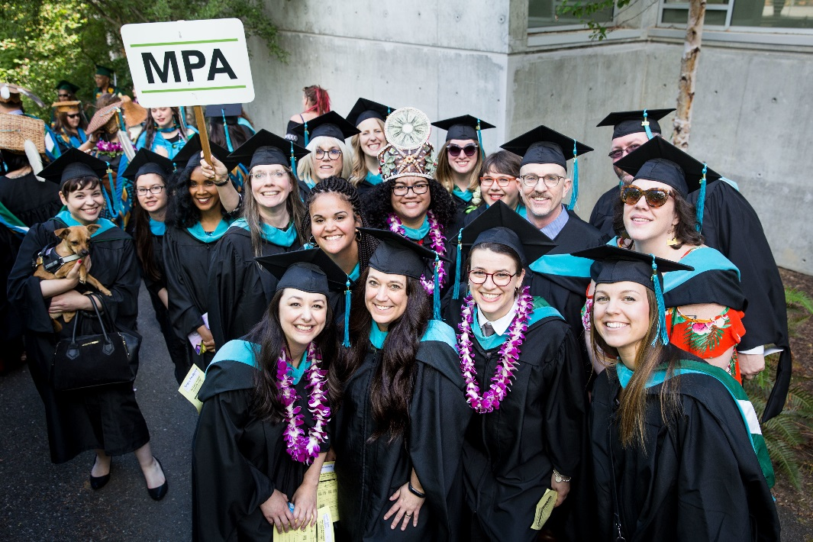
Master of Public Administration (MPA) Info Session
Thursday, November 7, 5:30-6:30 p.m.
Location: Olympia Timberland Library, Downtown Olympia
Join us to find out more about the MPA program including schedule, admissions requirements, financial aid, and to answer any questions you may have.
For more information: evergreen.edu/mpa

