Slide 1
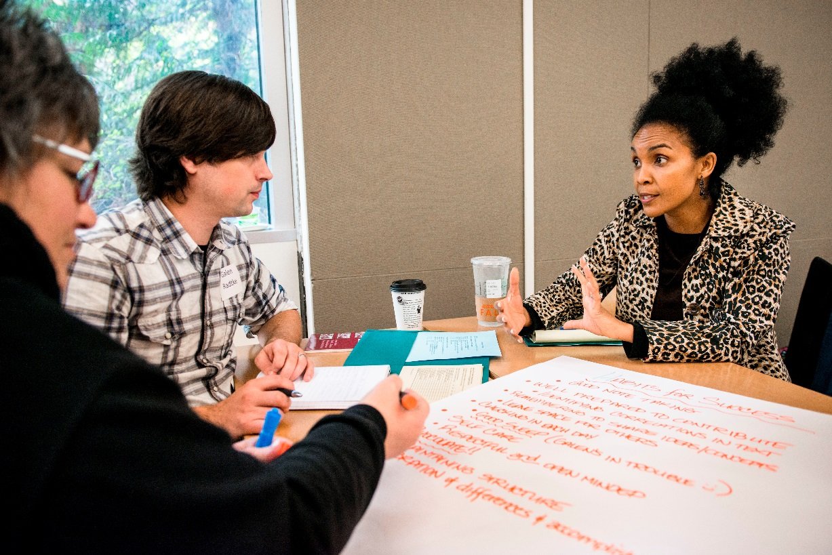
Be the change! Apply for Evergreen’s MPA program
Second round deadline Monday, March 4, 2019
For more information: evergreen.edu/mpa
Questions?
Contact Anna Rhoads, MPA Assistant Director 360-867-6554 rhoadsa@evergreen.edu

