Slide 1
Master of Public Administration (MPA) graduate program at The Evergreen State College

Slide 2
Road Map
Why MPA at Evergreen?
Schedule
MPA Curriculum
Concentrations
How to Apply
Costs and Financial Aid
Questions

Slide 3
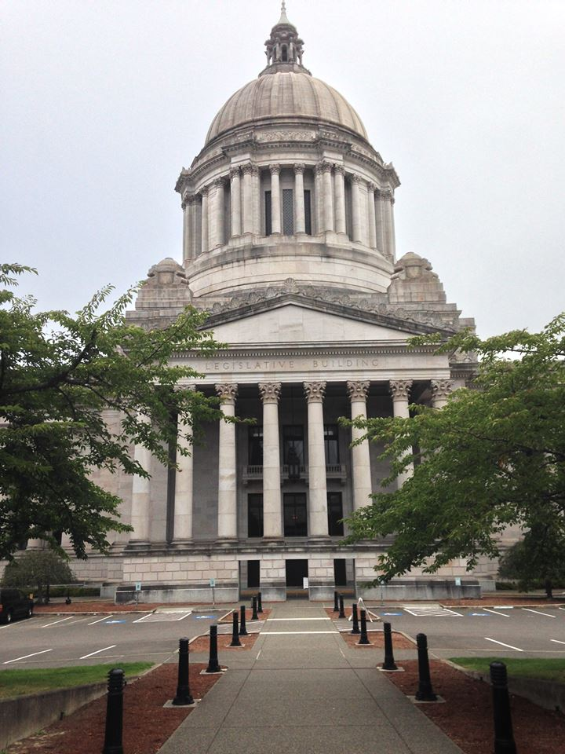
Why pursue a MPA degree?
Study governance, management and policy in an interdisciplinary context
Aspire for a career working in the non-profit or public sector

Slide 4
Why Evergreen?
Classes are convenient – keep your day job and earn your graduate degree
Based in state capitol – Gain valuable exposure to government and supporting organizations
One of the most affordable MPA programs in the region
Where do MPA Evergreen graduates work?
Federal, state, tribal, and local government
Nonprofit organizations
Washington State Legislature
Higher Education
Organizations working on Native/Indigenous issues
Private industry and consulting

Slide 5
Schedule
You can complete your degree in two years attending full-time or as little as three years attending part-time
Core classes = 6 credits and meet on Thursdays 6 – 10 pm
Concentration and elective courses are offered on evenings and weekends
Tribal Governance concentration meet five sessions each quarter. Each session is 20 hours long and meets Fridays, Saturdays, and Sundays

Slide 6
MPA Curriculum
Core courses
First-Year Core
Second-Year Core
Elective Coursework
Example elective courses
Doing the Public’s Business
Homeland Security is Local
International NGOs
Science Policy into Action
Lean in the Public Sector
International Drug Policy
Public Budgeting for the 21st Century
Negotiation Through a Feminist Lens

Slide 7
Concentrations
Tribal Governance | Public & Nonprofit Administration | Public Policy
Gain an in-depth education in the field of indigenous government administration Learn about sovereignty issues, intergovernmental relations, regulatory policy, and economic development Only program of its kind in the USA | Prepare for careers as administrators in public or nonprofit organizations Coursework includes budgeting, strategic planning, human resources and information systems, public law, leadership and ethics, and multicultural competencies | Prepare for careers in positions such as policy analyst, budget analyst, or evaluator. Coursework includes understanding of various models of public policy, how to analyze current and proposed policies, and how to engage in policy development and advocacy.
Degree Requirements Core courses + Capstone 36 credits Tribal concentration series 20 credits Electives 4 credits Total 60 credits | Degree Requirements Core courses + Capstone 36 credits Electives 24 credits Total 60 credits | Degree Requirements Core courses + Capstone 36 credits Foundations of Public Policy 4 credits Advanced Research Methods 4 credits Electives 16 credits Total 60 credits

Slide 8
Admission requirements
Bachelor’s degree
Minimum GPA of 3.0
Statistics pre-requisite
Evidence of your ability to do high quality graduate-level work
May require 1-credit internship
We do not require the GRE

Slide 9
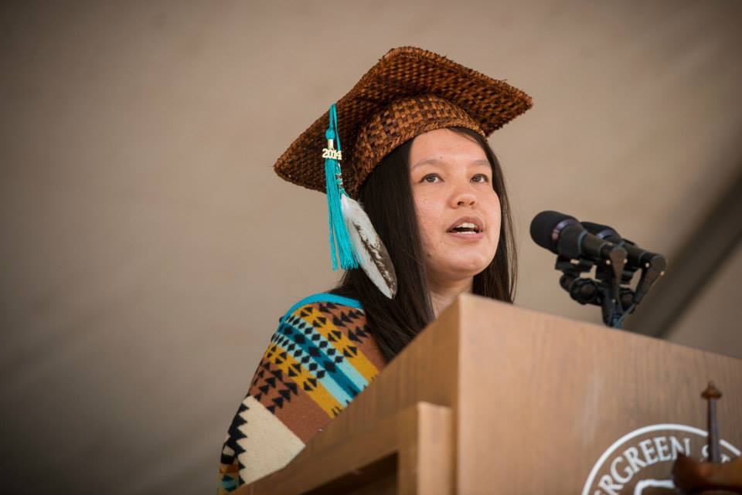
Prepare your application
Select and contact two recommenders
Format your resume
Write a statement of purpose
Write a public policy essay
Request official transcripts
Apply online
Priority deadline is February 1, 2018!

Slide 10
Costs and Financial Aid
One of the most affordable MPA programs in the country at under $10,000 a year for in-state resident, full-time study
Tuition calculator
MPA offers federal student aid and scholarship opportunities
To be eligible for federal student aid, you must take at least 4 credits per quarter

Slide 11
Stay connected
?
Puanani Nihoa 360-867-6202 nihoap@evergreen.edu
Anna Rhoads 360-867-6554 rhoadsa@evergreen.edu
@EvergreenMPA
@MPAEvergreen

