Slide 1
Master of Public Administration

Slide 2
What’s an “MPA”?
Master’s degree
Public Administration =
work in govt. -- all levels
nonprofit sector
public/private partnerships
Professional degree: crossroads of theory + practice
“An MBA for public/nonprofit sector”

Slide 3
Why an MPA?
Advance your career: move up into
management
policy
Flexibility: move out → toward other jobs, orgs
Go deep, with colleagues: move beyond the day-to-day
Notes:
Graphic for move up
Graphic for move out

Slide 4
Why an Evergreen MPA?
Doable for working adults:
evenings & weekends
Minimum: 2 years (f/t); 3 years (p/t)
no I-5 commute
Affordable: ½ the cost of other WA MPA programs
Well connected
In state capital: faculty, jobs, internships
Cohort model
100s of alums
Notes:
Maybe make each bullet into its own slide, then each point for each bullet into its own slide; graphics – no symbol with I5 or traffic with no symbol across it

Slide 5
1. Doable.
For working adults – keep your day job
Evening and weekend program:
Core courses = just 1 evening/week: Thursday nights from 6-10pm
Electives = 2 or 4 credits, mostly on weekends
Typically just 1 “crazy long day” per week
Typical full time schedule: Thursdays from 6-10pm + 1 or 2 weekends each quarter
Go part-time or full-time and get your MPA in as little as 2 years

Slide 6
Close up: schedule for 1 quarter
Notes:
Magnifying glass

Slide 7
Start w/Core (= 6 cr = P/T)…
Week | M | T | W | Thurs | Fri | Sat | Sun
1 |  |  |  | Core 6-10
2 |  |  |  | Core 6-10
3 |  |  |  | Core 6-10
4 |  |  |  | Core 6-10
5 |  |  |  | Core 6-10
6 |  |  |  | Core 6-10
7 |  |  |  | Core 6-10
8 |  |  |  | Core 6-10
9 |  |  |  | Core 6-10
10 |  |  |  | Core 6-10 |  | Core 9-5

Slide 8
Add a 2 cr elective = 8 cr (= F/T min)
Week | M | T | W | Thurs | Fri | Sat | Sun
1 |  |  |  | Core 6-10
2 |  |  |  | Core 6-10
3 |  |  |  | Core 6-10
4 |  |  |  | Core 6-10
5 |  |  |  | Core 6-10 | Local Gov 5-9 | Local Gov 9-5 | Local Gov 9-5
6 |  |  |  | Core 6-10
7 |  |  |  | Core 6-10
8 |  |  |  | Core 6-10
9 |  |  |  | Core 6-10
10 |  |  |  | Core 6-10 |  | Core 9-5

Slide 9
…or add a 4 cr course = 10 cr
Week | M | T | W | Thurs | Fri | Sat | Sun
1 |  |  |  | Core 6-10
2 |  | Design Thinkg 6-10 |  | Core 6-10
3 |  |  |  | Core 6-10 |  | Design Th 9-5
4 |  | Design Thinkg 6-10 |  | Core 6-10
5 |  |  |  | Core 6-10
6 |  | Design Thinkg 6-10 |  | Core 6-10
7 |  |  |  | Core 6-10
8 |  | Design Thinkg 6-10 |  | Core 6-10 |  | Design Th 9-5
9 |  |  |  | Core 6-10
10 |  | Design Thinkg 6-10 |  | Core 6-10 |  | Core 9-5

Slide 10
The big picture: 2-3 year plan

Slide 11
Curriculum: the basics
60 credits = 36 “Required” + 24 “Other”
Required Core Classes (Thurs 6-10)
Other
Concentration courses (Public Policy, Tribal Gov.)
Electives (weekends, other evenings)
Required Capstone (Thurs 6-10)
Notes:
Core is interdisciplinary; electives are single subject 1 x week; can take MPA, other school courses, or do internship/ILC

Slide 12
F/T & P/T options…
Full-time (2 years)
Part-time (3 years min.)
Can take up to 6 years
Accommodate big job, family responsibilities
Unexpected life events

Slide 13
Required: Core + Capstone = 36 cr
Year | Fall | Winter | Spring
Year 1 | 1st Year Core (6 cr) | 1st Year Core (6 cr) | 1st Year Core (6 cr)
Year 2 | 2nd Year Core (6 cr) | 2nd Year Core (6 cr) | Capstone (6 cr) (if full-time)
Year 3 (if part-time) |  |  | Capstone (if part-time)

Slide 14
Electives: lots of options
Electives = 2 or 4 credit courses
2 credits = 1 weekend per quarter (F 5-9, S/S 9-5)
4 credits = evenings, weekends or combo
Typically 2 weekends per quarter
40 hours of classroom time
4 “flavors” → can take any, regardless of conc.
Individual study
Internships
MES electives

Slide 15
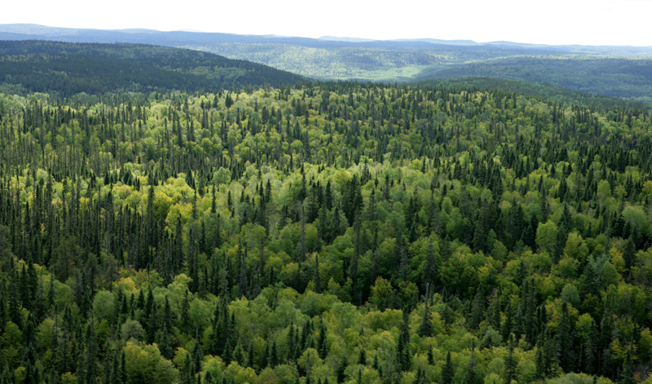
Putting it all together…

Slide 16
Add a 2 cr elective = 8 cr (= F/T min)
Week | M | T | W | Thurs | Fri | Sat | Sun
1 |  |  |  | Core 6-10
2 |  |  |  | Core 6-10
3 |  |  |  | Core 6-10
4 |  |  |  | Core 6-10
5 |  |  |  | Core 6-10 | Local Gov 5-9 | Local Gov 9-5 | Local Gov 9-5
6 |  |  |  | Core 6-10
7 |  |  |  | Core 6-10
8 |  |  |  | Core 6-10
9 |  |  |  | Core 6-10
10 |  |  |  | Core 6-10 |  | Core 9-5

Slide 17
F/T: 2 years w/summers (avg 8 cr/qtr = F/T min)
 | Fall | Winter | Spring | Summer
Year 1 | 1st Year Core (6 cr) + Elective (2 cr) | 1st Year Core (6 cr) + Elective (2 cr) | 1st Year Core (6 cr) + Elective (2 cr) | Electives (8 cr)
Year 2 | 2nd Year Core (6 cr) + Elective (2 cr) | 2nd Year Core (6 cr) + Elective (2 cr) | Capstone (6 cr) + Elective (2 cr) | Electives (4 cr)

Slide 18
…or add a 4 cr course = 10 cr
Week | M | T | W | Thurs | Fri | Sat | Sun
1 |  |  |  | Core 6-10
2 |  | Design Thinkg 6-10 |  | Core 6-10
3 |  |  |  | Core 6-10 |  | Design Th 9-5
4 |  | Design Thinkg 6-10 |  | Core 6-10
5 |  |  |  | Core 6-10
6 |  | Design Thinkg 6-10 |  | Core 6-10
7 |  |  |  | Core 6-10
8 |  | Design Thinkg 6-10 |  | Core 6-10 |  | Design Th 9-5
9 |  |  |  | Core 6-10
10 |  | Design Thinkg 6-10 |  | Core 6-10 |  | Core 9-5

Slide 19
F/T schedule: 2 years, no summers (6 qtrs @ 10 credits/quarter)
 | Fall | Winter | Spring | Summer
Yr 1 | 1st Year Core (6 cr) + Elective or Concentration (4 cr) | 1st Year Core (6 cr) + Elective or Concentration (4 cr) | 1st Year Core (6 cr) + Elective or Concentration (4 cr) | n/a
Yr 2 | 2nd Year Core (6 cr) + Elective or Concentration (4 cr) | 2nd Year Core (6 cr) + Elective or Concentration (4 cr) | Capstone (6 cr) + Elective (4 cr) | n/a

Slide 20
Start w/Core (= 6 cr = P/T)…
Week | M | T | W | Thurs | Fri | Sat | Sun
1 |  |  |  | Core 6-10
2 |  |  |  | Core 6-10
3 |  |  |  | Core 6-10
4 |  |  |  | Core 6-10
5 |  |  |  | Core 6-10
6 |  |  |  | Core 6-10
7 |  |  |  | Core 6-10
8 |  |  |  | Core 6-10
9 |  |  |  | Core 6-10
10 |  |  |  | Core 6-10 |  | Core 9-5

Slide 21
P/T schedule: 3 years (10 qtrs @ 6 credits/quarter )
 | Fall | Winter | Spring | Summer
Year 1 | 1st Year Core (6 cr) | 1st Year Core (6 cr) | 1st Year Core (6 cr)
Year 2 | 2nd Year Core (6 cr) | 2nd Year Core (6 cr) | Electives (6 cr) | Electives (6 cr)
Year 3 | Electives *or* Elective + Concentration (6 cr) | Electives *or* Elective + Concentration (6 cr) | Capstone (6 cr)

Slide 22
Avoid the I-5 commute hassle…

Slide 23
2. Affordable.
½ the tuition & fees of other WA MPA programs
$305 per credit
$18,000 tuition & fees total
Funding sources: Scholarships, Tuition Waivers, Loans, Fellowships, Grants, Internships, Jobs
Ability to work while attending school

Slide 24
3. Well connected.
Olympia = state capital = hub
Connection to Leg, agencies, nonprofits
Jobs, internships, faculty
Cohort model = form strong bonds
Network: 100’s of alums in the area

Slide 25
Location, location, location…

Slide 26
Alums working in policy…

Slide 27
…state agencies

Slide 29
…nonprofits

Slide 31
Consider joining us.

Slide 32
Apply for Fall 2017 by 2/1/17.

Slide 33
This could be you, in June 2019.

Slide 34
To find out more…
Contact Randee Gibbons:
gibbonsr@evergreen.edu
See your packet for more info
Electives, syllabus, Capstones
Application info
Info sessions
Visit class
Make an appointment

Slide 35
Questions?

