Slide 1
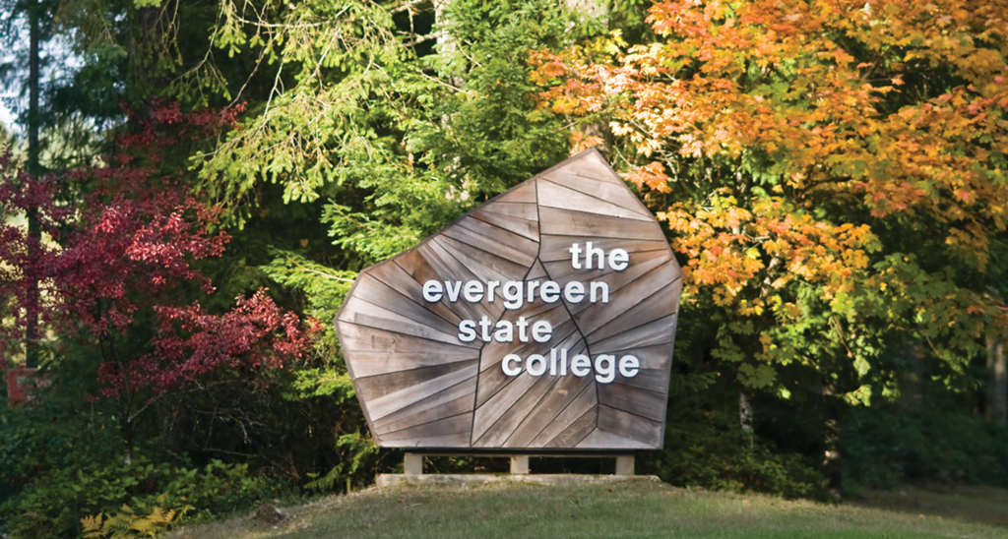

Slide 2
Why Evergreen?
Established program – 32nd year in 2015
Any major may apply
Interdisciplinary & Flexible
Cohort Model; Team-taught courses
Evening Classes
Full- or Part-Time (2 or 3 years)
Thesis of your choice
Affordable

Slide 3
Evergreen’s Approach to Education
Collaboration across Disciplines
~ Team-teaching
~ Interdisciplinary Group Project
Student-centered Learning
~ Seminar
Hands-on Learning
~ Field Trips
MESA (Student Association)
~Rachel Carson Forum
Original Research
~ Thesis

Slide 4
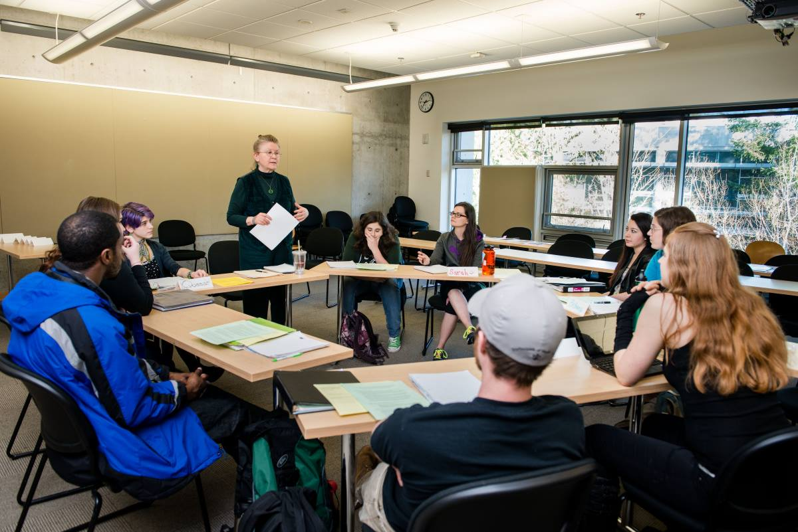
Notes:
classroom

Slide 5
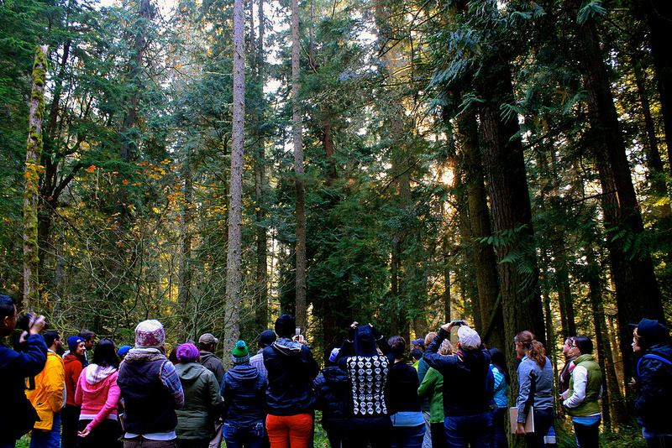
Pack Experimental Forest
Notes:
gCore field trip at UW center for sustainable foresty at Pack Forest

Slide 6
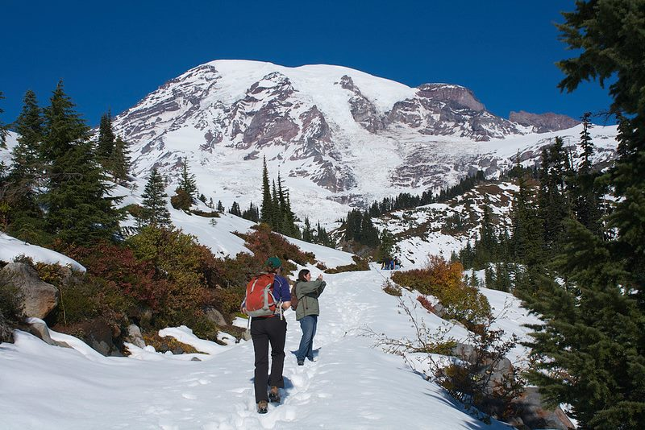
Mount Rainier
National Park
Notes:
gCore field trip cont.

Slide 7
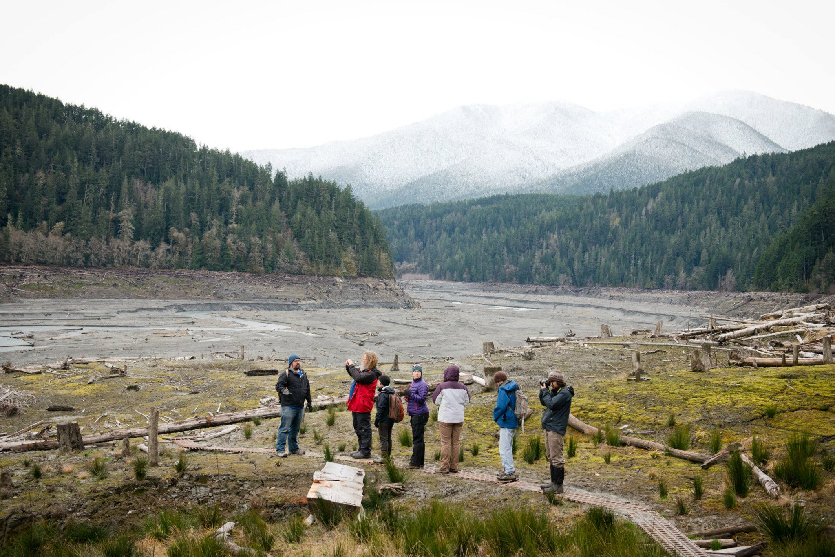
Elwha River
Notes:
Field trip

Slide 8
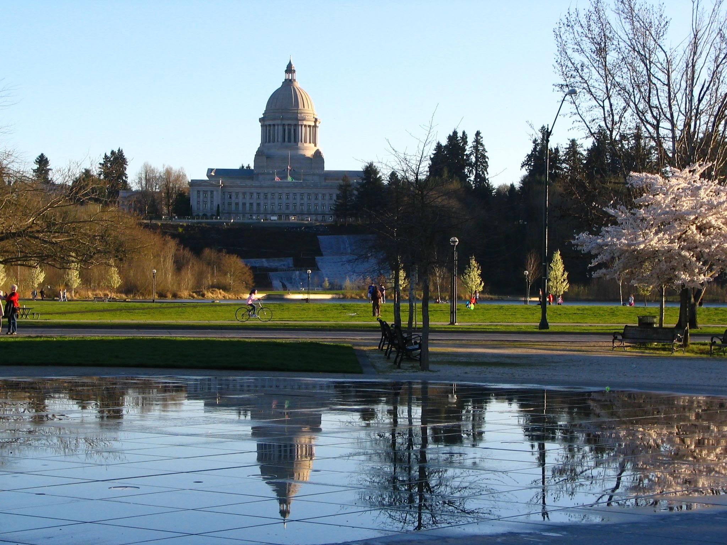
Olympia – Washington’s State Capital
Notes:
Olympia capitol

Slide 9
Curriculum
72 credits
Required Core Classes (Tue/Thu)
Electives (Mon or Wed)
Internships
Individual Study
MPA Courses
Transfer Courses
Thesis
Notes:
Core is interdisciplinary; electives are single subject 1 x week; can take MPA, other school courses, or do internship/ILC

Slide 10
Sample 2-Year Plan
12 credits for 6 quarters or 3 nights/week
 | F | W | Sp | Su
Year 1 | Core & Elective | Core & Elective | Core & Elective | Internship or Elective
Year 2 | Core & Elective | Thesis & Elective | Thesis & Elective | Graduate!

Slide 11
1st Year Core Sequence
FALL: Conceptualizing our Regional Environment
~ Interdisciplinary Group Project
WINTER: Ecological and Social Sustainability
~ Candidacy Paper
SPRING: Research Design / Quantitative Methods
~ Group Experiment and Analysis
+ Electives and/or Internships!

Slide 12
2nd Year Core Sequence
FALL: Case Studies
~ Thesis Prospectus
WINTER and SPRING: Thesis
~ Original Research Project
~ Presentation
+ Electives and/or Internships!

Slide 13
Sample Elective Topics
GIS
Sustainable Forestry
Water Management
Energy
Biodiversity
Restoration Ecology
Environmental Education
Wildlife Conservation

Slide 14
MES Faculty
6 core faculty
Economics, Conservation Biology, Chemical Oceanography, History of Science, Climate Justice, Alternative Energy
7 adjunct faculty
Depts. of Ecology, Natural Resources, & Fish & Wildlife; Center for Natural Lands Management, Esri, WA Center for Improving the Quality of Undergraduate Education

Slide 15
Sample Internships
Wetlands Monitoring
Environmental Education/Event Planning
Grant Writing
Habitat Connectivity
Mapping Stormwater Systems with GIS
Sustainability in Prisons Project
Restoration Management
Fisheries Science
Climate Justice
Notes:
WSDOT Wetland Monitoring (3)
Department of Ecology (Climate Change Policy Adaptation for Washington State)
Glacier Bay Natl Park (A Field Study of Grizzly/Black Bear Behavior and Management Practice in Glacier Bay National Park)
Washington Dept of Health Marine Biotoxin Program (Occurrence of Dinophysis and Diarrhetic Shellfish Poisons in Washington State Waters and Shellfish Internship)
Bear: , Glacier National Park
Institute of Human Ecology/Forest Service (Mapping Human interactions on places on the Olympic Peninsula)

Slide 17
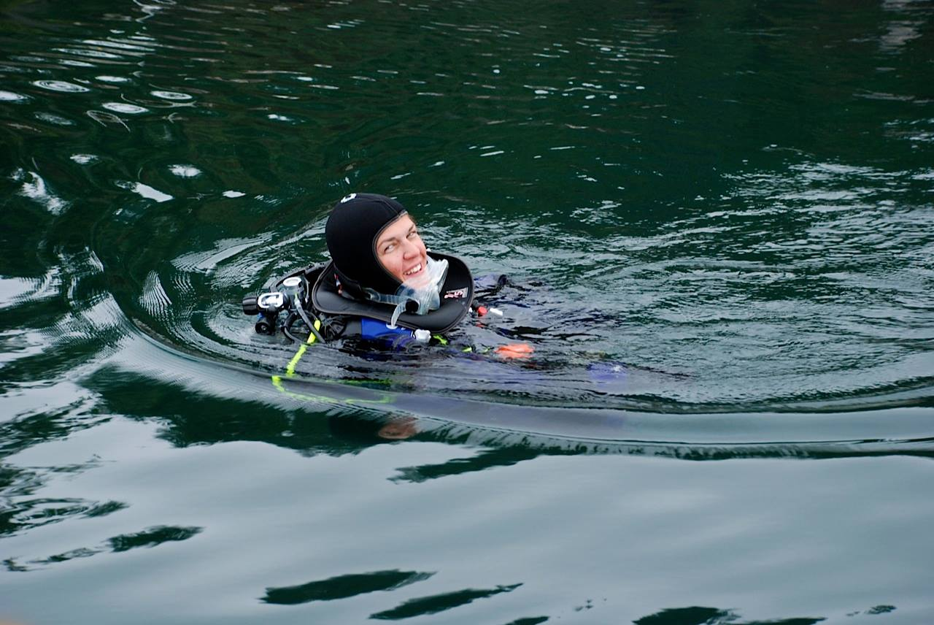
Notes:
Student Thesis Projects: Traci Sanderson - Diving for algae samples

Slide 18
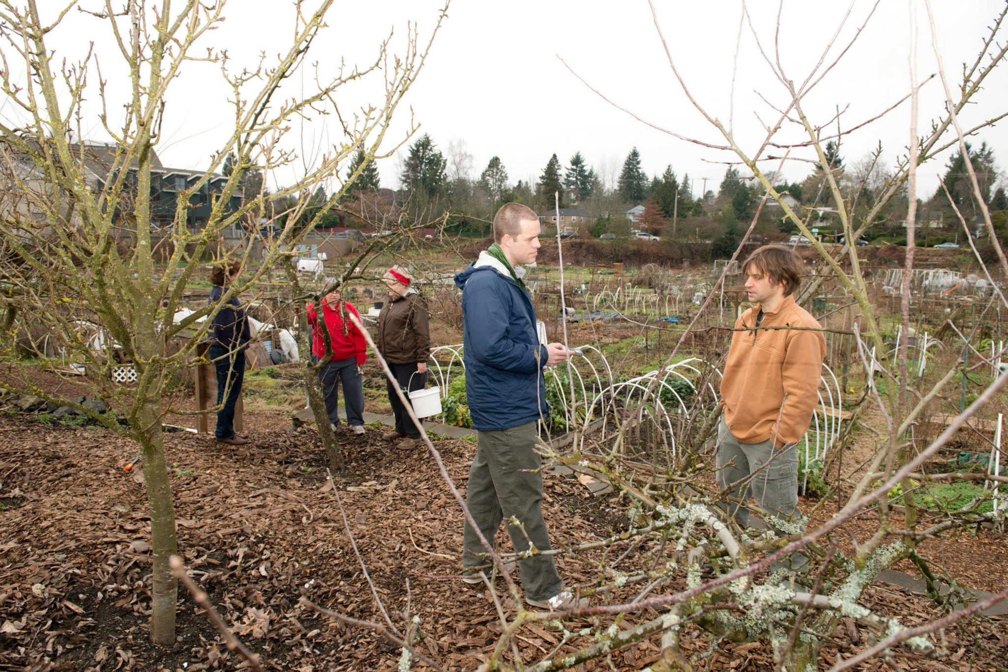
Notes:
Student Thesis Project: interviews orchard volunteer Stephanie Butow at the Picardo Pea Patch in Seattle. Rambo is doing in-depth interviews with volunteers of the City Fruit program and writing his thesis on the factors that motivate them to volunteer. Photo by Shauna Bittle, TESC

Slide 19
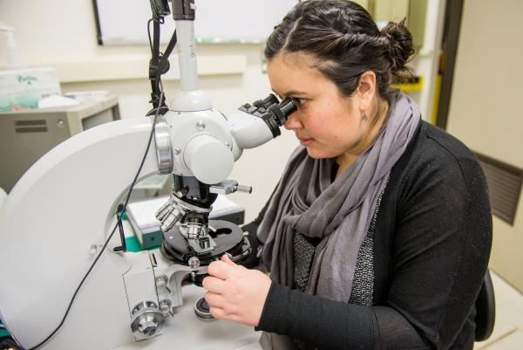

Slide 20
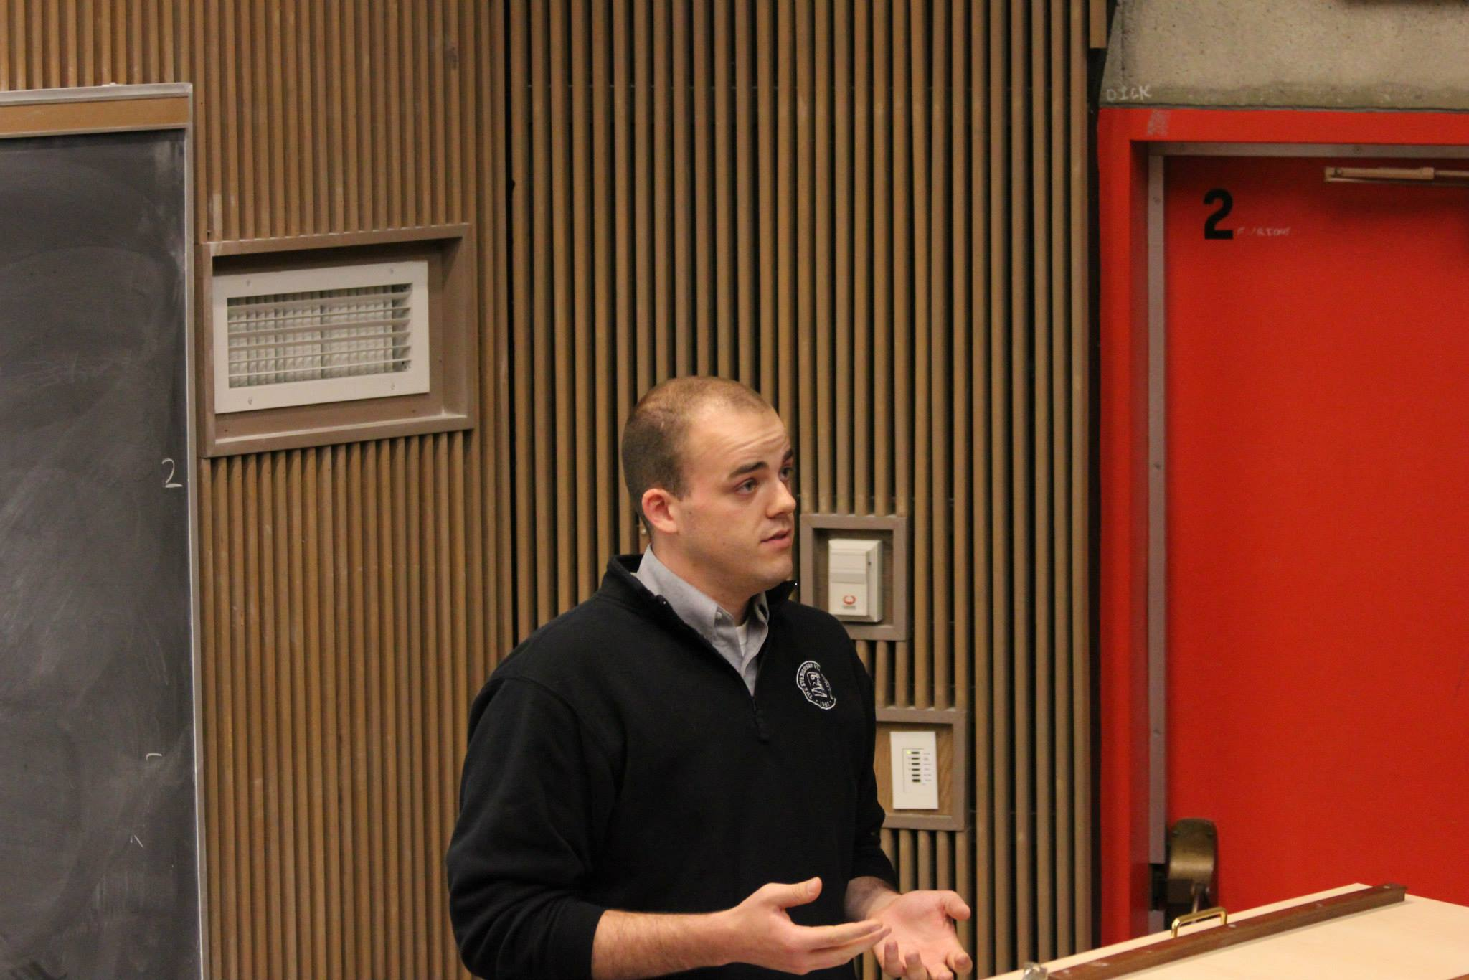
Notes:
Thesis Presentation: Robert Coleman “Establishing a Baseline: A Community Greenhouse Gas Emissions Inventory for Thurston County, WA”

Slide 21
After MES
Fisheries Biologist
Environmental Educator
Sustainability Director
Solid Waste Management
Environmental Planner
Natural Resources Director
Professor
MES Weekly Blog
Notes:
Also city, county, state, federal govt, WA state tribes, NOAA; all over the states, even Australia

Slide 22
MES Demographics
Demographics (as of Oct 2015) | Fall 2015 Cohort | Fall 2014 Cohort | Other Cohorts | Total Students
Number of Students | 44 | 40 | 14 | 99
Average Age | 28 | 31 | 30 | 29
Age Range | 21-49 | 19-56 | 23-46 | 19-56
% Women | 73% | 63% | 100% | 73%
% Students of Color | 18% | 10% | 21% | 17%
% Non WA Resident | 27% | 18% | 14% | 19%
% Veteran | 7% | 8% | 7% | 7%
% AmeriCorps Alums | 25% | 13% | 7% | 17%

Slide 23
What do MES students study before graduate school?

Slide 24
Admission Requirements
Bachelor’s Degree
3.0 GPA for last 90 quarter credits
Pre-requisites
Natural Science, Social Science, Statistics
15 credits social science & natural science (recommended)
GRE
Notes:
Application, $50 app fee, official transcripts, statement of purpose, 3 letters of recommendation

Slide 25
What We’re Looking For
Educational & Work Experience
Letters of Recommendation
Statement of Purpose
Writing abilities
Reason for applying
GRE Scores
Likelihood to Finish

Slide 26
Costs & Financial Aid
Funding Sources
Scholarships, Tuition Waivers, Loans, Fellowships, Grants, Internships, Jobs
Fall 2015 Cohort
Avg resident award = $2,232 ($500 - $7,499)
Avg nonresident award = $4,759 ($500 - $5,449)
79% of applicants received funding
15-16 tuition
Resident: $9,138; Nonresident: $21,501

Slide 27
Next Steps
Find three recommenders
Gather transcripts
Sign up for GRE by early January
Start online application and submit by 2/15
Be on lookout for reminders about FAFSA and financial aid application

Slide 28
Contact
Gail Wootan
Assistant Director
360-867-6225
wootang@evergreen.edu
www.evergreen.edu/mes

