Slide 1

MPA 101
How to navigate Evergreen and graduate with your MPA!

Slide 2

MPA Staff
MPA Director – Michael Craw
MPA Assistant Directors
  Anna Rhoads, PNAPP Olympia cohort
  Puanani Nihoa, Tribal Governance/PNAPP Tacoma cohort
MPA Program Assistant – Dhara Katz

Slide 3

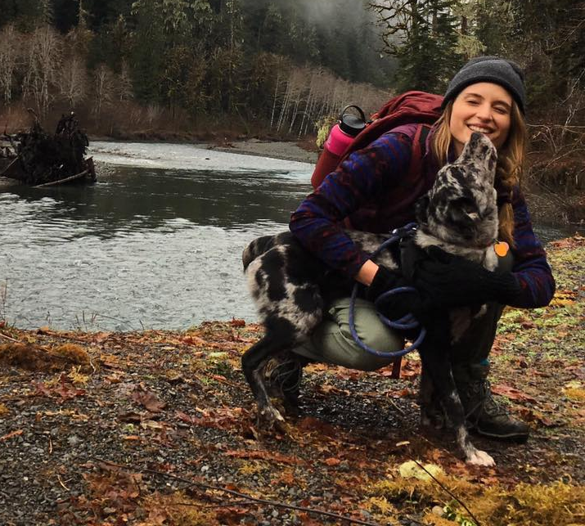

A little about me…
B.S. in Environmental Policy from Humboldt State University
M.E.S. from The Evergreen State College
  Thesis research focused on public transportation and housing equity
MPA Assistant Director PNAPP Olympia since October 2017
Outside of work - travel, hike, art, gluten-free baking

Slide 4
My responsibilities as Assistant Director
Guide: goal is to teach students to navigate Evergreen
MPA program and procedure questions
Info & referral when you don’t know where to go
Help you overcome obstacles and intercede when necessary
Assist in achieving conflict resolution
Course enrollment management
Degree requirements: “where am I in my program?”
Internship and job information and resources
MPA financial aid process
Orientation and graduation planning
Managing internal and external communications

Slide 5
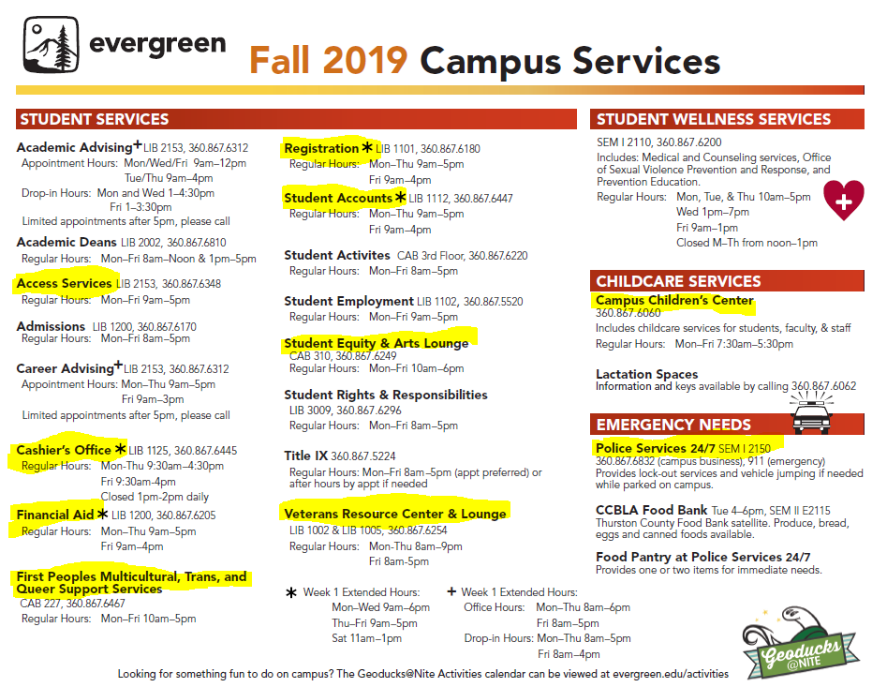

Slide 6
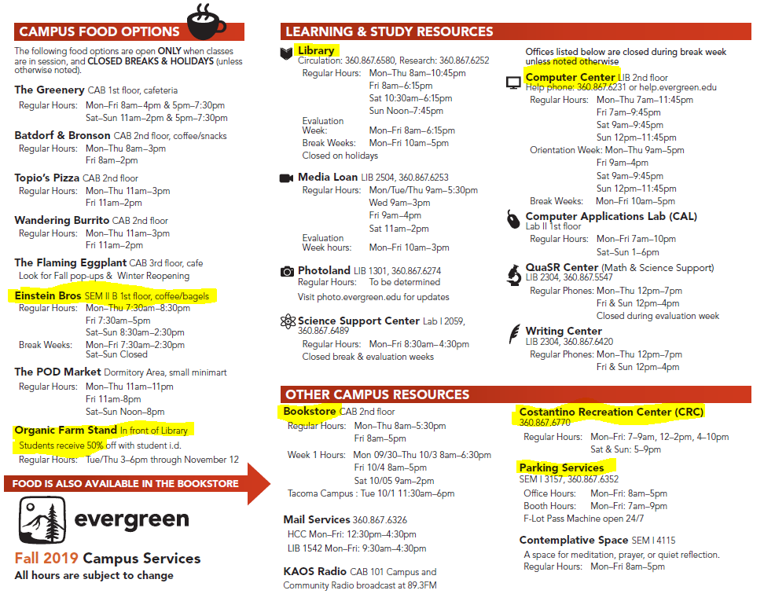

Slide 7

Navigating Evergreen
You can access Canvas, your Evergreen e-mail, financial aid, pay tuition, course registration, evaluations, order transcripts, etc. through my.evergreen.edu
Almost every office on campus operates on 8 – 4 or 9 - 5 pm hours, plan accordingly or call/email the office
Need to meet with me? Call or e-mail me to set-up an in-person or phone appointment.
E-mail faculty for office hours or to set-up an appointment

Slide 8
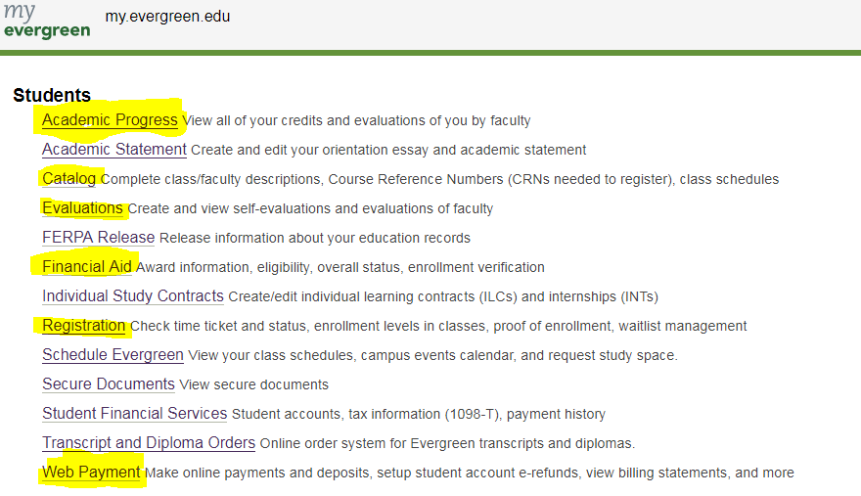

Slide 9
Navigating Evergreen
Parking is enforced Monday – Friday, 7 am to 9pm
Intercity Transit bus is free as an Evergreen student – use your ID to get around town or to class
Plan to bike to campus? Register your bike with Police Services
Food options are limited on campus after 6pm/weekends – plan ahead
Fall Bookstore hours:
8am – 5:30 pm (Mon through Thurs)
8am – 5:00 pm Friday
You can also rent textbooks at the library, buy/rent online, share…
Greener Commons
Schedule Evergreen

Slide 10
Emergency Preparedness
Sign up for e2Campus text alerts (e2campus.net/my/evergreen)
In case of an emergency/bad weather, visit Evergreen’s home page or call the main phone number 360-867-6000
Police Services:
  Emergency? Call 911! You can also reach Evergreen Police Services at 360-867-6140
  Escort/Locked out of your car/jump-start: Call 360-867-6832

Slide 11

Student perks
The Organic Farm Produce Stand is 3pm – 6pm Tuesdays/Thursdays April – November. Students receive 50% off!
Use of the Constantino Recreation Center (CRC) and classes
TOP Outdoor Program Rentals (tent, backpack, sleeping bags, snowshoes, etc.)
Student Wellness Services (Medical care & counseling)

Slide 12
Career & Internship Resources
Academic and Career Advising Services: offers mock interviews and resume help
MPA Job and Internship LinkedIn Page: https://www.linkedin.com/company/mpaevergreen/
MES Job and Internship Blog: http://blogs.evergreen.edu/mesweekly/

Slide 13

Writing Assistant
Evergreenwritingassistant@gmail.com
Current MPA or MES graduate student – can help with writing process.

Slide 14
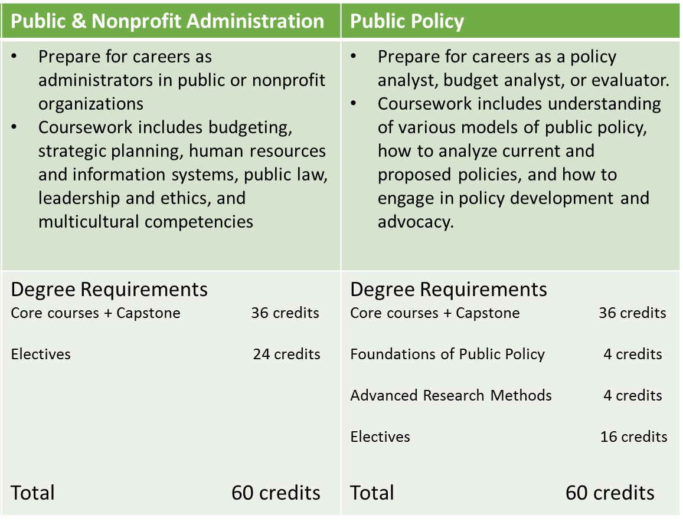
“PNAPP” Degree Requirements

Slide 15

Degree Requirements, cont.
Capstone – must take a minimum of 40 credits before taking Capstone, only offered Spring term
Concentration courses – Public Policy concentration students will need to complete Foundations of Public Policy and Advanced Research Methods/Feminist Approaches to Measurement and Evaluation
Electives – Public policy take 16 elective credits; Public and Nonprofit Administration take 24 elective credits. You may take Tribal Governance concentration course for elective credit. You can take up to six 2-credit MPA courses. You may take MPA electives at Evergreen Tacoma site.
Internships – you may be required to complete an internship before you graduate, refer to your admissions letter.* Internships 2 – 4 credits. May begin Winter 2019
Individual Learning Contracts (ILCs) – A great opportunity to study a topic of your choosing/build your own curriculum, usually 2-4 credits. Need faculty sponsorship.

Slide 16

Degree planning worksheet exercise
Spend the next 10 minutes drafting your MPA path.

Slide 17
How do narrative evaluations work?
Similar to a performance review
  Faculty will evaluate your work
  You’ll write your own self-evaluation
  You’ll also get to evaluate your faculty
How are you evaluated?
  Evaluation of your completed assignments, classwork, and exams
  How you approach your work
  How you work with your fellow students
  Objectives and preparation
  Attendance record
  Highlights of your skills and abilities
  https://www.evergreen.edu/evaluations

Slide 18
Financial Aid and Scholarships
Financial Aid available to graduate students:
Loans*
Need Grants*
AmeriCorps Education Awards
MPA Scholarships*
*To qualify for most awards, complete the FAFSA for before February 1
Question about your Veterans Benefits? Contact the Veterans Resource Center (veterans@evergreen.edu) 360-867-6254

Slide 19
Your to-do list:
Read the MPA Handbook
Check your evergreen.edu email regularly(or forward your evergreen.edu e-mail to a personal e-mail account and check that e-mail regularly)
Immunization form – turn in to the Health Center (or me) by the end of the Fall quarter. If you don’t, there will be a hold on your account and you won’t be able to register for Winter classes.

Slide 20
MPA Handbook Quiz

Slide 21
How many credits do you need to have before you can begin Capstone?

Slide 22
Fill in the blank:
You may take a maximum of ____ 2 credit elective courses

Slide 23
What is the maximum number of credits you can take per quarter (without the Director’s approval?)

Slide 24
True or false: You may receive partial credit for a Core Course

Slide 25
What is the maximum number of credits you may complete during the program?

Slide 26
True or false: You may take a leave of absence if you are in good academic standing for up to one year

Slide 27
True or false: You can’t take Tribal Governance concentration courses for elective credit

Slide 28
Fill in the blank: Tuition for courses that you are registered for is due by the first ______ of the quarter

Slide 29
How many credits do you need before you can apply for graduation?

Slide 30
Who would you talk to first if you were unsure about your degree requirements?

Slide 31


Thanks for listening!
Questions?
rhoadsa@evergreen.edu
360-867-6554
Office: Lab 1, 3024

