Slide 1
Evergreen’s Master of Public Administration (MPA)
Information Session
Notes:
Welcome, introduce everyone. Presentation will be about 20 minutes. We will leave the rest of the time for q&a.

Slide 2
Road Map
Why MPA at Evergreen?
Schedule
MPA Curriculum
Concentrations
How to Apply
Costs and Financial Aid
Questions
Notes:
Today we will be talking about the MPA program at Evergreen and why it may be a good fit for you. We will discuss what a typical full time and part time schedule look like. Next I will cover the curriculum that is taught in the MPA program. Then talk about the concentration options you can choose from. Then we will cover the application process and the steps that go into that. Then we’ll cover costs and financial aid.

Slide 3
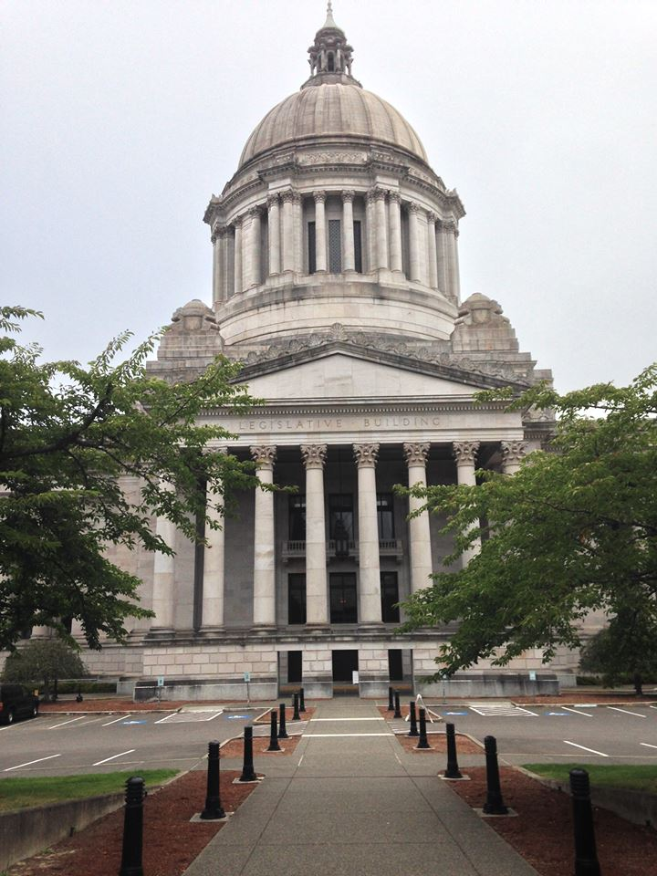
Why pursue your MPA degree?
Study governance, management and policy in an interdisciplinary context
Explore and implement socially just, democratic public service.
Aspire for a career working in the non-profit or public sector
Notes:
Why pursue your MPA degree?
Our students are passionate about working for the public good. They work in government, non-profits, and even the private sector. Our students pursue an MPA to gain necessary, real-world, hands-on skills and to move up into policy or management.

Slide 4
Why Evergreen?
Classes are convenient – keep your day job and earn your graduate degree
Based in state capitol – Gain valuable exposure to government and supporting organizations
One of the most affordable MPA programs in the region
Where do MPA Evergreen graduates work?
Federal, tribal, state and local government
Nonprofit organizations
Washington State Legislature
Higher education
Organizations working on Native/Indigenous issues
Private industry and consulting
Notes:
Why do MPA students choose Evergreen? We offer a flexible graduate program. Classes are during the evening and on the weekend. That way, you can keep your day job and still earn a graduate degree.
We are based in the capitol and have connections with state policy makers, non profits, and other public administrators. We are able to connect you with agencies and organizations looking for interns and employees. Several of our faculty have experience working in local, state, tribal, and federal government.
We are the most affordable MPA program in the region at approx $10,000 a year if you are in-state and attending full time.
So where do our graduates work? What is great about a MPA degree is its transferability. You could start working out for local government, but as your skills and interests change, the degree is applicable for different fields.

Slide 5
MPA Curriculum
Core courses
First-Year Core
Second-Year Core
Elective Coursework
Example elective courses
Doing the Public’s Business
Homeland Security is Local
International NGOs
Science Policy into Action
Grant Writing
Lean in the Public Sector
International Drug Policy
Public Budgeting for the 21st Century
Negotiation Through a Feminist Lens
Public Speaking
Notes:
Mention that Doreen is the director
Evergreen’s graduate programs have a cohort model. You start with the same group of peers and are likely to finish with the same group. Core is mandatory and must be taken in order i.e. start in fall. The purpose of Core is to identify and explore the fundamentals of public administration. In the second year core course you will learn about research methodology and communicating data. This will prepare you for your Capstone Project – a project where you can demonstrate what you learned in the program. Previous capstone projects include titles like “State Parks for All Washingtonians,” “Social Media Practices for Non-Profits”, and “Breaking the Cycle: Women in Poverty in Mason County.”
In PNAPP, core courses are taught Thursday evenings from 6 – 10 pm.
Electives are taught on the weekends and some evenings. Electives are required – they are a great way to expand your knowledge on public administration topics and gain new skills, such as grant writing and public speaking. Depending on your concentration, you will be required to take a certain number of electives to fulfill your graduate degree requirements.

Slide 6
Schedule
You can complete your degree in two years attending full-time or as little as three years attending part-time
Core classes = 6 credits; meet on Thursdays 6 – 10 pm
Concentration and elective courses are offered on evenings and weekends
Tribal Governance concentration meet five sessions each quarter. Each session is 20 hours long and meets Fridays, Saturdays, and Sundays

Slide 7
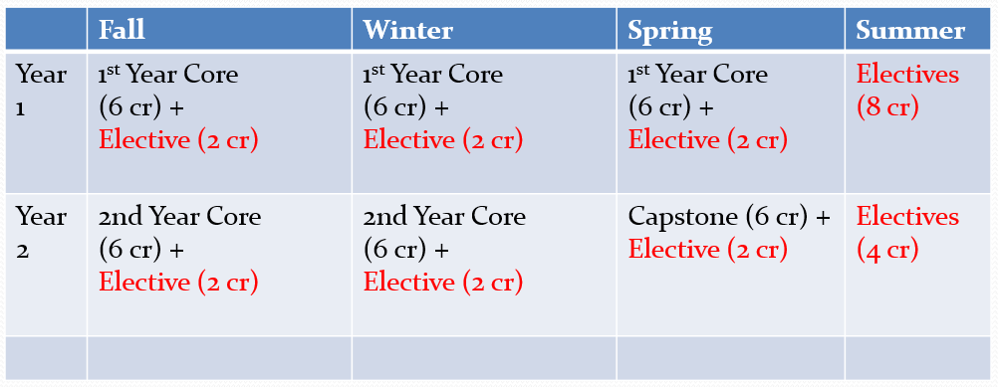
Sample schedule – Full time
Notes:
Note you don’t have to take electives during the summer. You could take elective classes that are more than 2 credits throughout the year.

Slide 8
Tribal Governance concentration
Gain an in-depth education in the field of indigenous government administration
Learn about sovereignty issues, intergovernmental relations, regulatory policy, and economic development
Only program of its kind in the USA
Degree Requirements
Core Courses & Capstone | 36 credits
Concentration series | 20 credits
Electives | 4 credits
Total: | 60 credits

Slide 9
Public & Nonprofit Administration concentration
Prepare for careers as administrators in public or nonprofit organizations
Coursework includes budgeting, strategic planning, human resources and information systems, public law, leadership and ethics, and multicultural competencies
Degree Requirements
Core Courses & Capstone | 36 credits
Concentration series | 0 credits
Electives | 24 credits
Total: | 60 credits

Slide 10
Public Policy concentration
Prepare for careers as a policy analyst, budget analyst, or evaluator.
Coursework includes understanding of various models of public policy, how to analyze current and proposed policies, and how to engage in policy development and advocacy.
Degree Requirements
Core Courses & Capstone | 36 credits
Concentration series | 8 credits
Electives | 16 credits
Total: | 60 credits

Slide 11
Test drive the MPA program before you apply!
You can register as a non-admitted special student and take up to 12 credits of MPA elective courses
If you are admitted, the credits will be applied to your degree.
Contact the MPA office on March 23, 2020 to see elective course availability!

Slide 12
Admission requirements
Bachelor’s degree
Minimum GPA of 3.0
Statistics pre-requisite-REQUIRED
Evidence of your ability to do
high quality graduate-level work
May require 2-credit internship
We do not require the GRE
Notes:
Talk about statistics resources on our website.
Internship conditional to experience.

Slide 13
Prepare your application
Select and contact two recommenders
Format your resume
Write a statement of purpose
Write a public policy essay
Request official transcripts
Apply online
Fall 2020 applications are open!
Second round deadline is March 9

Slide 14
MPA Tacoma Program
Live or work in Tacoma?
Program is similar to MPA Olympia
Interested? Contact Puanani Nihoa, MPA Assistant Director for the MPA Tacoma Program (nihoap@evergreen.edu)

Slide 15
Costs and Financial Aid
One of the most affordable MPA programs in the country at approximately $11,000 a year for in-state resident, full-time study
MPA offers federal student aid and scholarship opportunities
Apply for the FAFSA by February 1, 2020 to be considered for aid.
To be eligible for federal student aid, you must take at least 4 credits per quarter (4 credits to be considered ‘Part-time’ student status and 8 credits per quarter to be considered ‘Full-time’ graduate student status)

Slide 16
Keep in touch
Stay connected
?
Anna Rhoads, Assistant Director – Public & Nonprofit Administration and Public Policy concentrations
360-867-6554 rhoadsa@evergreen.edu
@EvergreenMPA
@MPAEvergreen
Notes:
Thank you for listening to our presentation.

