Slide 1

Master in Teaching at
The Evergreen State College
Information Workshop
Monday February 1
3-5pm
Olympia Campus Seminar 2 E 3120

Slide 2

Master in Teaching at
The Evergreen State College
Information Workshop
Thursday February 18
6-7pm
Olympia Timberland Regional Library
313 8th Avenue Olympia, WA 98501

Slide 3

Master in Teaching at
The Evergreen State College
Information Workshop
Wednesday 1/13
6-7pm
Olympia Timberland Regional Library
313 8th Avenue Olympia, WA 98501

Slide 4

Master in Teaching at
The Evergreen State College
Information Workshop
Monday March 14
3-5pm
Olympia Campus
Seminar 2 E 3120
Happy Pi Day!

Slide 5
Master in Teaching at
The Evergreen State College
Information Workshop
Thursday 3/10
6-7pm
Olympia Timberland Regional Library
313 8th Avenue Olympia, WA 98501

Slide 6

Master in Teaching at
The Evergreen State College
Information Workshop
Monday February 1
3-5pm
Olympia Campus Seminar 2 E 3120

Slide 7

Master in Teaching at
The Evergreen State College
Information Workshop
Monday February 1
3-5pm
Olympia Campus Seminar 2 E 3120

Slide 8

Master in Teaching at
The Evergreen State College
Information Workshop
Monday February 1
3-5pm
Olympia Campus Seminar 2 E 3120

Slide 9

Master in Teaching at
The Evergreen State College
Information Workshop
Monday February 1
3-5pm
Olympia Campus Seminar 2 E 3120

Slide 10

Master in Teaching at
The Evergreen State College
Information Workshop
Monday February 1
3-5pm
Olympia Campus Seminar 2 E 3120

Slide 11
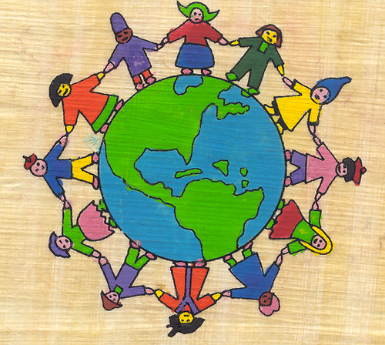
Master in Teaching at
The Evergreen State College
Information Workshop
Monday February 1
3-5pm
Olympia Campus Seminar 2 E 3120

