Slide 1
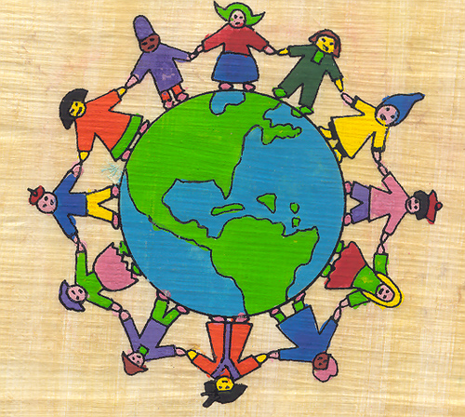
Master in Teaching at The Evergreen State College
Information Workshop
Thursday March 10 6-7 pm
Olympia Timberland Regional Library
313 8th Avenue Olympia

