Slide 1
MES Thesis Presentations
Guidelines and suggestions for effective presentations
May 4, 2023

Slide 2
Thesis Presentation
Introduction by Thesis Reader (~1 minute)
Thesis Presentation (12-14 minutes / 15 minutes maximum)
Questions (~5 minutes)
We’ll have someone keeping track of time to stay on schedule

Slide 3
Thesis Presentation Schedule
May 23 and 25 / May 30 and June 1
Please block out 3-6 pm on these dates for thesis presentations!
Please email Kevin if you cannot present on certain dates/times.
We’ll record the presentations and share link with you
We’ll schedule breaks every hour
We’ll attempt to cluster in-person presentations and zoom presentations—indicate preference on Request to Present form

Slide 4
One Structure for Thesis Presentations
Cover Slide (Title, Author, Date)
Introduction: Who’s your primary audience? What’s your hook? What background does your audience need to understand research?
Research Question(s)
Methods: Brief overview of key activities, visual of study design, map
Results: How can you tell your story in 3-5 (fairly simple) slides?
Discussion: What are the key insights, surprises, caveats?
Conclusion: What are the applications or implications? What are the next steps for future investigators? What’s the new “starting point” in this research?
Acknowledgements
Key References

Slide 5
Reminders for PowerPoint
Communicate with visuals (images, diagrams, graphs)*
Limit amount of information, especially text, for each slide
So much data, so little time! Possible strategies:
Brief overview that conveys the breadth of your research
Case in point (here’s data from one species, case study, etc.)
Other strategies?
We’ve all experienced plenty of good and bad PowerPoint presentations. Crowdsource: What’s the most important thing to remember when creating and delivering a PowerPoint presentation?
PowerPoint vs. Storymap: What are pros and cons of each mode?
* “Do as I say, not as I do” ☺ (I designed this PowerPoint to serve as a reference.)

Slide 6
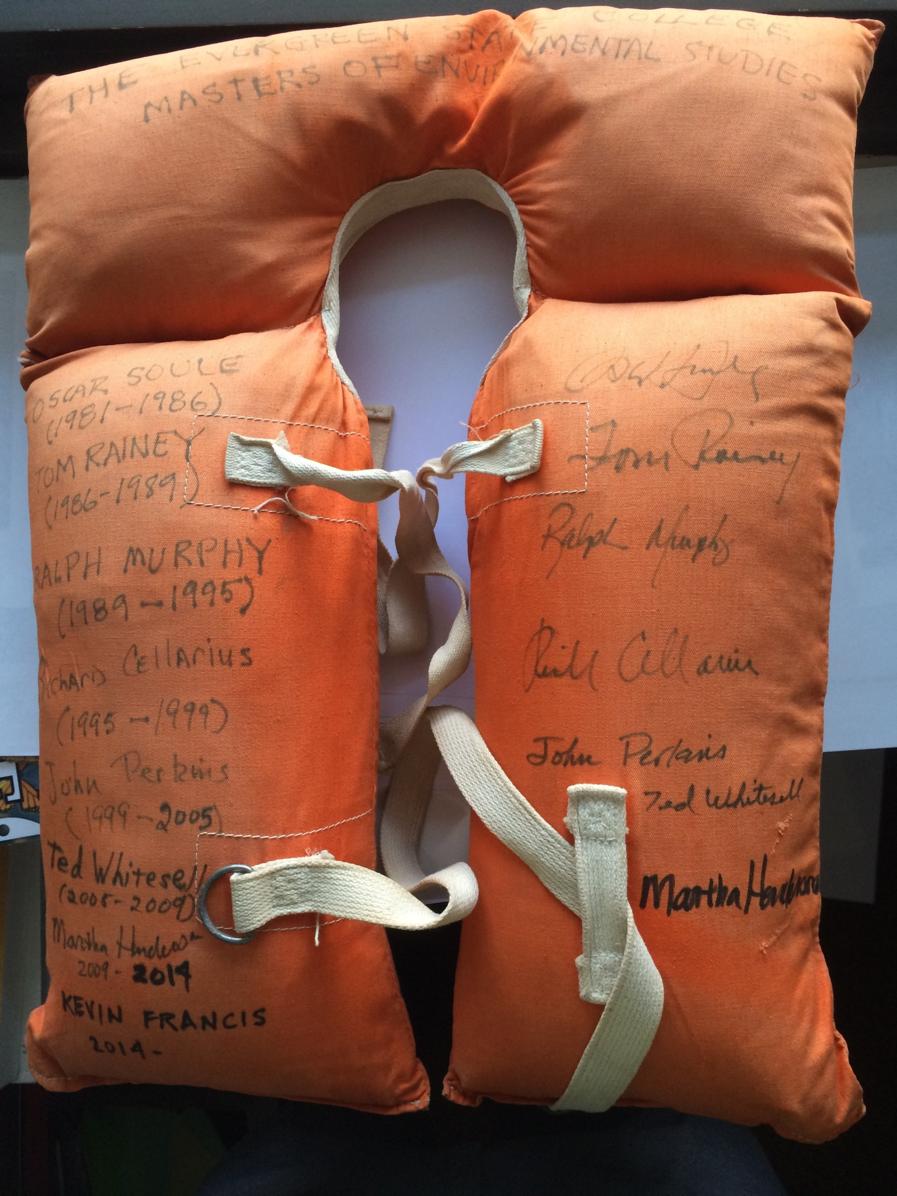
Data Visualization Label graphs and axes Work systematically through each visualization: This graph shows… On the X axis… On the Y axis… Make sure to notice… (Remember: You’ve been looking at these graphs for weeks or months. Your audience is seeing them for the first time!)
MES Directors (1981-2020)
Director and Reign (BCE)
Printed Cursive

Slide 7
Reminders for Presentation
Write presentation and practice to make conversational…or…create outline and practice to create focused and efficient delivery
Practice alone and with audience (peer reviewers, faculty reader, friends without prior knowledge of subject)
Time your presentation
Other suggestions?
We’ll do practice presentations on May 18 Thesis Workshop
Contact Averi/Kevin to schedule practice for in-person presentation (Note: Averi out-of-office May 15-19)

