Slide 1
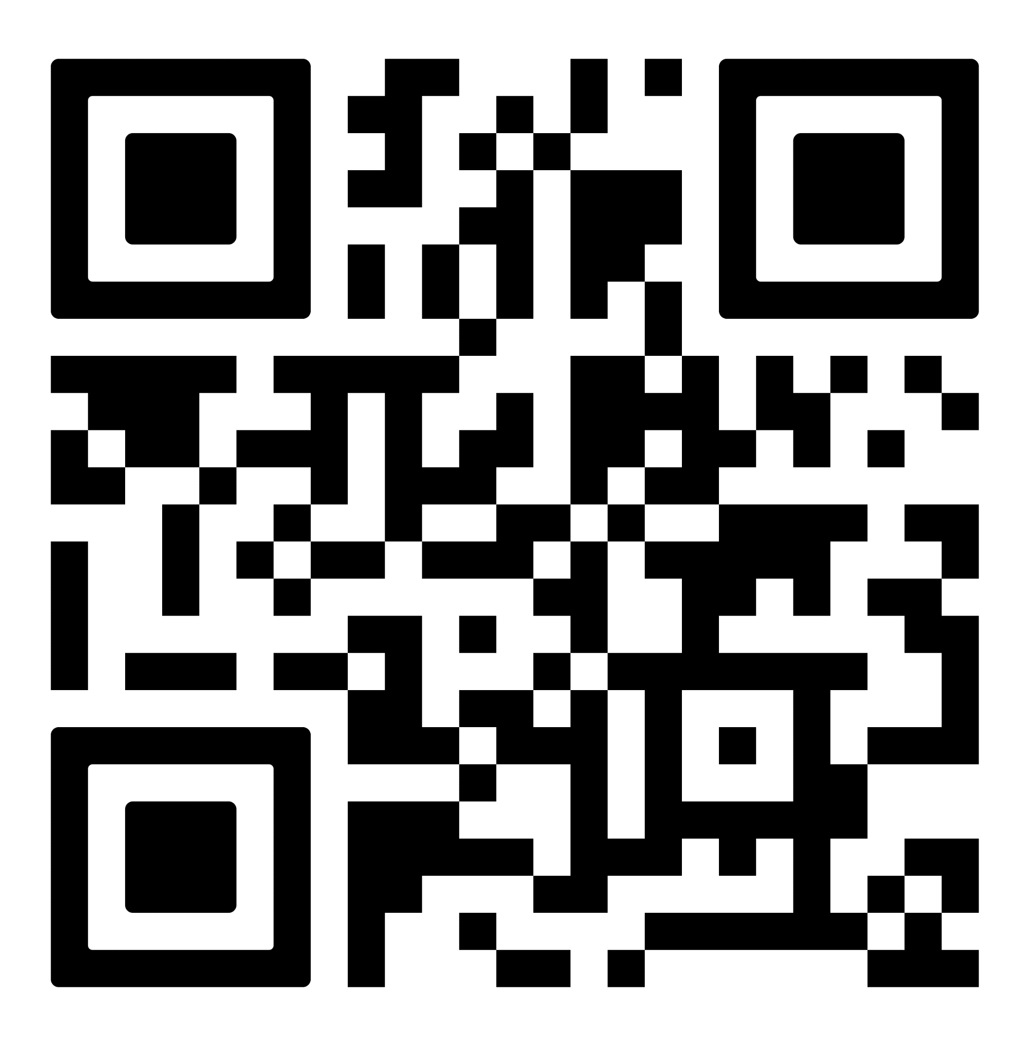
Sign up for MES Email Updates!
Scan me!

