Slide 1
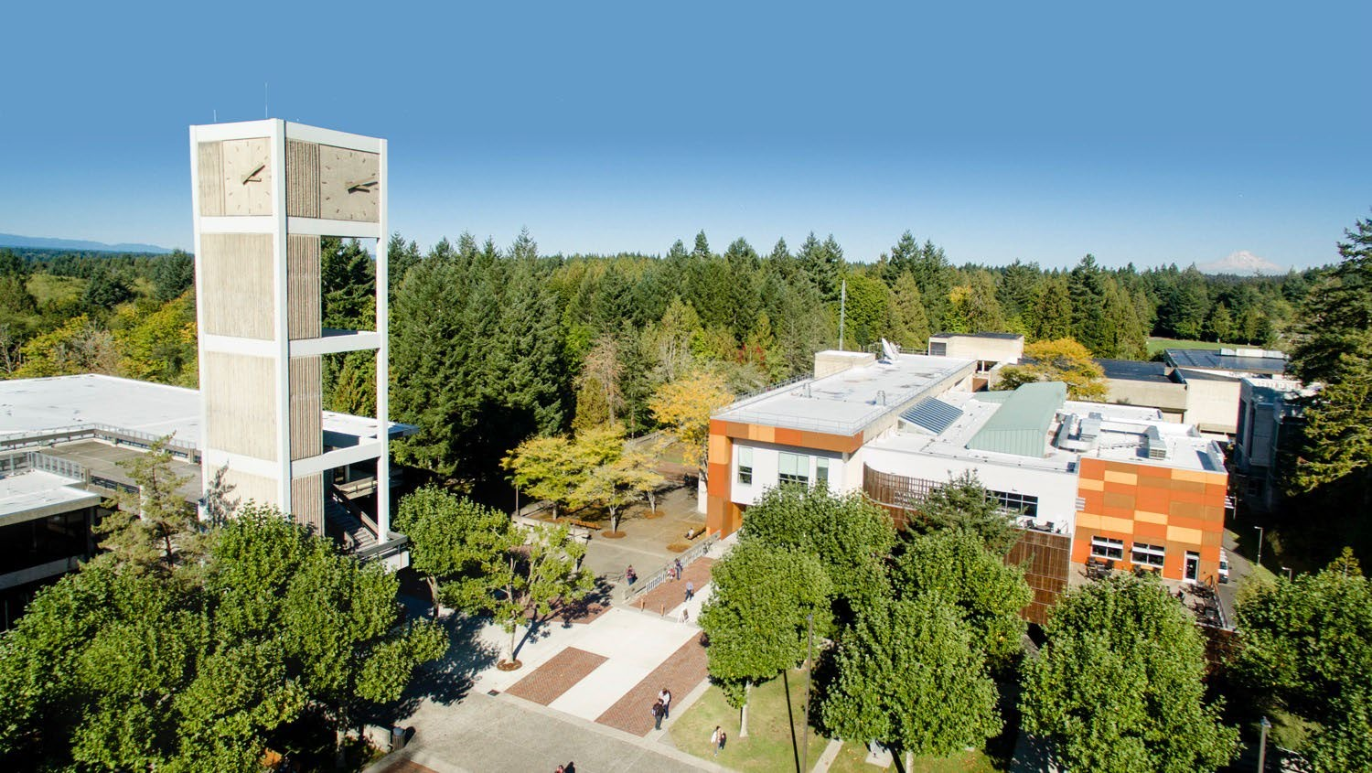
Scholarships and Funding Resources!

Slide 2
Finding scholarships

Slide 3
MES scholarships: evergreen.awardspring.com
Professional organizations
Solid Waste Association of North America
https://swananw.org/scholarships/
Washington Lakes Protection Association Scholarships:
https://www.walpa.org/scholarships_awards/
Banks and credit unions
Where to look
Foundations and civic groups
Scholarship search engines
https://www.environmentalscience.org/scholarships#
Be aware of scholarship scams!

Slide 4
Merit-based
Types of scholarships
Need-based
Interest-based

Slide 5
$12,795 for 2 Academic Years – 2 Awards Available
Offered on behalf of The Evergreen State College Foundation, the Sara Ann Bilezikian Memorial Fellowship is an award offered to students who demonstrate commitment to social justice and environmental improvement. Sara Bilezikian believed in and was an advocate for peace, human rights, and a safe environment. Recipients of this endowment fund will share these beliefs and plan to implement them either through their careers or through the life they will live. Preference for this award will be given to Washington State residents.
Additional Requirements
All Applicants: Please upload an essay of no more than 500 words explaining your commitment to social justice and environmental improvement.
US Applicants: FAFSA received by Evergreen's Financial Aid Office by April 1st
Undocumented Applicants: WASFA received by Evergreen's Financial Aid Office by April 1st
International Applicants: Financial Need Statement submitted with MES Scholarship Application
MES Awards
Sarah Bilezikian Graduate Fellowship

Slide 6
$1,166 for 1 Academic Year – 1 Award Available
Offered on behalf of The Evergreen State College Foundation, this scholarship is intended for an MES graduate student.
Additional Requirements
Merit-based, not interest or need-based
MES Awards
Alumni and Friends Fellowship

Slide 7
$500 for 1 Academic Year – 1 Award Available
Offered on behalf of The Evergreen State College Foundation, this scholarship is intended for a second, third, or fourth year MES graduate student who has not yet taken thesis credits. Preference is given to applicants who have demonstrated financial need, and those who have completed the first three core classes, two electives, and reached candidacy.
MES Awards
Emory Pyle Scholarship

Slide 8
$6,500 for 1 Academic Year – 2 Awards Available
Offered on behalf of The Evergreen State College Foundation, this scholarship is intended for a new MES graduate student. Applicants cannot be residents of the state of Washington.
MES Awards
Evergreen Foundation Graduate Fellowship

Slide 9
$1,329 for 1 Academic Year – 4 Awards Available
Offered on behalf of The Evergreen State College Foundation, this scholarship is intended for a second, third, or fourth year MES graduate student who has not yet taken thesis credits. Applicants must demonstrate financial need. Preference is given for academic merit, and to students who have completed the first three core classes, two electives, and have reached candidacy. Important Information: this is a tuition award. Tuition Awards listed are a waiver of a student’s tuition. A recipient of a tuition award cannot receive funding in excess of the cost of full-time graduate tuition. In addition, a recipient of a tuition award cannot use the funding for any of the study abroad consortium agreements.
Additional requirements
US Applicants: FAFSA received by Evergreen's Financial Aid Office by April 1st
Undocumented Applicants: WASFA received by Evergreen's Financial Aid Office by April 1st
International Applicants: Financial Need Statement submitted with the MES Scholarship Application
MES Awards
Graduate Fellowship Trust

Slide 10
$1,000 for 1 Academic Year – 2 Awards Available
Offered on behalf of The Evergreen State College Foundation, this scholarship is intended for an incoming MES graduate student. This scholarship was established by friends and family of Randy Ray, a graduate of Evergreen's Master of Environmental Studies Program. Preference is given to applicants with demonstrated financial need.
Additional Requirements
All Applicants: Please upload an essay of no more than 250 words explaining your interest in pursuing environmental policy with an emphasis on economic and business impacts at the state and local levels.
US Applicants: FAFSA received by Evergreen's Financial Aid Office by March 1st
Undocumented Applicants: WASFA received by Evergreen's Financial Aid Office by March 1st
International Applicants: Financial Need Statement submitted with MES Scholarship Application
MES Awards
Randy Ray Memorial Scholarship

Slide 11
$1,800 for 1 Academic Year – 5 Awards Available
Offered on behalf of The Evergreen State College Foundation, this scholarship is intended for an MES graduate student who has completed one year or more of AmeriCorps service.
Important Information: this is a tuition award. Tuition Awards listed are a waiver of a student’s tuition. A recipient of a tuition award cannot receive funding in excess of the cost of full-time graduate tuition. In addition, a recipient of a tuition award cannot use the funding for any of the study abroad consortium agreements.
Additional Requirements
Service letter from AmeriCorps showing dates of service.
MES Awards
AmeriCorps Education Award

Slide 12
Applying for a scholarship

Slide 13
First complete the application in Award Spring and be sure to indicate that you will be a graduate student in the 2024-2025 academic year and then select your program, Master of Environmental Studies from the drop down menu.
We are using a common application with the other graduate programs and the undergraduate scholarship office so there is no MES-specific scholarship application, and the above qualifying questions will allow you to be routed to the MES awards specifically.
Application Process

Slide 14
Application Essay(s) give you an opportunity to describe your educational goals, and your compatibility with the goals and values of the scholarship award. You may also need to define your need, merits, or interests.
Application Essay(s)

Slide 15
For MES scholarship-specific essays: write one letter that responds to each element of the prompt, as they apply to you.
Use: plain, white, printer paper, a text size of 11 pt or 12 pt, and a common, standard font like Arial or Times New Roman.
MES Scholarship-specific essays have specific word count maximums, please refer to their criteria word count for each specific award that requires an essay.
For external scholarships: write separate letters for each scholarship.
Keep copies of your applications and essays.
Format & General Tips

Slide 16
The MES Scholarship application opened on February 1st, and closes on March 15th at 11:59 pm.
Make sure all scholarship requirements are complete by this deadline, such as uploading scholarship-specific essays or AmeriCorps services letters for example.
Important Deadlines
Make sure to complete your FAFSA or WASFA if you have not already done so for the 2024-2025 academic year.
Deadlines vary greatly for external scholarships

Slide 17
Scholarships through WASHPIRG: https://washpirgstudents.org/chapters/evergreen/
Funding through the Seattle Foundation:
https://www.seattlefoundation.org/current-scholarship-opportunities/
External Funding Resources List curated by MES:
https://www.evergreen.edu/mes/external-fellowships
External Funding Resources

Slide 18
WICHE Eligible Regions for Western Regional Graduate Program
Awarded during admissions process
U.S. Pacific Territories and Freely Associated States
Commonwealth of the Northern Marianas Islands
Guam
Republic of the Marshall Islands
Federated States of Micronesia
Republic of Palau
2023-2024 Tuition Rates
Resident: $12,402
Nonresident: $28,782
WRGP: $19,503

Slide 19
To qualify for either waiver, you must be:
A permanent WA State employee
Employed half-time or more in one of the following:
Classified service under chapter 41.06 RCW
Classified employee or exempt paraprofessional of a technical college
Faculty member, counselor, librarian, exempt professional or administrative employee at an institution of higher education as defined in RCW 28B.10.016
Teacher or other certified instructional staff employed at public common and vocational schools
Classified staff employed at a public common school as defined in RCW 28A.150.020, when used as part of a teacher preparation program or which is relevant to their work assignment
https://www.evergreen.edu/registration/registering-waiver
WA State Employee Tuition Waivers
MES can offer 2 waivers this summer for students enrolled 2024-2025

Slide 20
Employee 50% Operating Fee Tuition Waiver
4 Waivers for MES students each year!
Application process in Summer:
1. Complete tuition waiver signed by their HR departments
2. Submit 250 Professional Development Essay
Must be taking at least 8 credits per quarter and certify before registering each quarter.
Full Tuition Waiver Up to 4 Credits
Take a 4-credit elective for a $100 administrative fee with a full tuition waiver.
Available Fall, Winter, and Spring Quarters for matriculated and non-matriculated students.
On first day of the quarter, register with the waiver by:
1. Submitting faculty permission for the chosen course
Registration Add/Drop form
2. And completed Washington State Employee Tuition Waiver Request form signed by your Human Resources Department
WA State Employee Tuition Waivers
Summer application process for 50% Waivers

Slide 21
Writing Process

Slide 22
Brainstorm on your educational goals, previous history, and your values
Draft out a letter
Revise your letter asking yourself how your audience would respond. Is it easy to understand? Does it respond to what they need to know?
Edit your letter to ensure that each sentence is complete, clear, and compelling
Proof read your application for errors
Submit!
If you receive the scholarship: Send a thank you note
Letters of application writing process

Slide 23
How long will it take you to do each step? Consider starting with budgeting one hour per step.
Identify the scholarships
Brainstorm
Draft
Revise
Edit
Proof read
Submit!
If you receive the scholarship: Send a thank you note
Planning
ahead

Slide 24
Writing a compelling letter

Slide 25
Don’t look up other essays for content. Do tell your own story in the pattern that makes sense for it!
Don’t repeat information from other places in your application. Do use the space you have to the fullest!
Don’t be too modest or sell yourself short. Do trust that you are worthy of making this request!
Don’t write in a style that is unnatural for you. Do trust that your own voice will carry your story!
Don’t just list information about yourself. Do show the impacts, importance, and “why”s behind your most important claims and requests.
Scholarship Essays Do’s and Don’ts

Slide 26
Tell: I changed my mind about being an Engineer.
Showing: I changed my mind about being an Engineer after having to complete a robust project through a volunteer service learning program. The work was very isolating and I realized that I would prefer to work with people in a collaborative environment to solve complex issues.
Telling more: I did service learning with an Engineering firm and realized it wasn’t for me.
Show instead
of tell

Slide 27
Tell: My family was a big influence on me.
Telling More: I saw how hard my family worked to ensure that I did well in school.
Show instead
of tell, 2
Showing: After a full day of work, my mom made time every weeknight to help me with my homework and study for exams.

Slide 28
Does my essay:
Address the prompt and my educational goals?
Meet the length requirements?
Show instead of tell?
Application
Essay Revision Questions
Start with an attention grabber/hold the reader’s attention?
Stand out and showcase my story to the fullest?

Slide 29
Revision Questions for purpose, audience, tone, and theme:
Is my purpose in writing the letter clear?
How am I interacting with my audience?
What kind of mood/tone comes through? Professional? Casual? Kind? Artistic?
Are there any themes (overcoming hardship, commitment to an issue) that are coming through that could come through more?
More Application
Essay Revision Questions

Slide 30
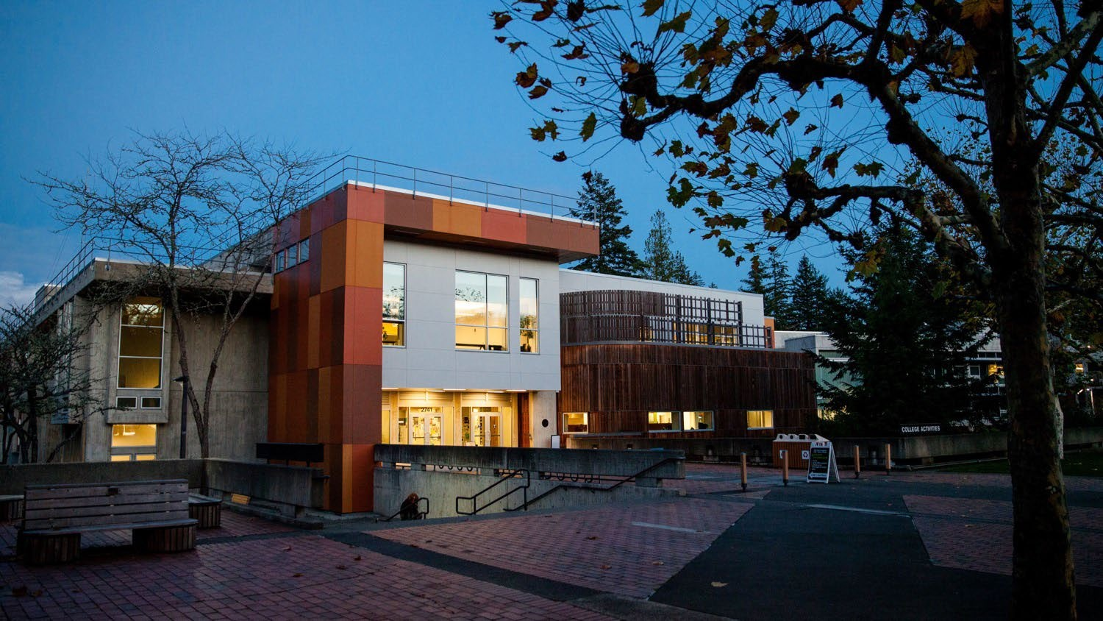
Thank You

