Slide 1
Notes:
Slide formats can be added to your presentation by selecting the “New Slide” option (shown above) and clicking on the desired template to be used in the overall layout. Color choices of green, blue, purple, and orange are available as options. They can be used together as a group (theme) or can be intermixed with one another. A blank page has also been added for importing photos or inserting unformatted text. A footer is also available for more traditional looking presentations.

Slide 2
Master of Environmental Studies
New Student Orientation
September 18th, 2021

Slide 3

Welcome & Program Overview
Faculty Introductions
gCORE Overview
Seminar: Victor and the Fish
Lunch Break!
Evergreen Resources
  Financial Aid
  Student Wellness Services
  First Peoples Multicultural, Trans & Queer
  Support Services
  Veterans Resource Services
Afternoon Snack Break
Current Student Panel
Closing Announcements & Reminders
Overview & Agenda

Slide 4

#1 worst team names
on TIME
#1 worst college mascot
ever to stroll a sideline by MSN Now.
#2 weirdest college mascot
on BuzzFeed
#7 weirdest college mascot
at Huffington Post
The geoduck is the world’s largest burrowing clam!
We have the BEST fight song!
Congratulations! You’re a Geoduck!
The word geoduck comes from the Lushootseed word gʷídəq, meaning “dig deep.” Geoducks stretch their siphons out up to three feet beneath the sand!

Slide 5
MES Handbook!
evergreen.edu/mes/current-students
It is your responsibility to read and understand the Handbook
The Handbook for 2019-20 is your handbook until you graduate. Always refer to this handbook with questions
Where do I go to…
Learn everything I need to know about MES policy and expectations?

Slide 6

Where do I go to…
Find the course catalog for the year?
See information about scholarship deadlines?
See my faculty’s office location or phone number?
Learn about current students, alumni, and other things happening in the program?

Slide 7
MES Website!
evergreen.edu/mes
Check out the handy side bar to find most of the information you’re looking for!
There is a WHOLE section for current students!

Slide 8
Where do I go to…
Update my address?
See the location of my classes?
Pay tuition and fees?
Register for classes?
Drop classes?
See my evaluations?
Write self and faculty evaluations?

Slide 9
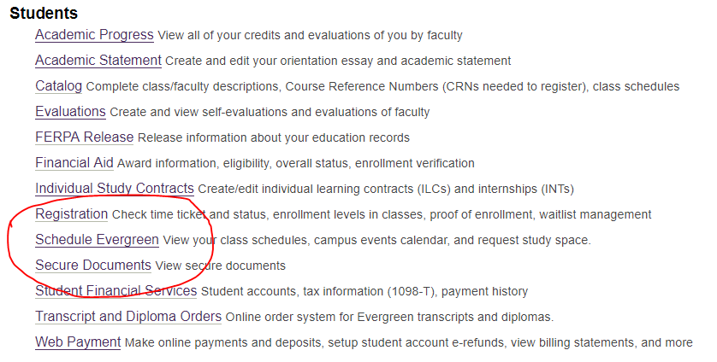
my.evergreen.edu!

Slide 10
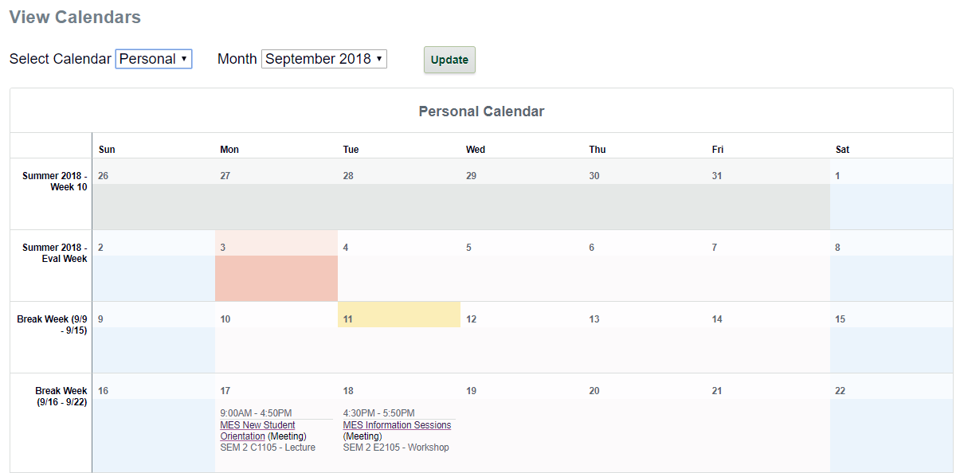
Schedule Evergreen - Find your class schedule and location!

Slide 11
What about…
Job and internship information?
Upcoming event information?
Updates on conferences, funding, webinars, free things for students, etc.?

Slide 12
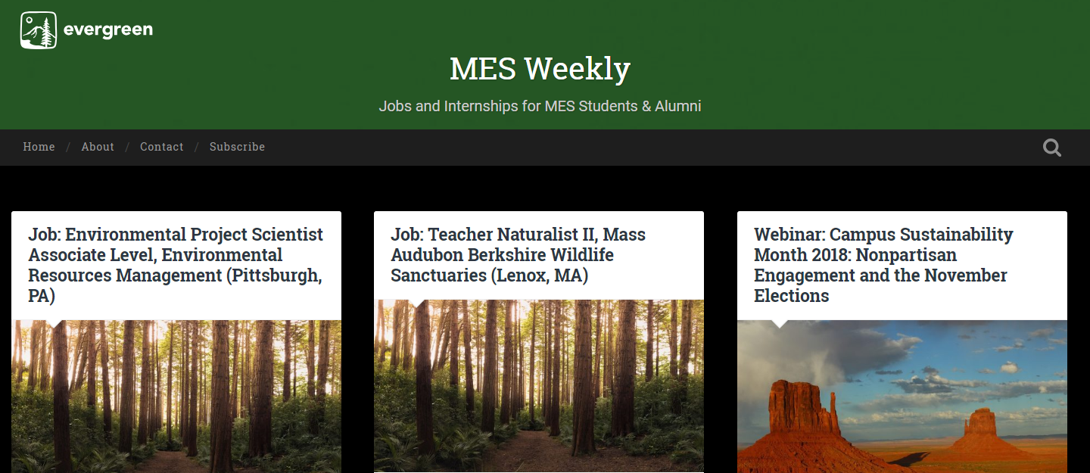
MES Weekly!
blogs.evergreen.edu/mesweekly

Slide 13
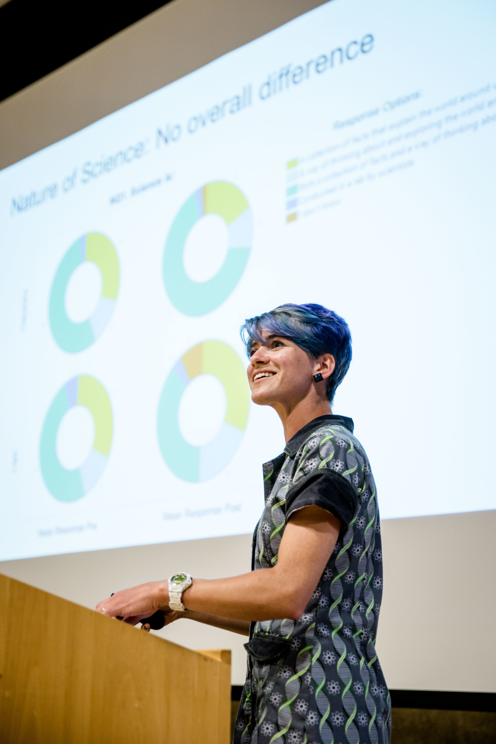
72 total credits
32 from Core classes (Tue/Thu)
  3 classes first year
  1 class Fall of final year
24 from Electives (8 must be MES electives)
  Up to 8 internship or
  Independent Learning Contracts
  Up to 8 MPA credits
  Up to 8 transfer credits
  (including special summer courses)
16 from Thesis
  Winter and Spring of final year
Curriculum

Slide 14
Registration Details
Waitlists
  Freeze 4pm Fri of week before quarter (9/27)
  Ask faculty to overenroll or wait and see if you get in due to people dropping
Deadlines
  Online – 4pm Fri of week before quarter
  Week 1 – faculty override required
  Add/drop by 4pm Friday of Week 1 (10/4)
Immunizations
  Turn into Registration or Health Center
  Will have hold on account Winter quarter
  if not received

Slide 15
Financial Aid Details
Check my.evergreen.edu for total awards
Tell Financial Aid office if taking more or less than 8 credits
Can request increase in loans for:
  Travel (more than 30 mi RT)
  Family care
  Computer
  Additional academic expenses
- Can apply for loans at any time
- Can accept or reject loans at any time
Excess checks sent out Day 1

Slide 16
Other Aid Opportunities
Outside scholarships – will email out and online
February 1: deadline for FAFSA and MES-specific scholarships for 20-21 school year
- MESA professional development funding (PDF)
- Research grants (on and off campus opportunities)
- Emergency loans
- Payment plan – pay per month

Slide 17
Access Services
Please complete a Request for Services Form BEFORE the quarter begins. This form must be completed each quarter.
Services include:
Accessible parking
Alternative testing
Note takers
Sign language interpreters
And more!

Slide 18
Other Resources
Graduate Writing Assistant:
evergreenwritingassistant@gmail.com
Current graduate student that can help with many stages of writing process. Will visit gCORE!
MESA:
Plans events and gatherings for MES students
A funding resource for research and professional development

Slide 19



Communication from MES
Please check your Evergreen email
  Regular emails from Andrea/Kevin
  Emails from faculty through Canvas
Join the MES 2019 Cohort Facebook Group

Slide 20
Diversity, Equity, and Inclusion in MES

Slide 21
All of you have joined MES to become leaders and professionals in the environmental sector, one of the most important aspects of leadership is ensuring all members of your community feel valued, safe, and included in conversations and decision making
Communicate community expectations for all students in the program
To create cooperative and collaborative community
Not all histories have experienced the same representation in academia or in the workplace and it’s important to elevate those underrepresented histories in environmental fields and movements
Expanding the collective perspectives which influence environmental work, so that all perspectives are included equally
Why are we talking about DEI?

Slide 22
“When we define ourselves, when I define myself, the place in which I am like you and the place in which I am not like you, I am not excluding you from the joining, I am broadening the joining.”
– Audrey Lorde
Sister Outsider

Slide 23
Ground Rules and Expectations:
What do we need to create a brave space and a safe space?

Slide 24
Describe a time when you felt excluded based on your identity.

Slide 25
Explicit and Implicit Bias
Microaggressions
Personal Pronouns
Student Conduct
  Seminar Discussions
  Inside and outside of class
Key Concepts

Slide 26
Access: Equal and equitable opportunities for students to take full advantage of their education.
Diversity: Individual differences (e.g., personality, prior knowledge, and life experiences) and group/social differences (e.g., race/ethnicity, class, gender, sexual orientation, country of origin, and ability as well as cultural, political, religious, or other affiliations). [AAC&U].
Equity: Opportunities for all students to have equal access to and take part in educational programs that can close achievement gaps in student success and completion. [AAC&U]
Inclusion: Active, intentional, and ongoing engagement with diversity in ways that increase awareness, content knowledge, cognitive sophistication, and empathic understanding of the complex ways individuals interact within systems and institutions. [AAC&U]
Inclusive Excellence: An active process through which colleges and universities achieve excellence in learning, teaching, student development, institutional functioning, and engagement in local and global communities.
Key Terms
Part 1

Slide 27
Inclusive Excellence: An active process through which colleges and universities achieve excellence in learning, teaching, student development, institutional functioning, and engagement in local and global communities. Requires uncovering inequities in student success, identifying effective educational practices, and building such practices organically for sustained institutional change. [AAC&U]
Intercultural Knowledge and Competence: A set of mental, emotional, and behavioral skills and qualities that support effective and appropriate interaction in a variety of cultural contexts. Demonstrated through self-evaluation and self-critique, a desire to fix power imbalances where none ought to exist, and the development of partnerships with people and groups who advocate for others. [Bennett, J. M. 2008. Transformative training: Designing programs for culture learning. Contemporary leadership and intercultural competence, ed. M. A. Moodian. Thousand Oaks, CA: Sage.]
Cultural Humility: A process-focused interpersonal attitude that is open to the aspects of cultural identity that are most important to others. Demonstrated by a commitment to self-evaluation and self-critique, a desire to fix power imbalances where none ought to exist, and the development of partnerships with people and groups who advocate for others. [Tervalon, M. and Murray-Garcia. 1998. Cultural humility versus cultural competence. Journal of Health Care for the Poor and Underserved.]
Cultural Wealth: An array of knowledges, skills, abilities and contacts possessed and used by Communities of Color to survive and resist racism and other forms of oppression. (Yosso 2005)
Key Terms
Part 2

Slide 28
Evergreen Resources

