Slide 1
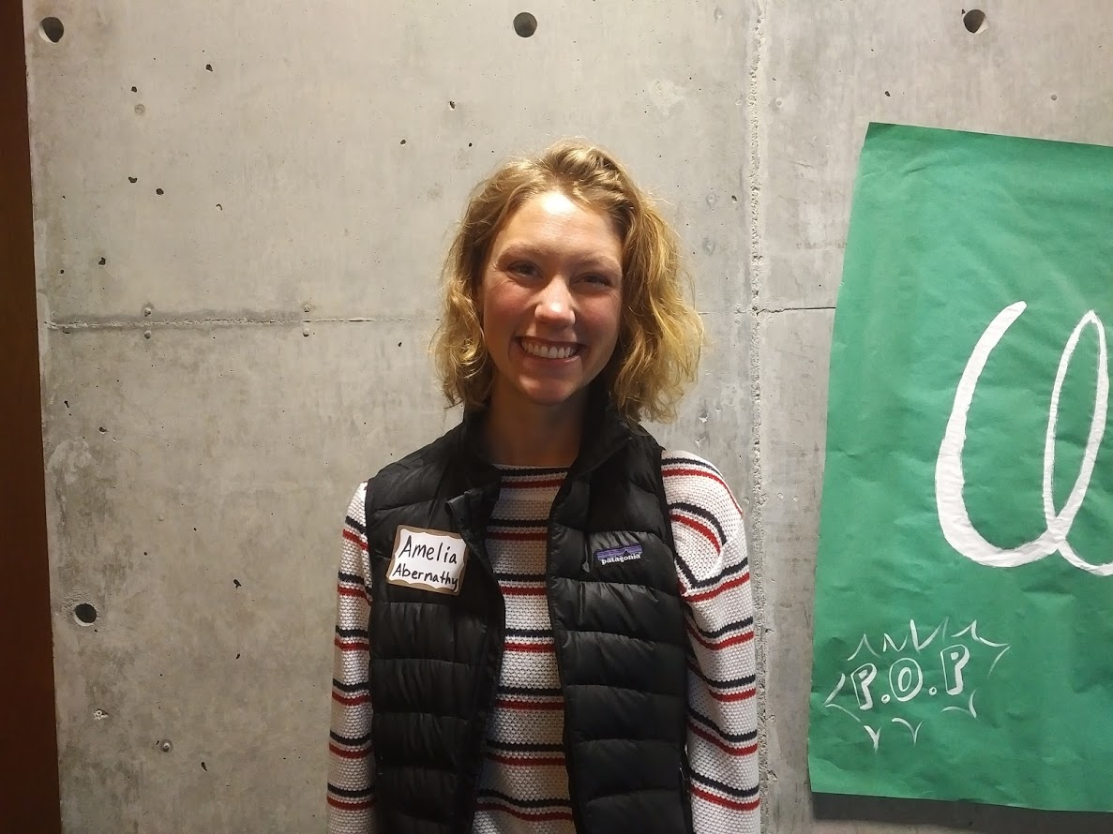
Amelia Abernathy

Slide 2
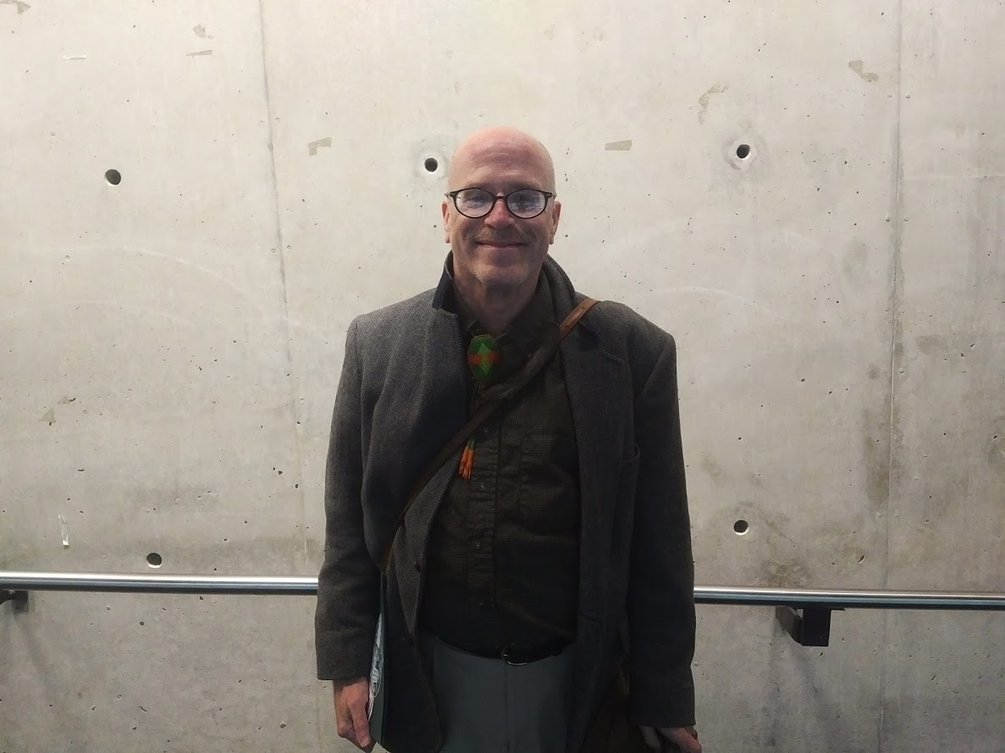
Daniel (Dan) Alden

Slide 3
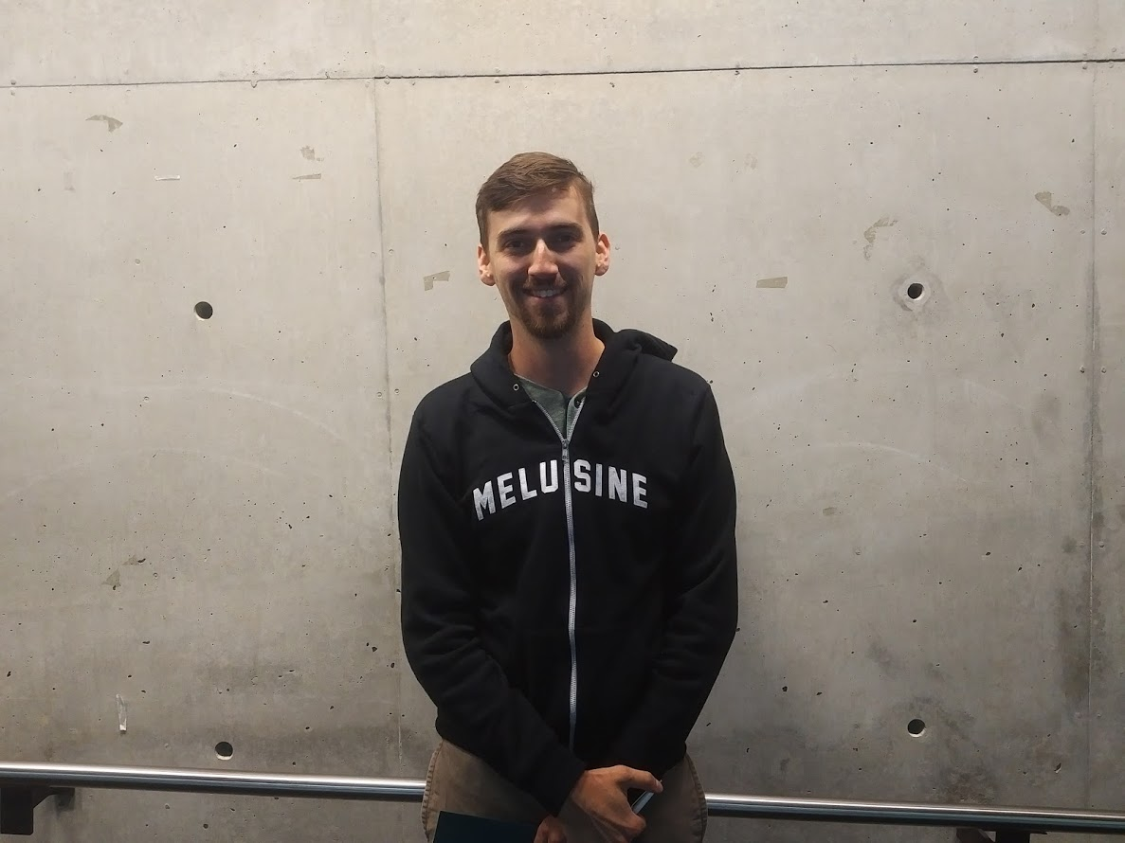
Timothy (Tim) Atkinson

Slide 4
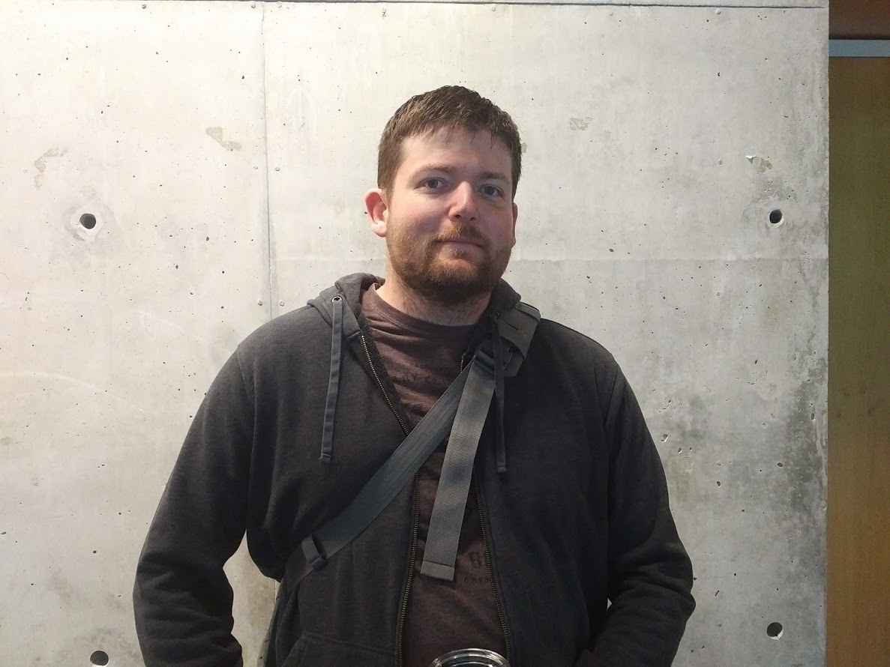
James Blacklaw

Slide 5
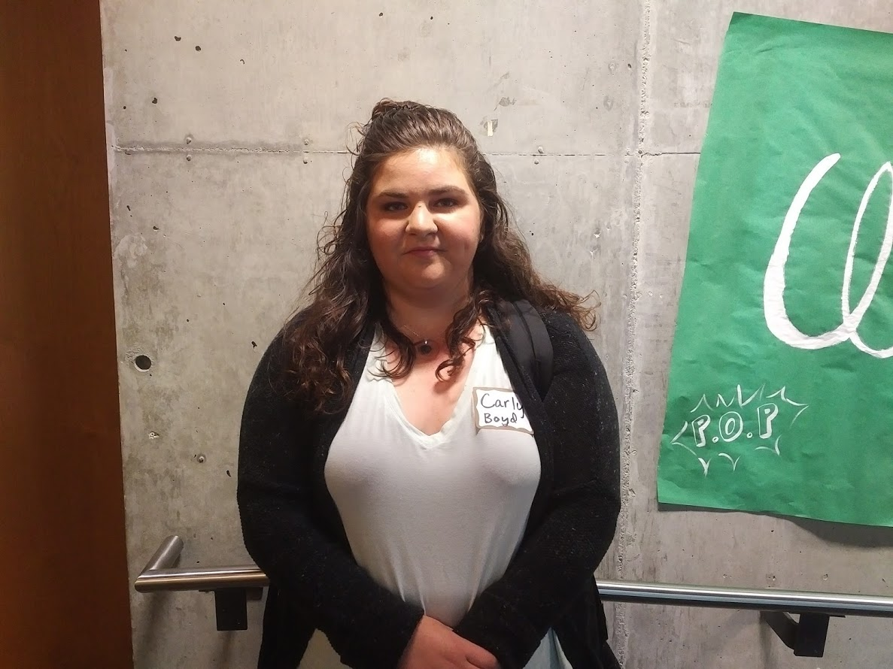
Carly Boyd

Slide 6
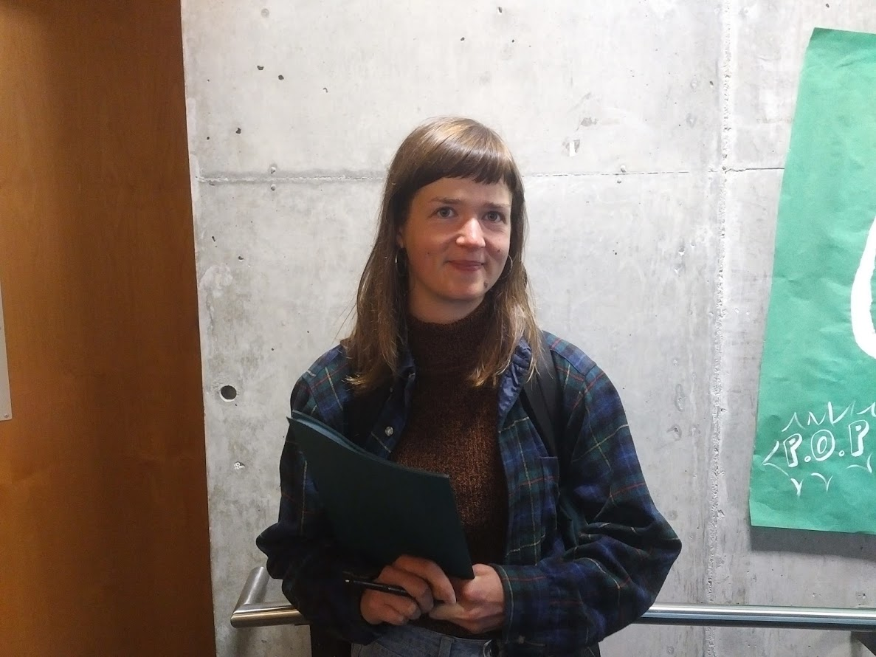
Hanna Broback

Slide 7
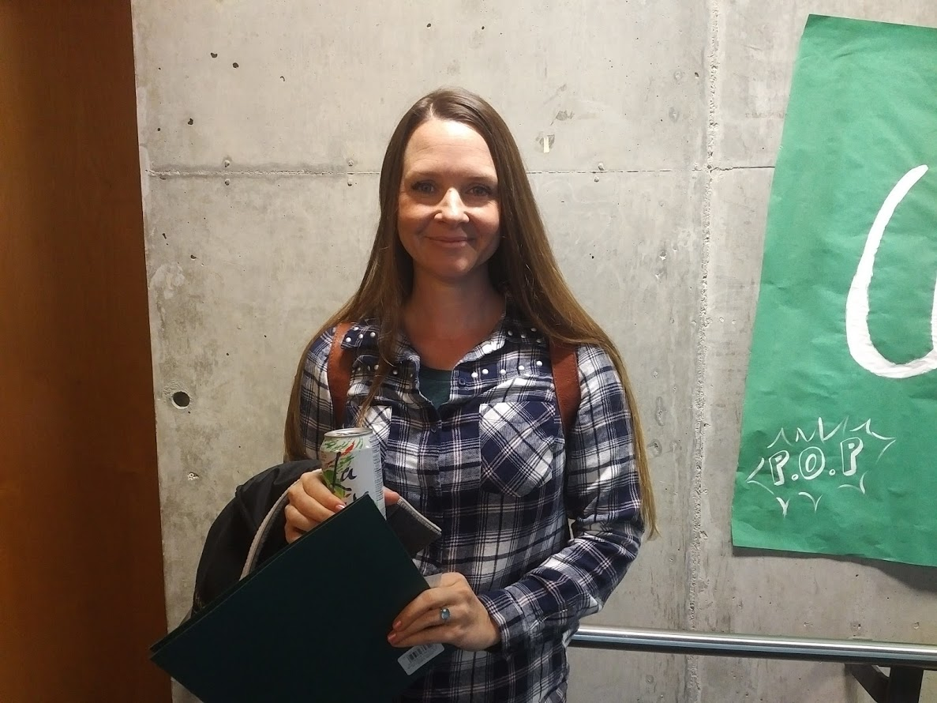
Gennifer (Genni) Brookshire

Slide 8
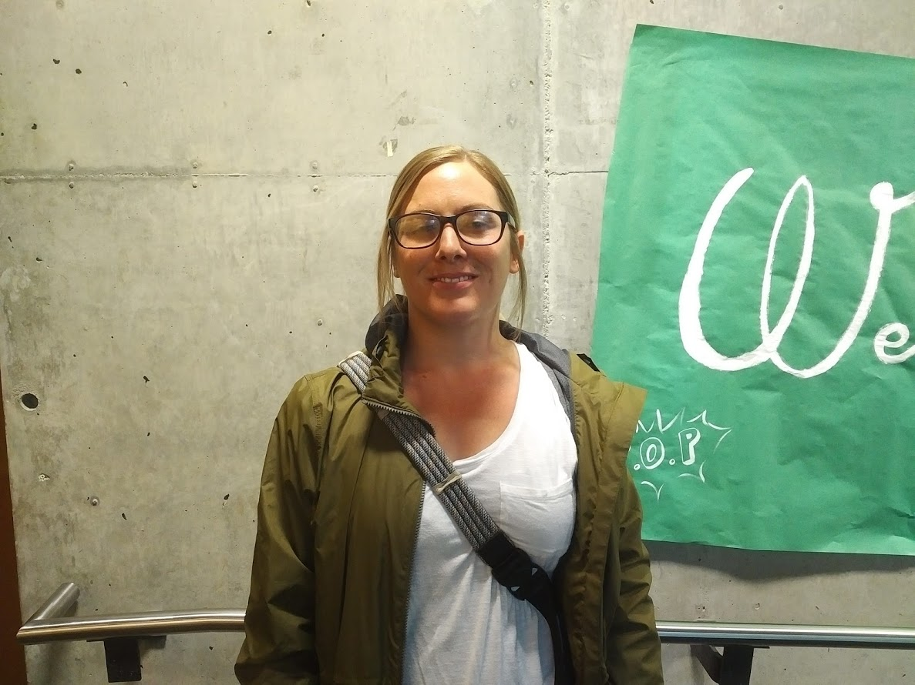
Megan Bungum

Slide 9
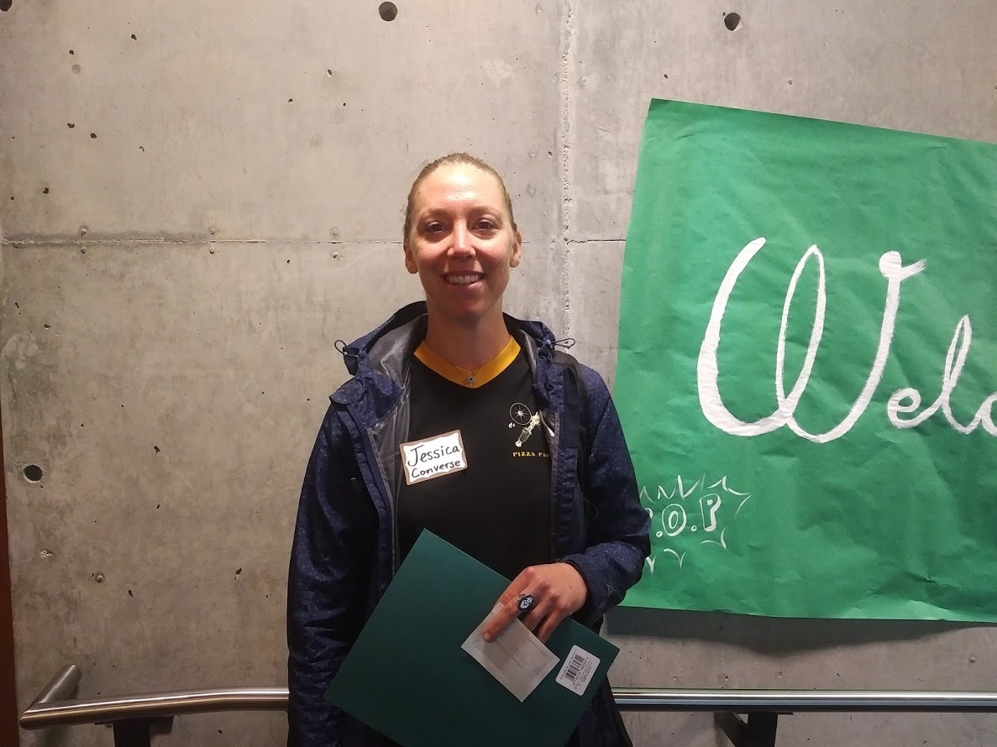
Jessica Converse

Slide 10
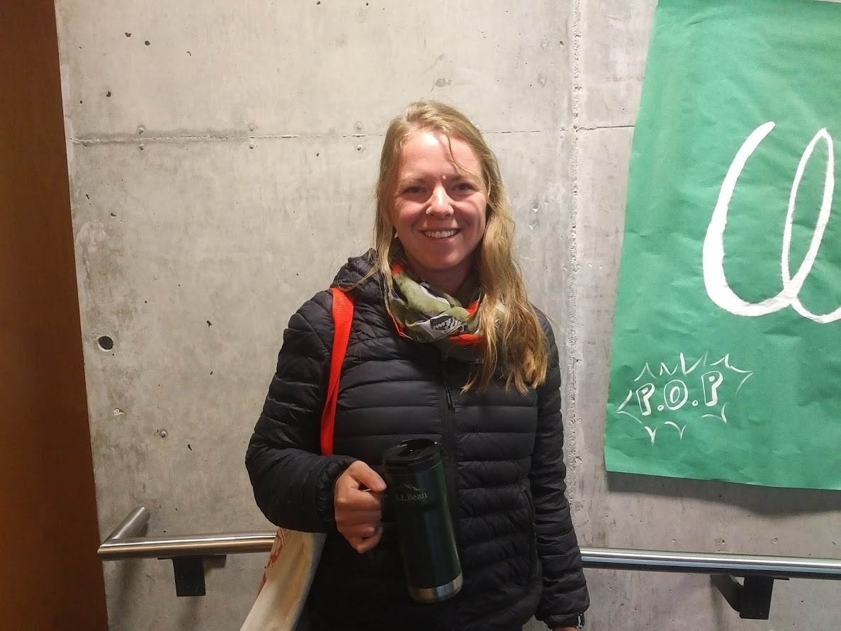
Sarah Croston

Slide 11
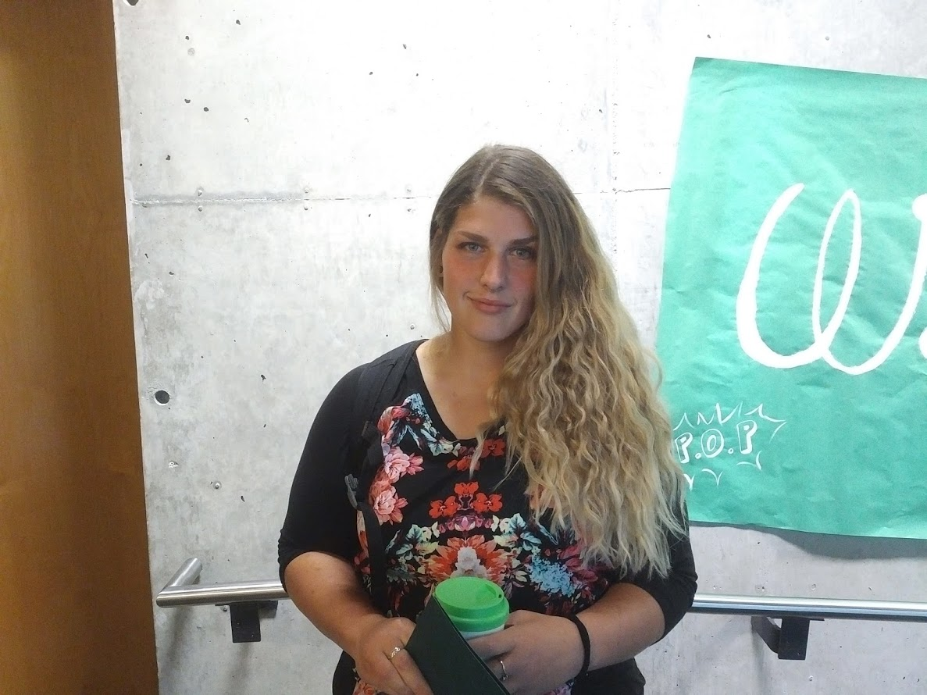
Danika Davis

Slide 12
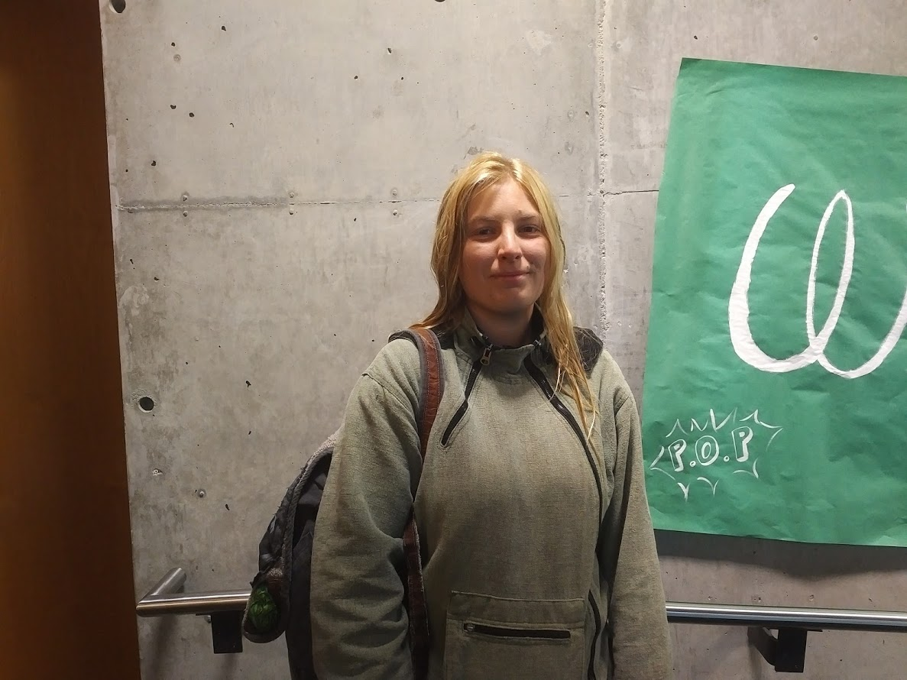
Alyssa Estes

Slide 13
Not Pictured:
Marina Glisic
Jonathan Grell

Slide 14
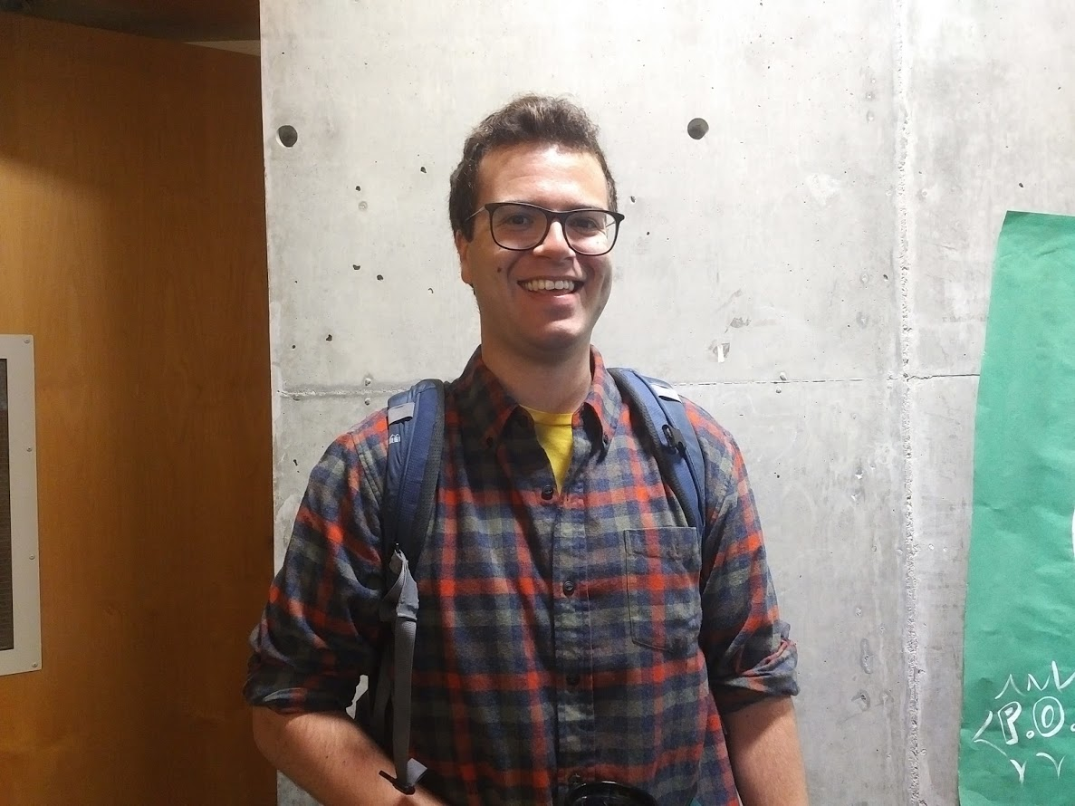
Robert (Bobby) Hall

Slide 15
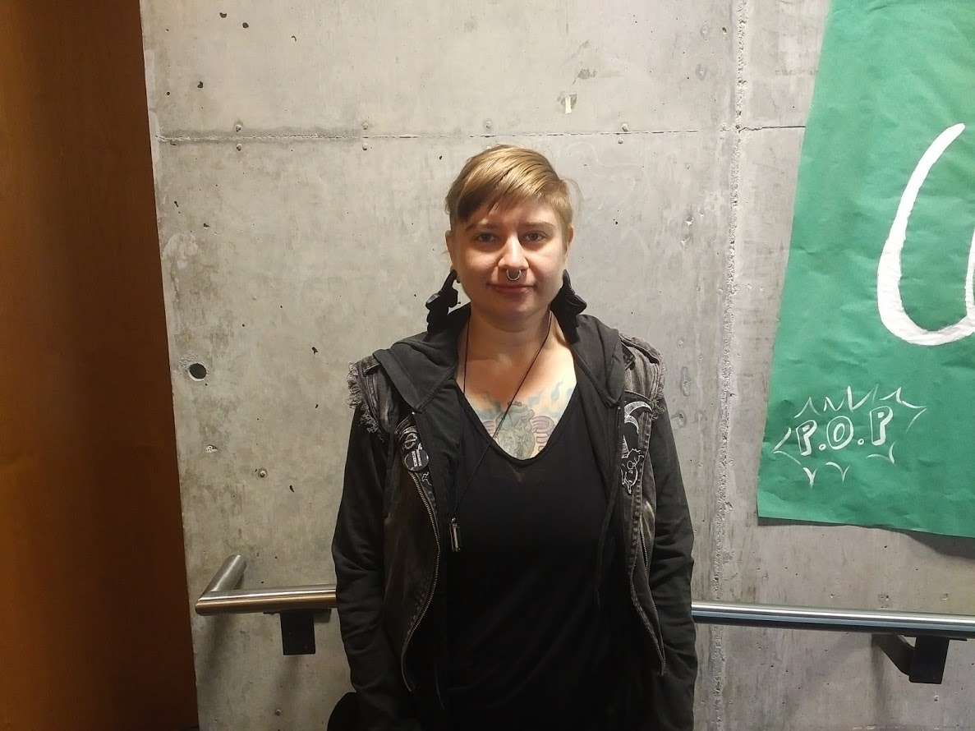
Kris Hill

Slide 16
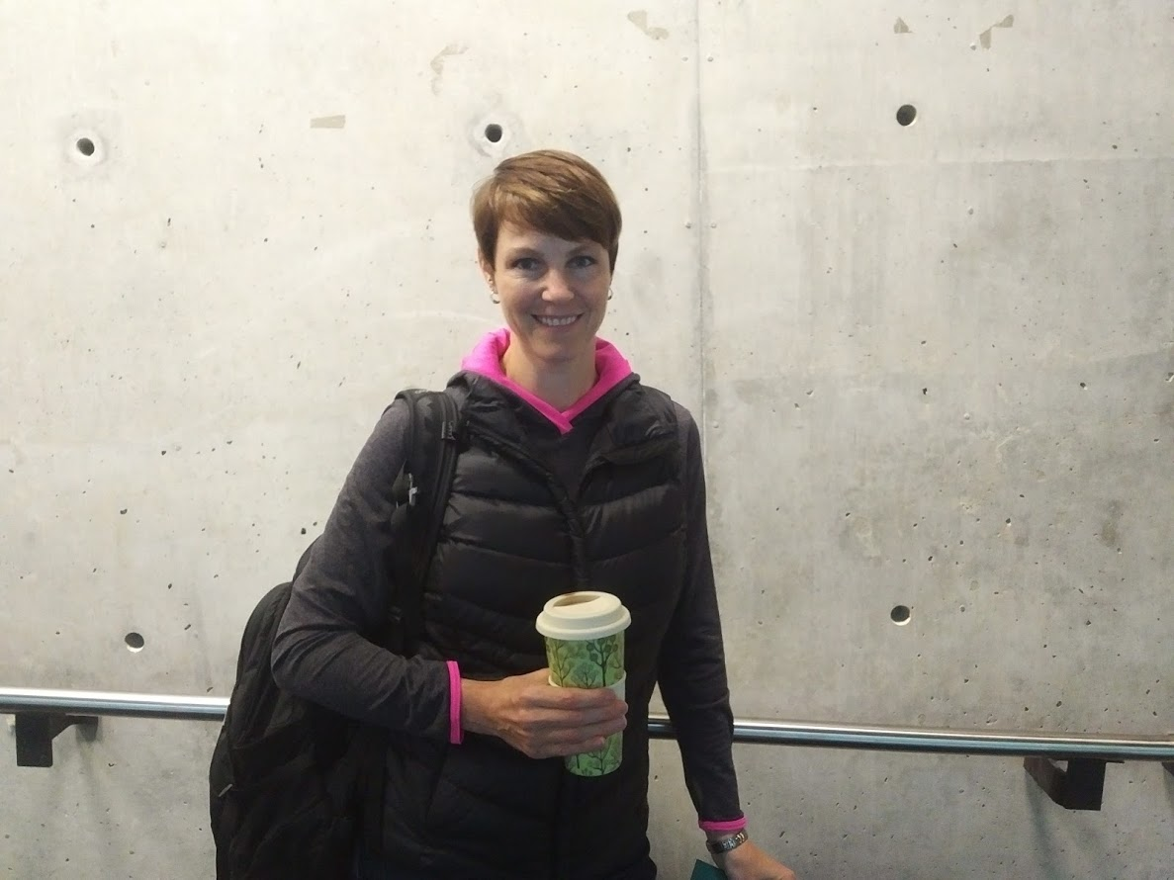
Lisa Hillier

Slide 17
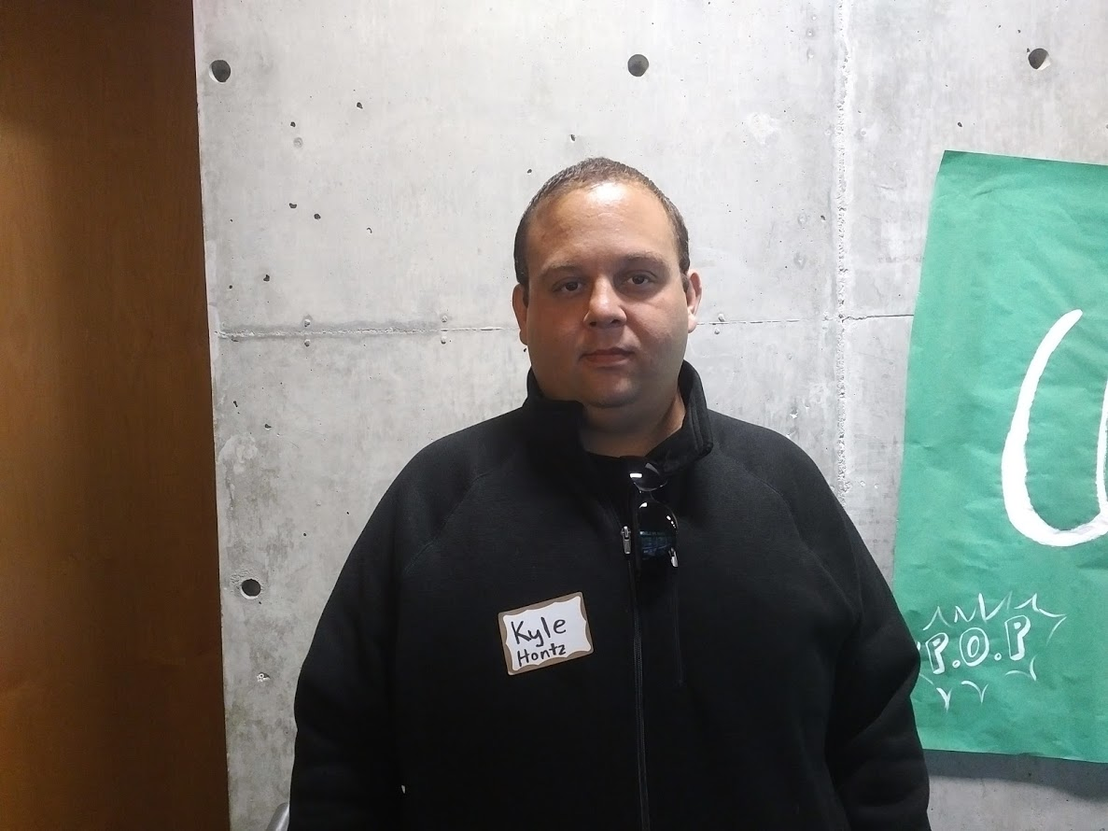
Kyle Hontz

Slide 18
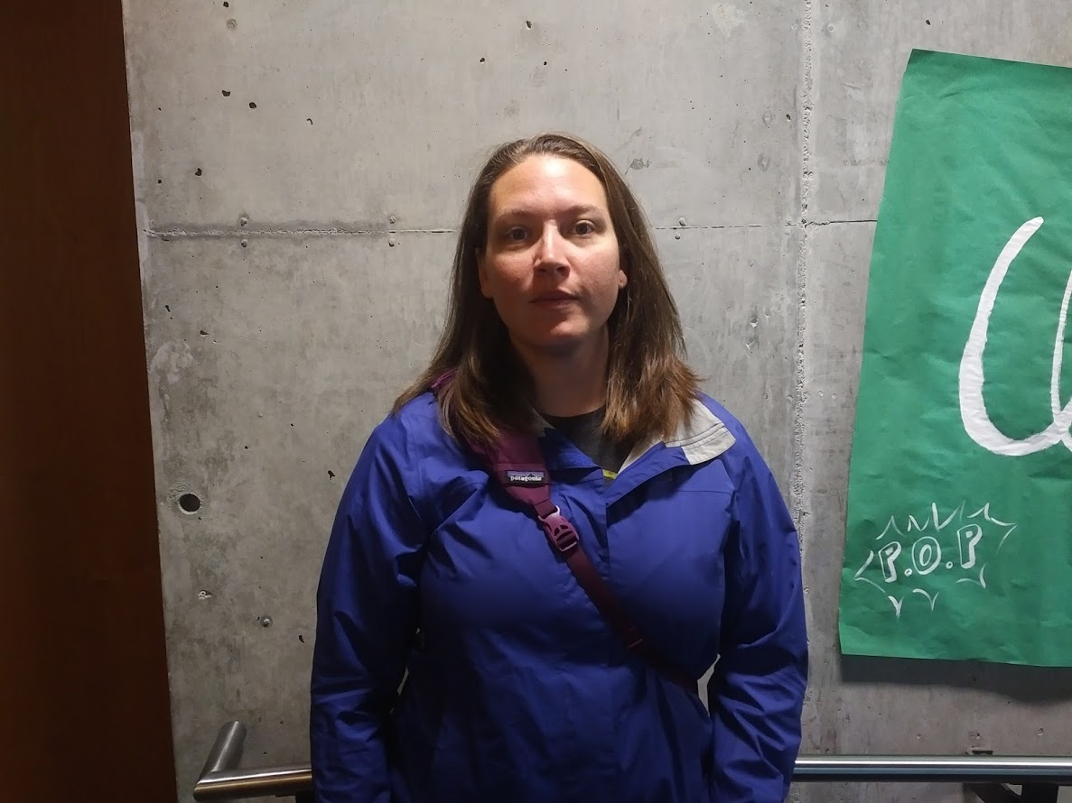
Brandie Horn

Slide 19
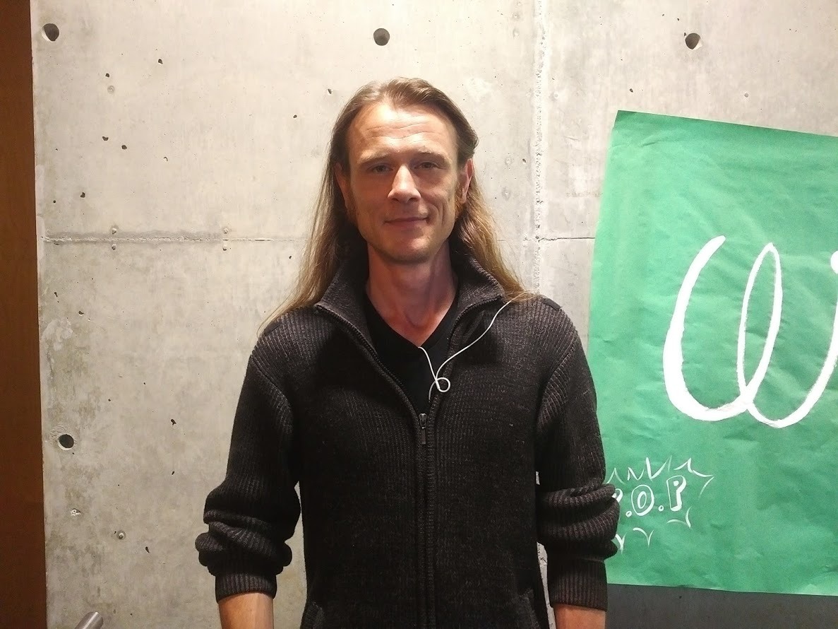
Matthew (Matt) Knox

Slide 20
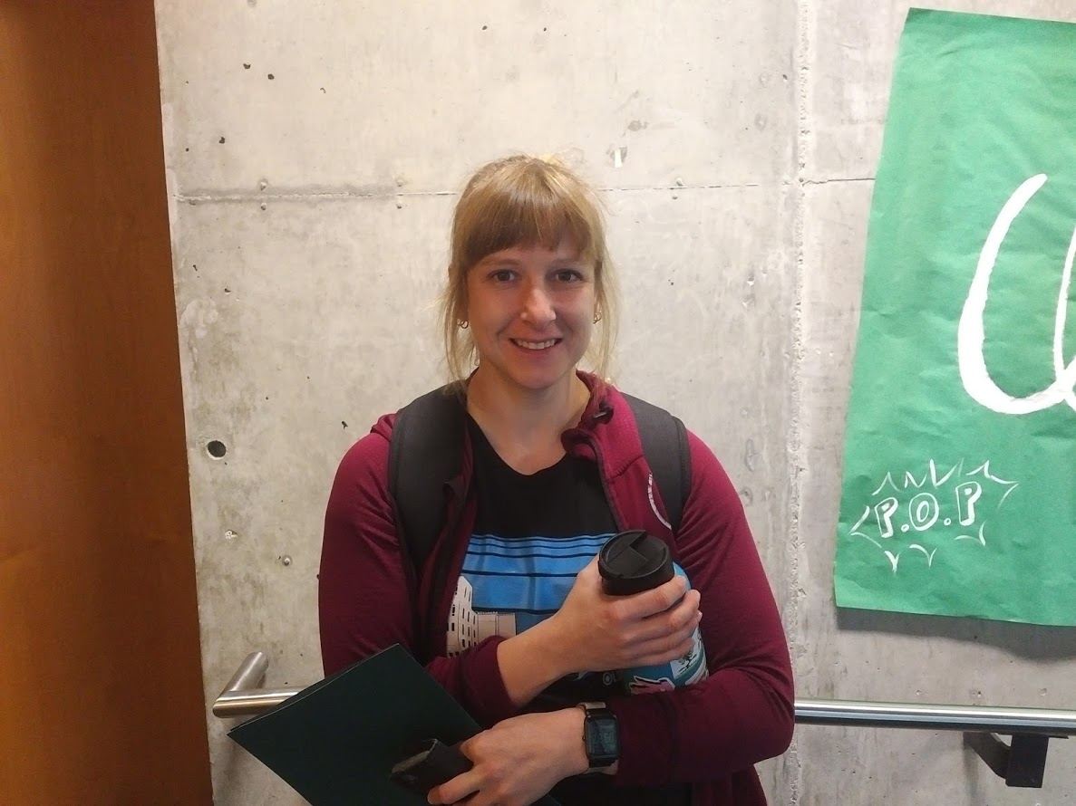
Erika Larson

Slide 21
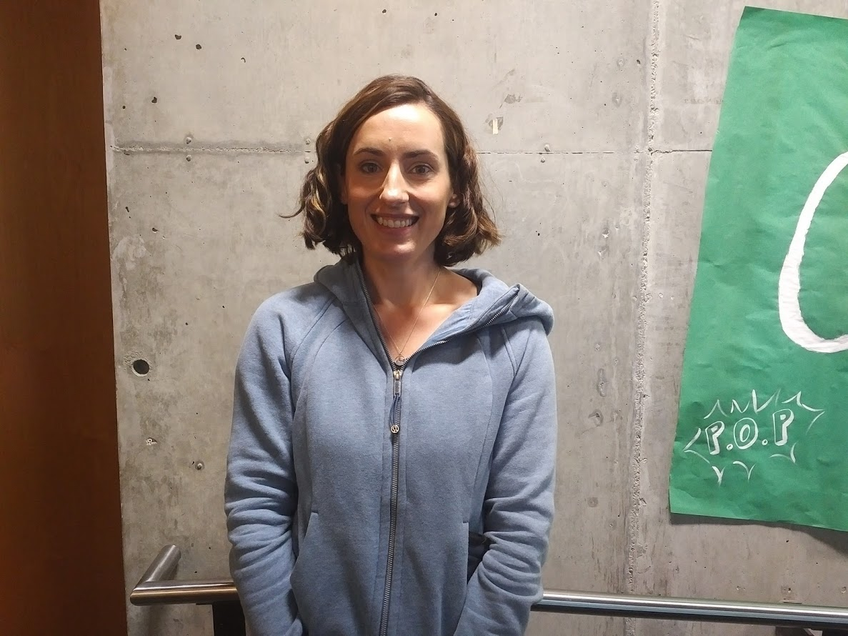
Sarah Larson

Slide 22
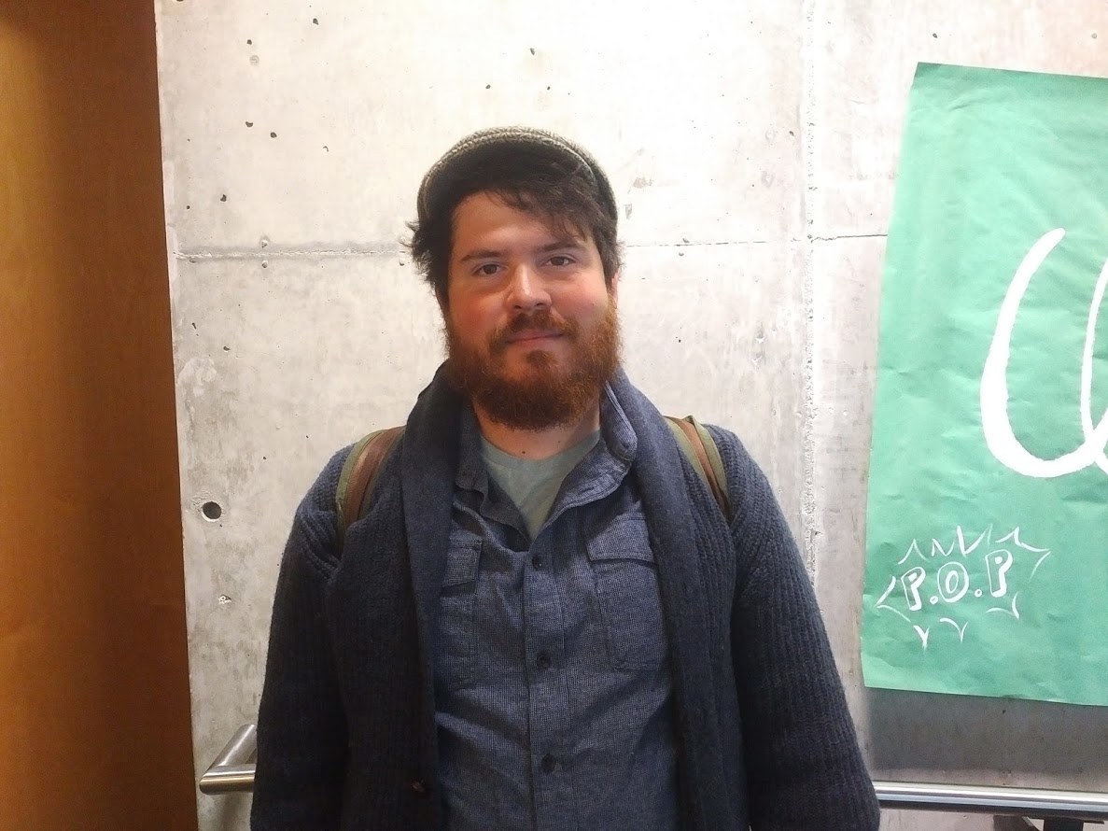
Randall (Adam) Martin

Slide 23
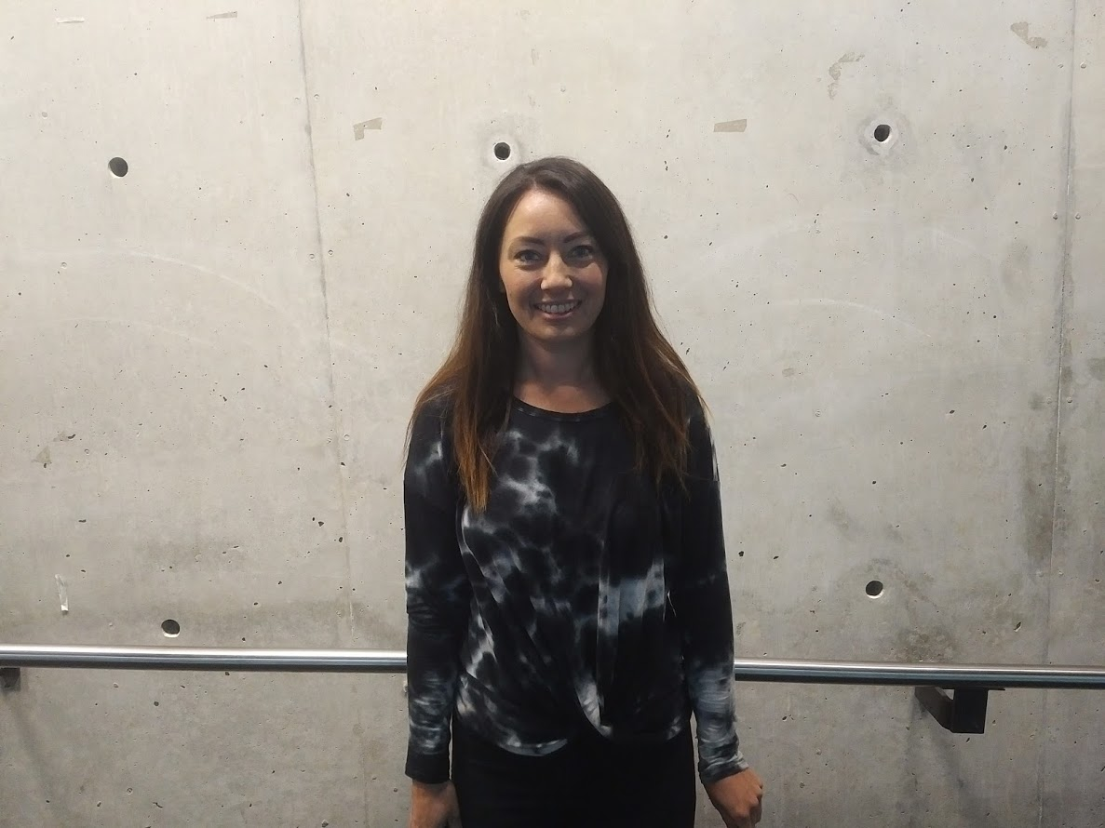
Caitlin McNamara

Slide 24
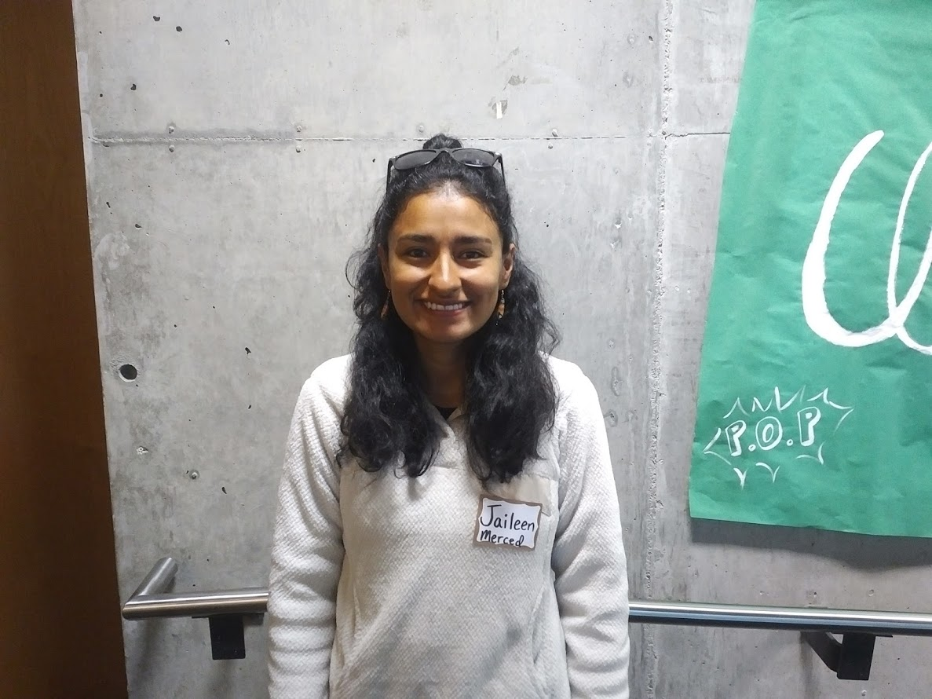
Jaileen Merced

Slide 25
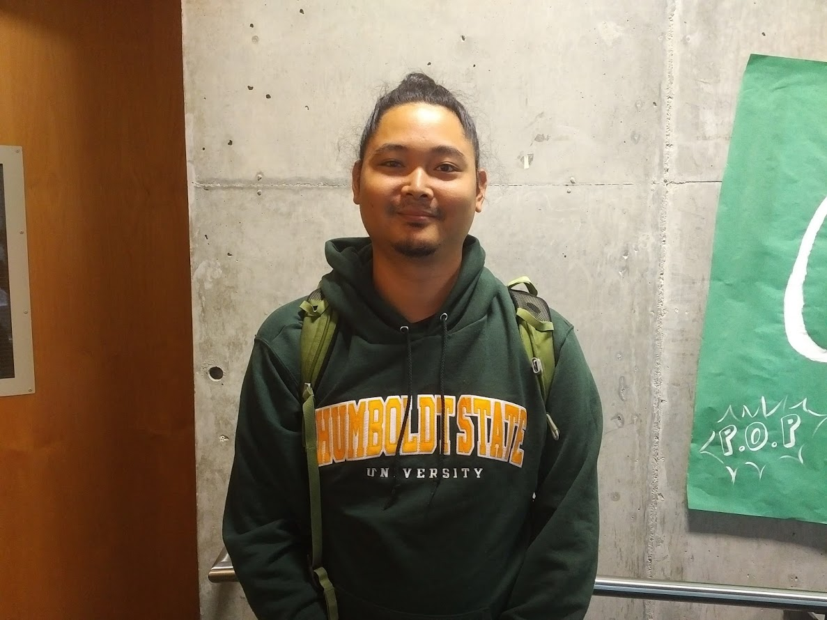
Shohei Morita

Slide 26
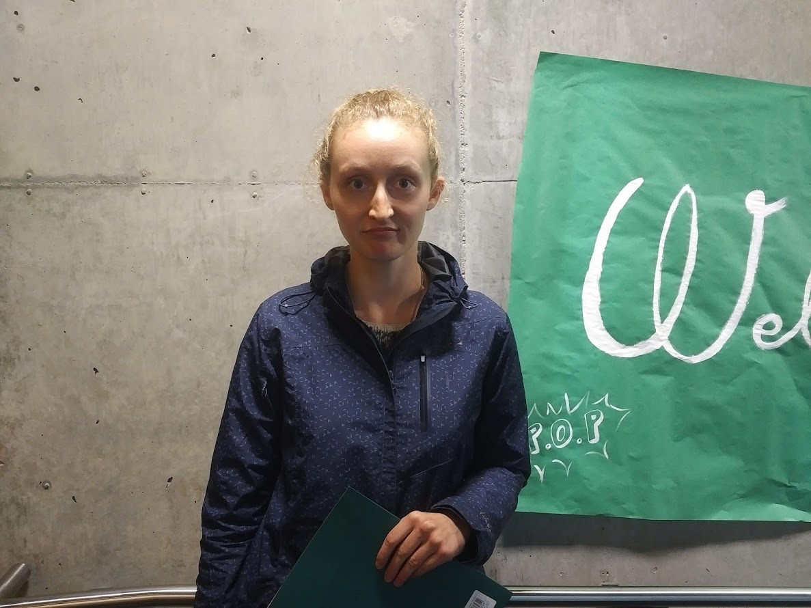
Claire Olson

Slide 27
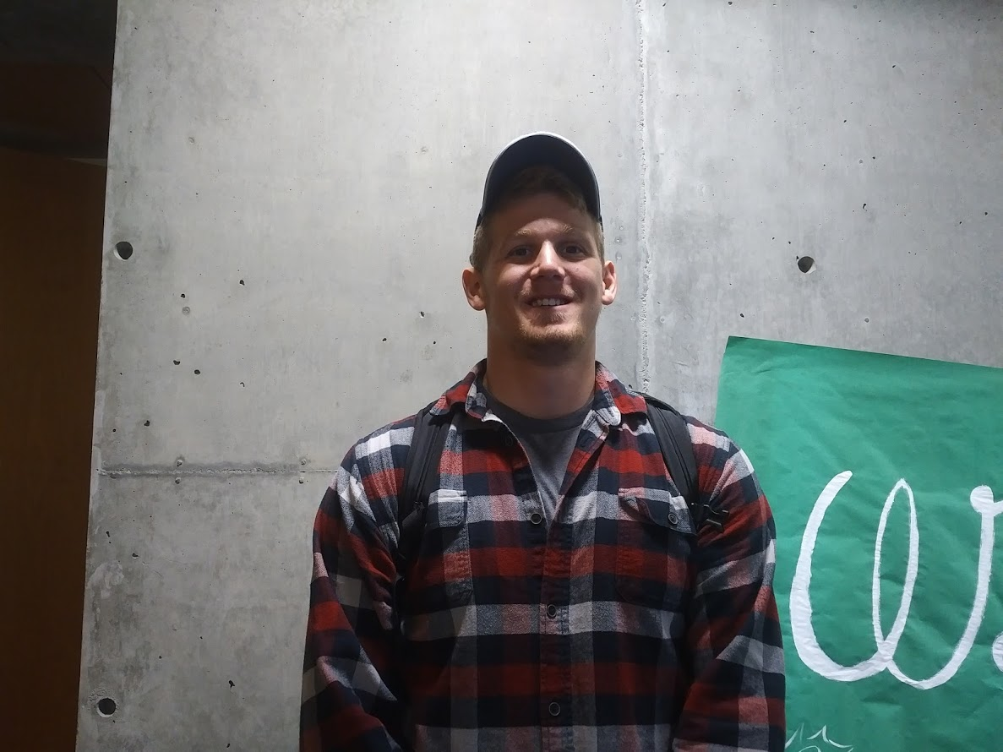
Alexander Pavlinovic

Slide 28
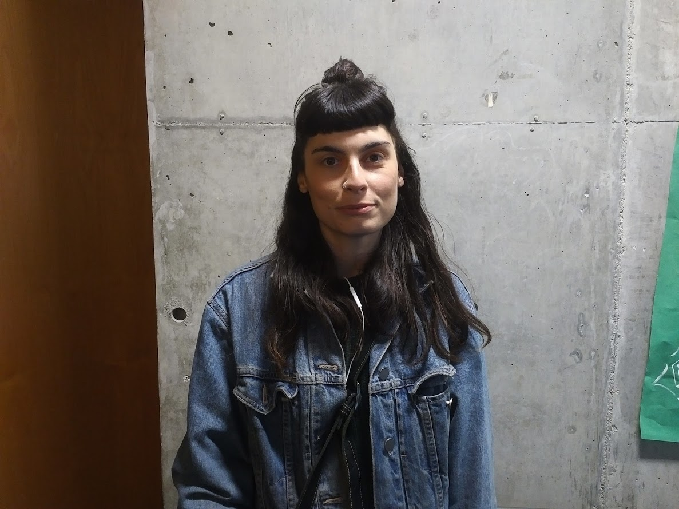
Savannah Richard

Slide 29
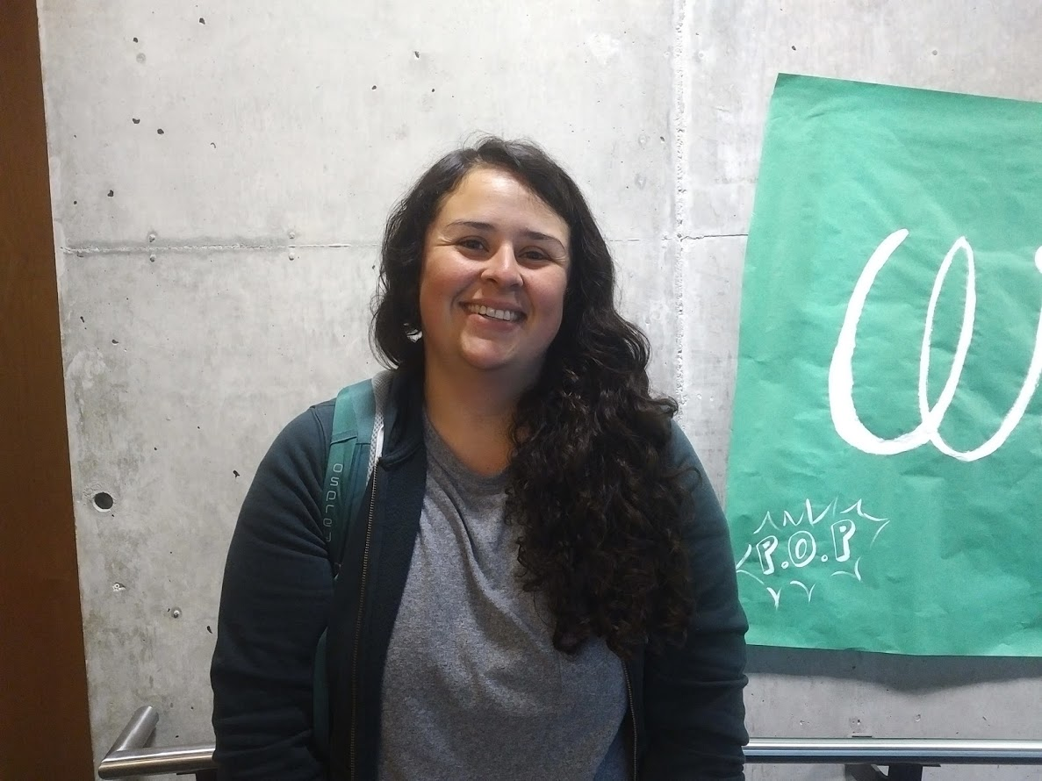
Melissa Sanchez

Slide 30
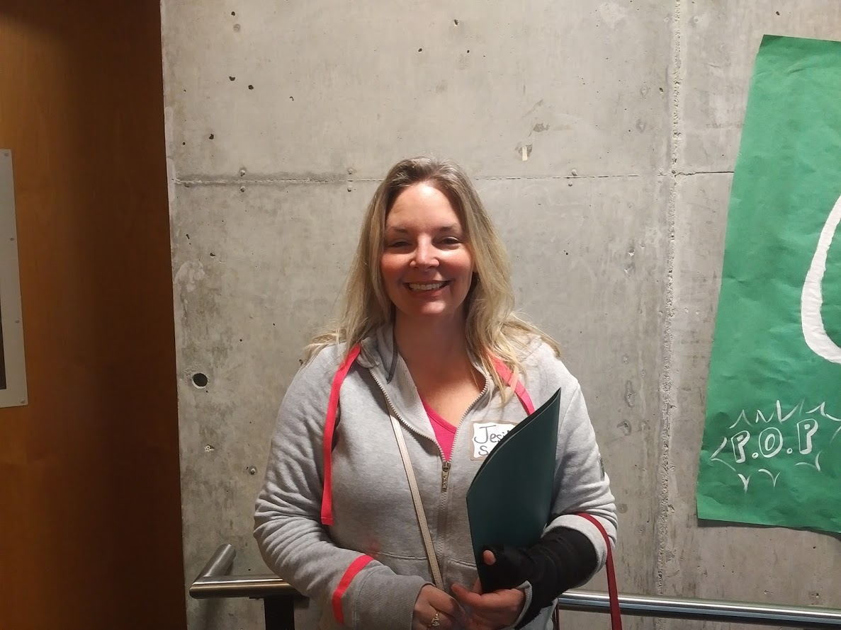
Jesika Sand

Slide 31
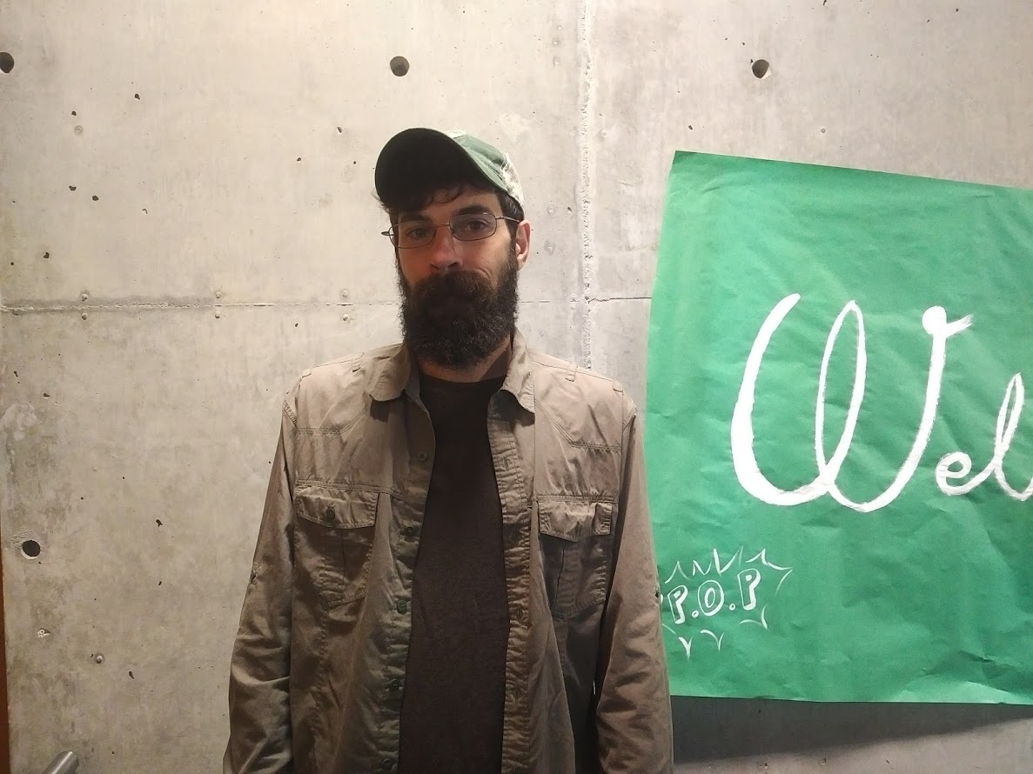
Alex Seebeck

Slide 32
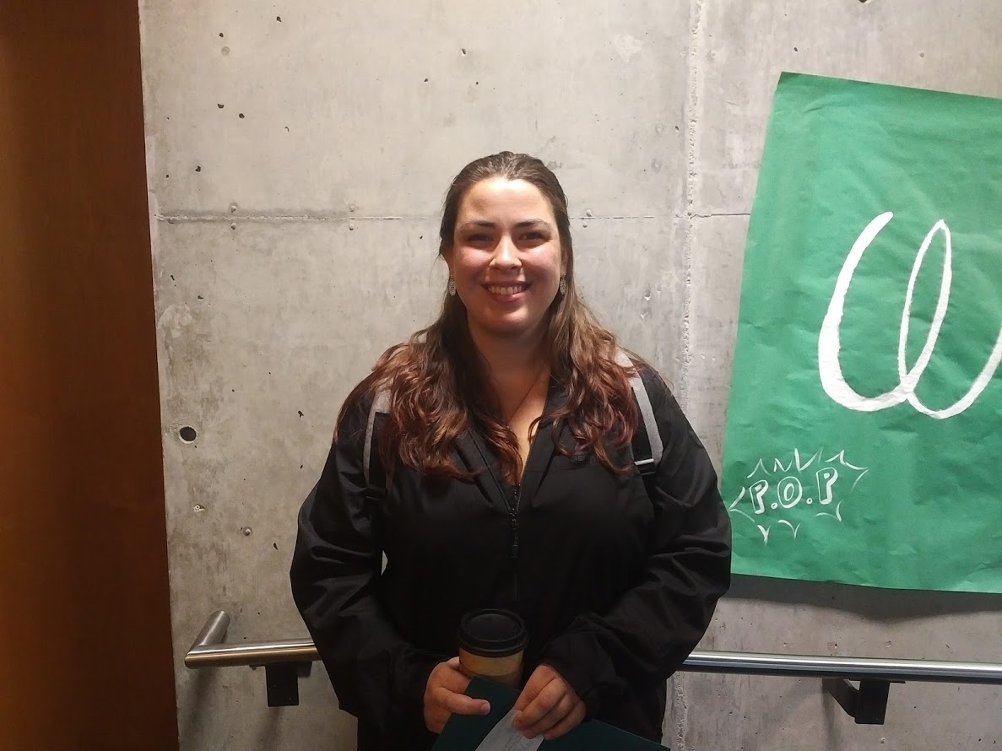
Megan Sharrow

Slide 33
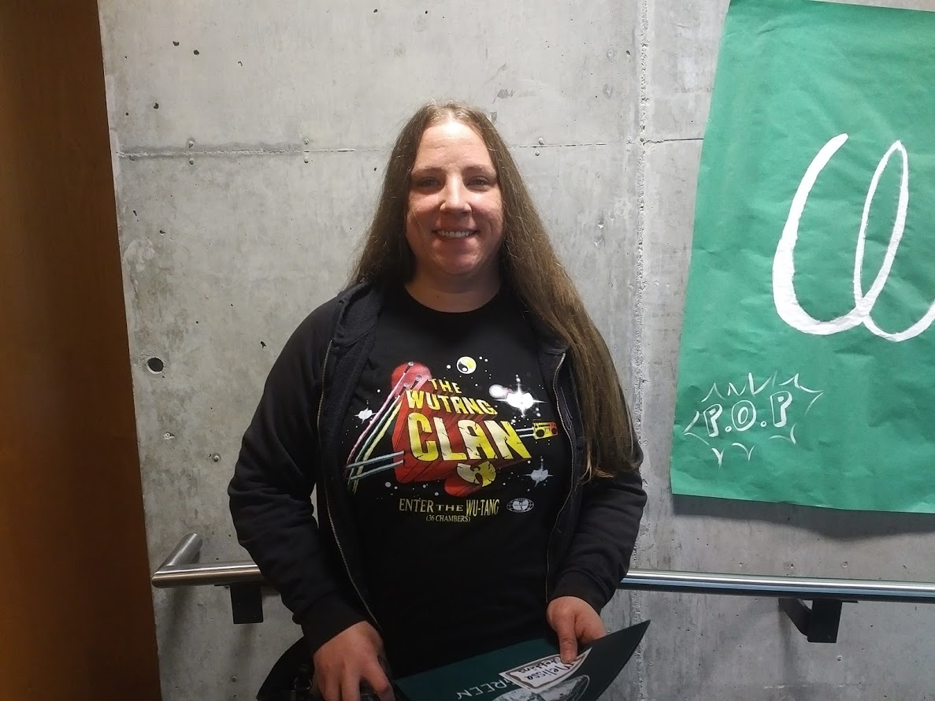
Melissa Stebbins

Slide 34
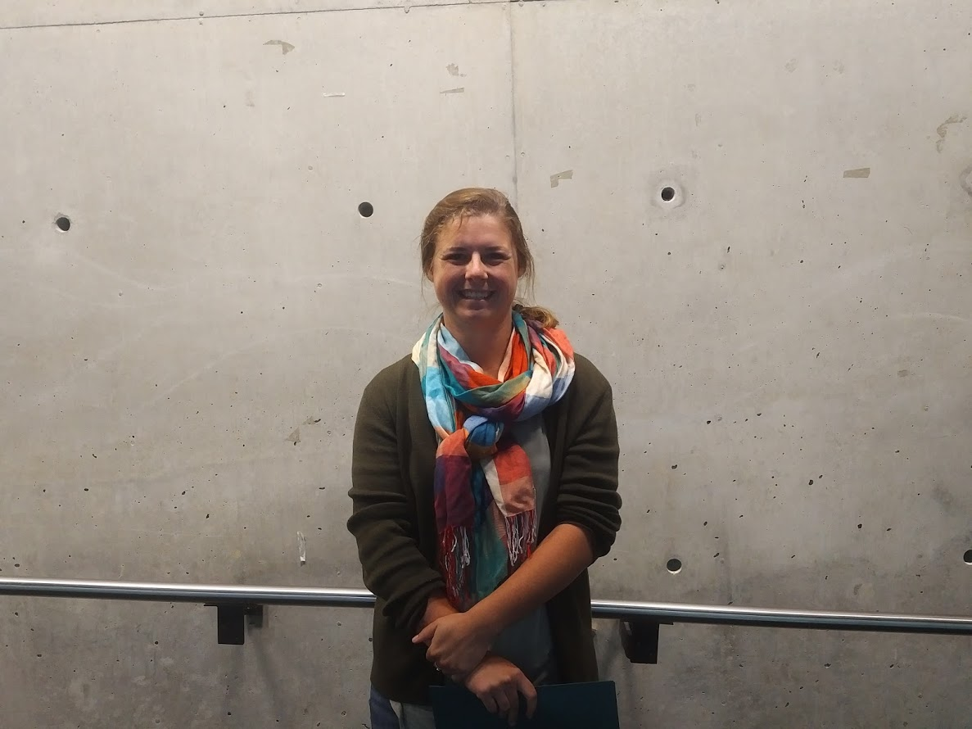
Erin Stehr

Slide 35
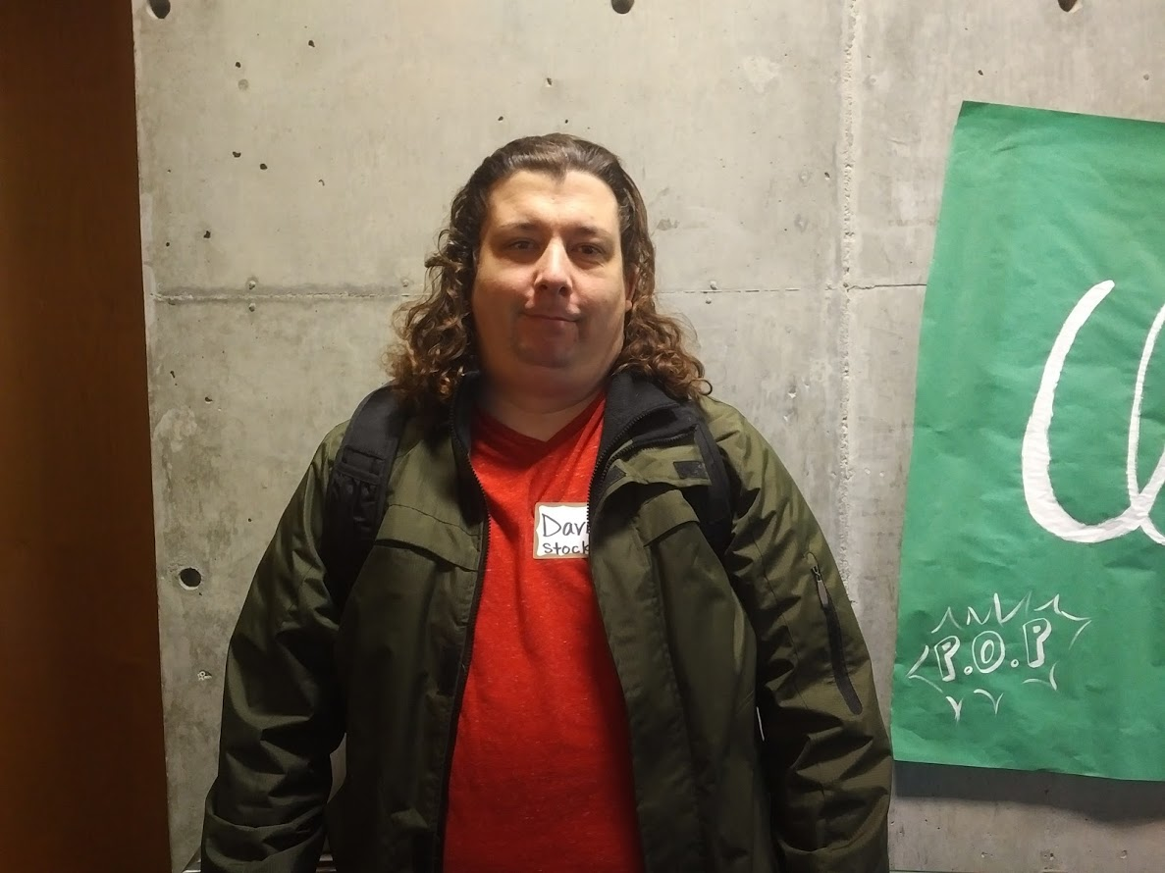
David Stocks

Slide 36
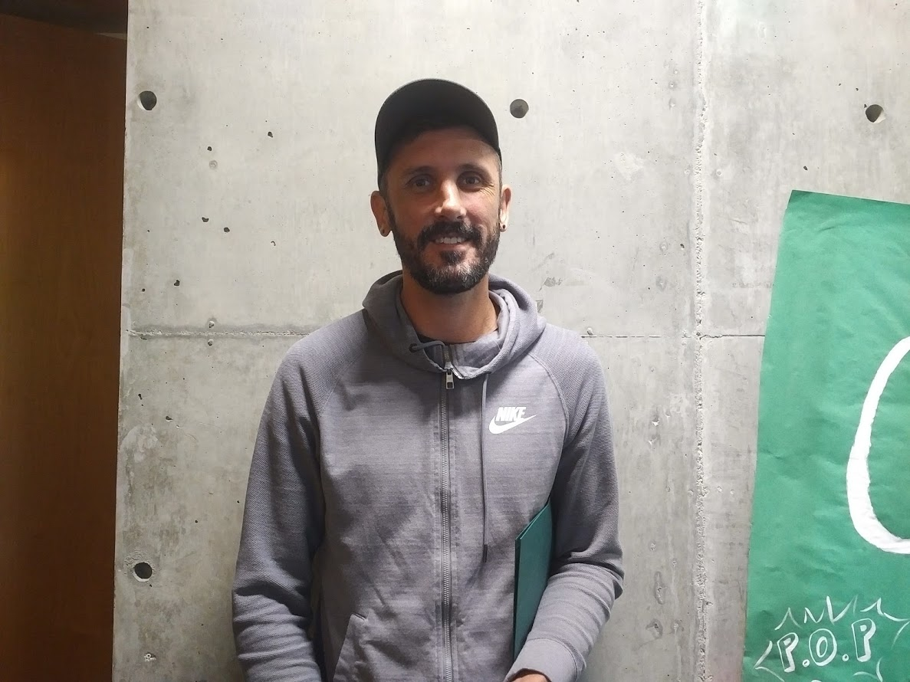
Johannes (JJ) Wukasch

