Slide 1
Welcome!
MES New Student Orientation
September 23, 2019

Slide 2
Overview of Agenda
Welcome and Introductions
Faculty and gCORE overview
Lunch
Get your photo taken for student ID
The Nitty Gritty
Current Student Panel (and snacks!)
Final Announcements and Closing
Optional Tour of Campus and Resources

Slide 3
Time for FUN
Break up into groups based on your card color (red, yellow, orange, green or purple)
Get excited.

Slide 4
Round 1 (Card Colors)
Name
Where do you live?
Where is home for you?
If you were to move, what is the first thing (or things) that you would unpack

Slide 5
Round 2 – (Excellent Drawings)
Name
Favorite Vegetable?
Favorite Ice Cream?
Are there any flavors of ice cream you would NOT eat?
What is your go-to potluck item?

Slide 6
Round 3 – (Scientist Quote)
If you weren’t at Orientation, what would you be doing right now?
Share one goal you have for the upcoming year (this does not have to be graduate school related!)

Slide 7
Round 4 – (Wilderness Areas)
Say five things about yourself, using your fingers as a guide:
Index – Favorite school/office supply
Middle – Your personal pet peeve
Ring – Environmental issue you’re passionate about
Pinky – Something you like that has nothing to do with “environmental studies”
Thumb – Where did you most recently travel (or hitchhike!) – near or far

Slide 8
Where do I go to…
Learn everything I need to know about MES policy and expectations?

Slide 9
MES Handbook!
evergreen.edu/mes/current-students
It is your responsibility to read and understand the Handbook
The Handbook for 2019-20 is your handbook until you graduate. Always refer to this handbook with questions

Slide 10
Where do I go to…
Find the course catalog for the year?
See information about scholarship deadlines?
See my faculty’s office location or phone number?
Learn about current students, alumni, and other things happening in the program?

Slide 11
MES Website!
evergreen.edu/mes
Check out the handy side bar to find most of the information you’re looking for!
There is a WHOLE section for current students!

Slide 12
Where do I go to…
Update my address?
See the location of my classes?
Pay tuition and fees?
Register for classes?
Drop classes?
See my evaluations?
Write self and faculty evaluations?

Slide 13
my.evergreen.edu!

Slide 14
Schedule Evergreen - Find your class schedule and location!

Slide 15
What about…
Job and internship information?
Upcoming event information?
Updates on conferences, funding, webinars, free things for students, etc.?

Slide 16
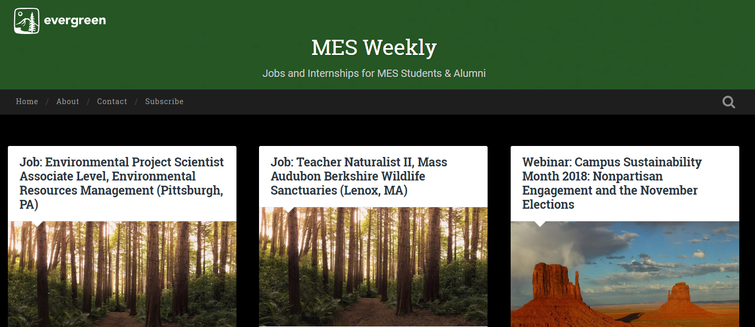
MES Weekly!
blogs.evergreen.edu/mesweekly

Slide 17
MES Degree Overview
72 total credits
32 from Core classes (Tue/Thu)
3 classes first year
1 class Fall of final year
24 from Electives (8 must be MES electives)
Up to 8 internship/independent learning contract credits
Up to 8 MPA credits
Up to 8 transfer credits (including special)
Summer courses
16 from Thesis
Winter and Spring quarter of final year

Slide 18
Registration Details
Waitlists
Freeze 4pm Fri of week before quarter (9/27)
Ask faculty to overenroll or wait and see if you get in due to people dropping
Deadlines
Online – 4pm Fri of week before quarter
Week 1 – faculty override required
Add/drop by 4pm Friday of Week 1 (10/4)
Immunizations
Turn into Registration or Health Center
Will have hold on account Winter quarter
if not received

Slide 19
Financial Aid Details
Check my.evergreen.edu for total awards
Tell Financial Aid office if taking more or less than 8 credits
Can request increase in loans for:
Travel (more than 30 mi RT)
Family care
Computer
Additional academic expenses
- Can apply for loans at any time
- Can accept or reject loans at any time
Excess checks sent out Day 1

Slide 20
Other Aid Opportunities
Outside scholarships – will email out and online
February 1: deadline for FAFSA and MES-specific scholarships for 20-21 school year
- MESA professional development funding (PDF)
- Research grants (on and off campus opportunities)
- Emergency loans
- Payment plan – pay per month

Slide 21
Access Services
Please complete a Request for Services Form BEFORE the quarter begins. This form must be completed each quarter.
Services include:
Accessible parking
Alternative testing
Note takers
Sign language interpreters
And more!

Slide 22
Other Resources
Graduate Writing Assistant:
evergreenwritingassistant@gmail.com
Current graduate student that can help with many stages of writing process. Will visit gCORE!
MESA:
Plans events and gatherings for MES students
A funding resource for research and professional development

Slide 23
Communication from MES
Please check your Evergreen email
Regular emails from Andrea/Kevin
Emails from faculty through Canvas
Join the MES 2019 Cohort Facebook Group
Join MESA!

Slide 24
Don’t Forget!
Welcome/Welcome Back Potluck
E1107 (next door)
5pm on Tuesday, 10/1

Slide 25
Campus Tour!
Emilia and Carly will lead a tour for anyone interested in seeing more of campus.

