Slide 1
Welcome!
MES New Student Orientation
September 17, 2018

Slide 2
Overview of Agenda
Welcome and Introductions
Faculty and gCORE overview
Lunch
Get your photo taken for student ID
Nitty gritty info about MES and Evergreen
Tour of Campus and Resource centers
Current Student Panel (and snacks!)
Final Announcements and Closing

Slide 3
Time for FUN
Break up into groups based on your card color (red, yellow, orange, green or purple)
Get excited.

Slide 4
Where do I go to…
Learn everything I need to know about MES policy and expectations?

Slide 5
MES Handbook!
evergreen.edu/mes/current-students
It is your responsibility to read and understand the Handbook
The Handbook for 2018-19 is your handbook until you graduate. Always refer to this handbook with questions

Slide 6
Where do I go to…
Find the course catalog for the year?
See information about scholarship deadlines?
See my faculty’s office location or phone number?
Learn about current students, alumni, and other things happening in the program?

Slide 7
MES Website!
evergreen.edu/mes
Check out the handy side bar to find most of the information you’re looking for!
There is a WHOLE section for current students!

Slide 8
Where do I go to…
Update my address?
See the location of my classes?
Pay tuition and fees?
Register for classes?
Drop classes?
See my evaluations?
Write self and faculty evaluations?

Slide 9
my.evergreen.edu!

Slide 10
Find your class schedule and location!

Slide 11
What about…
Job and internship information?
Upcoming event information?
Updates on conferences, funding, webinars, free things for students, etc.?

Slide 12
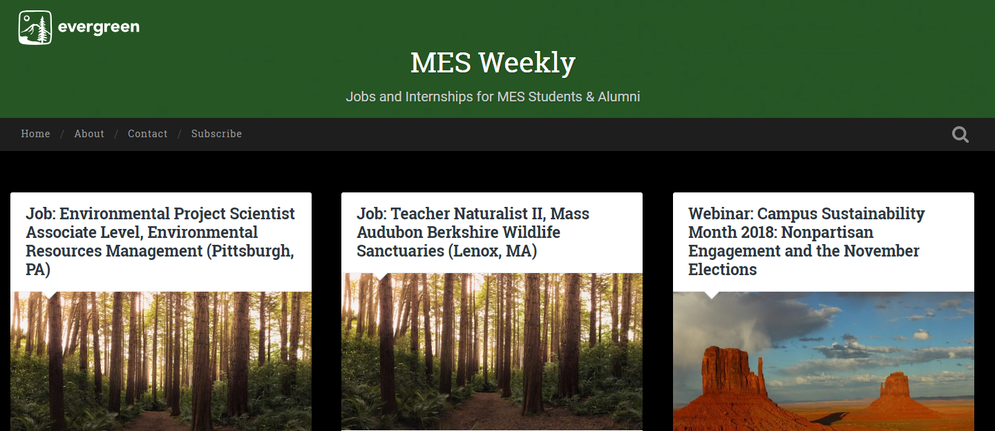
MES Weekly!
blogs.evergreen.edu/mesweekly

Slide 13
MES Degree Overview
72 total credits
32 from Core classes (Tue/Thu)
3 classes first year
1 class Fall of final year
24 from Electives (8 must be MES electives)
8 internship/independent learning contract credits
8 MPA (4-credit only) credits
8 transfer credits (including special)
Summer courses
16 from Thesis
Winter and Spring quarter of final year

Slide 14
Registration Details
Waitlists
Freeze 4pm Fri of week before quarter (9/21)
Ask faculty to overenroll or wait and see if you get in due to people dropping
Deadlines
Online – 4pm Fri of week before quarter
Week 1 – faculty override required
Add/drop by 4pm Friday of Week 1 (9/28)
Immunizations
Turn into Registration or Health Center
Will have hold on account Winter quarter
if not received

Slide 15
Financial Aid Details
Check my.evergreen.edu for total awards
Tell Financial Aid office if taking more or less than 8 credits
Can request increase in loans for:
Travel (more than 30 mi RT)
Family care
Computer
Additional academic expenses
- Can apply for loans at any time
- Can accept or reject loans at any time
- Excess checks sent out Day 1

Slide 16
Other Aid Opportunities
Outside scholarships – will email out and online
February 1: deadline for FAFSA and MES-specific scholarships for 2018-19
- MESA professional development funding (PDF)
- Research grants (on and off campus opportunities)
- Emergency loans
- Payment plan – pay per month

Slide 17
Access Services
Please complete a Request for Services Form BEFORE the quarter begins. This form must be completed each quarter.
Services include:
Accessible parking
Alternative testing
Note takers
Sign language interpreters
And more!

Slide 18
Communication from MES
Please check your email
Regular emails from Andrea/Kevin
Emails from faculty through Canvas
Join the MES 2018 Cohort Facebook Group
Join MESA!

Slide 19
Campus Tour!
Split into four groups based on the excellent illustration you had on your card this morning:
Trees and Flowers with Katrina and Alex
Mountains and Rivers with Meara and Hillary

Slide 20
Don’t Forget!
Welcome/Welcome Back Potluck
C1107 (next door)
5pm on Tuesday, 9/25

