Slide 1
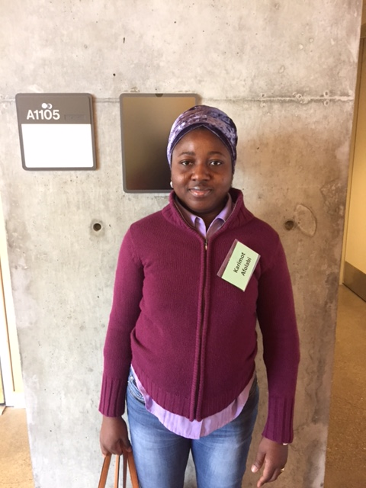
Karimot Afolabi

Slide 2
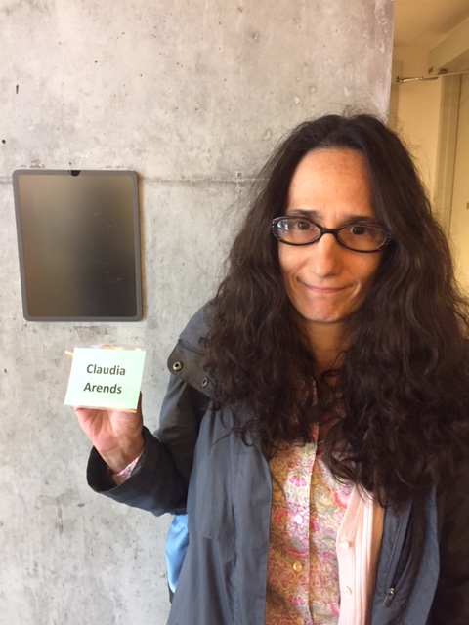
Claudia Arends

Slide 3
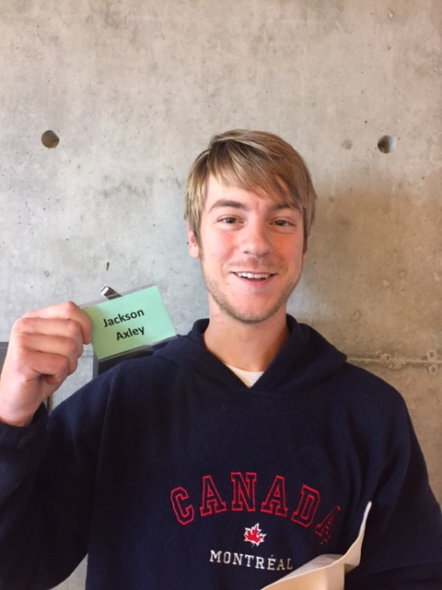
Jack (Jackson) Axley

Slide 4
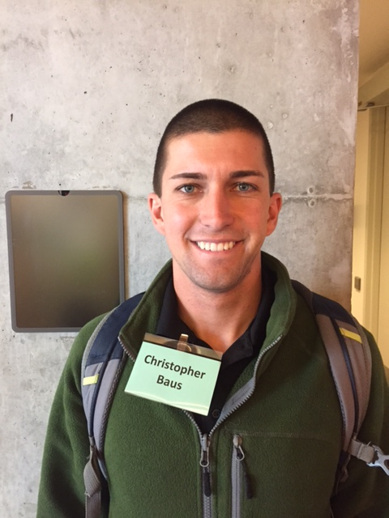
Christopher Baus

Slide 5
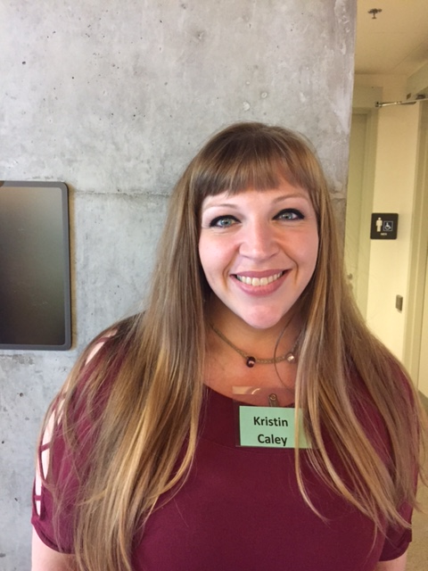
Kristin Caley

Slide 6
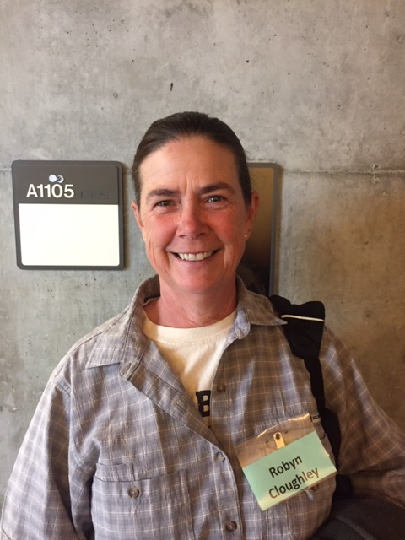
Robyn Cloughley

Slide 7
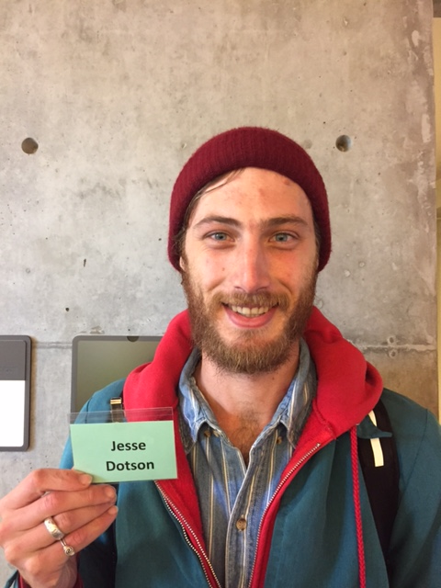
Jesse Dotson

Slide 8
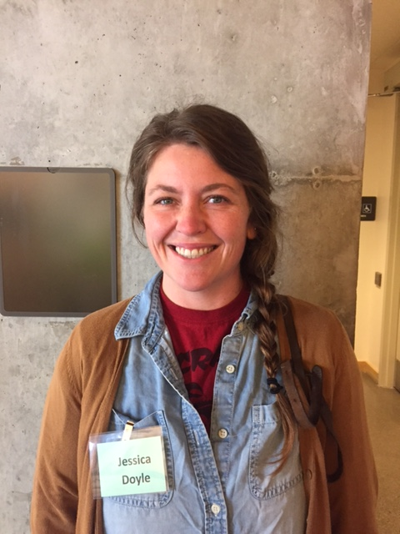
Jessica Doyle

Slide 9
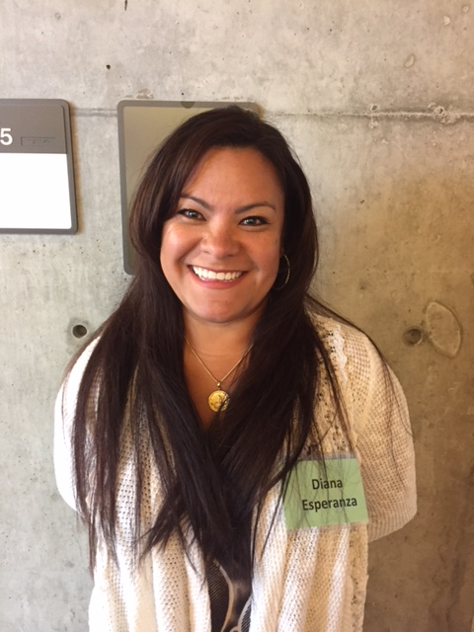
Diana Esperanza

Slide 10
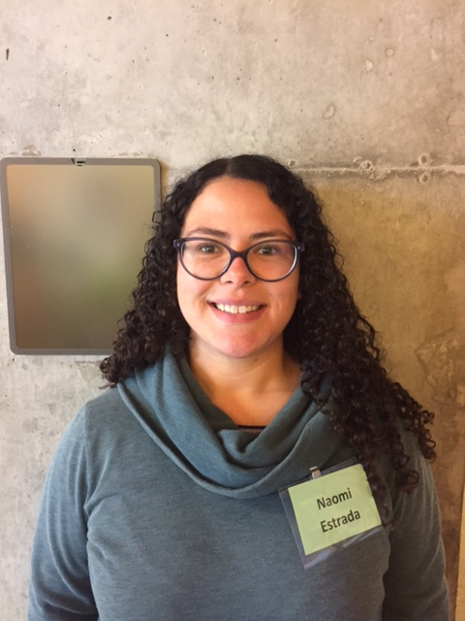
Naomi Estrada

Slide 11
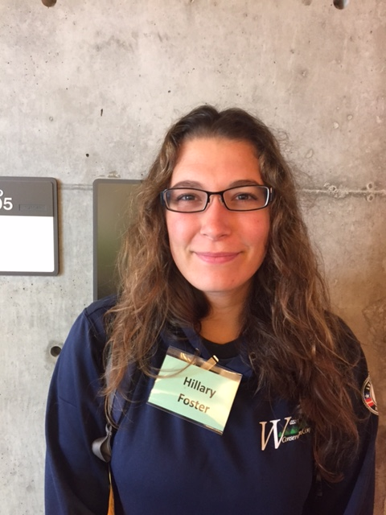
Hillary Foster

Slide 12
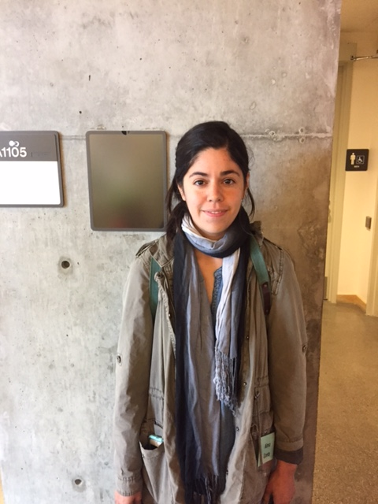
Alma Gaeta

Slide 13
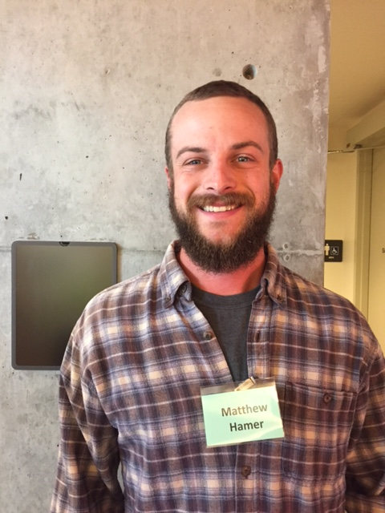
Matthew Hamer

Slide 14
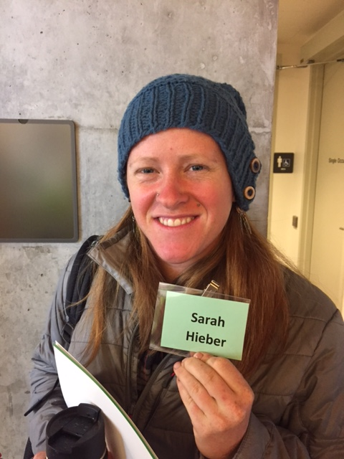
Sarah Hieber

Slide 15
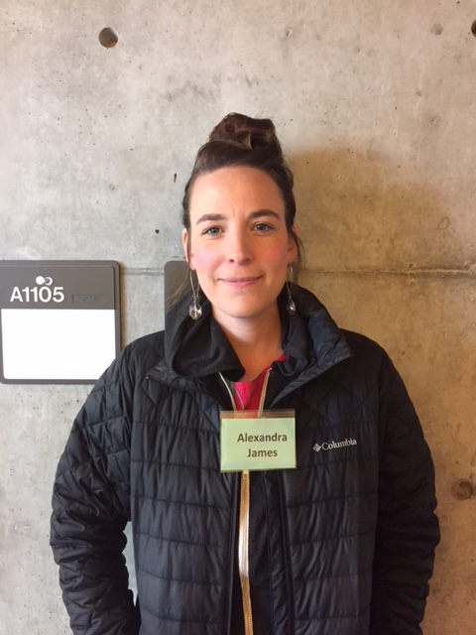
Alex James

Slide 16
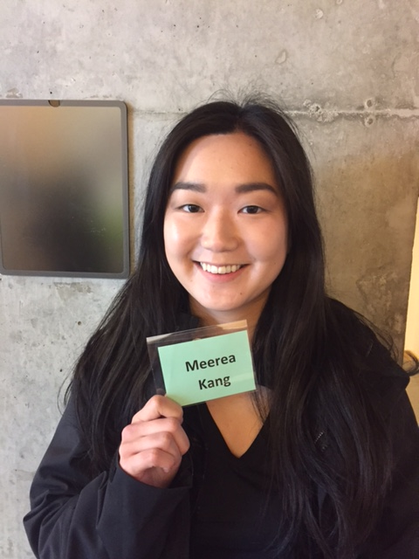
Meerea Kang

Slide 17
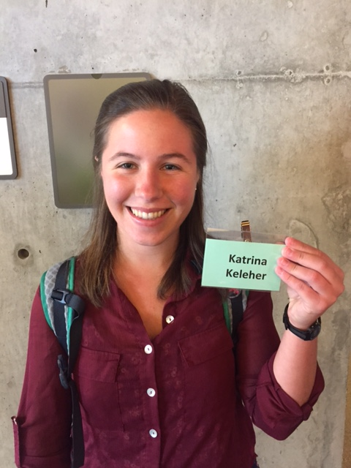
Katrina Keleher

Slide 18
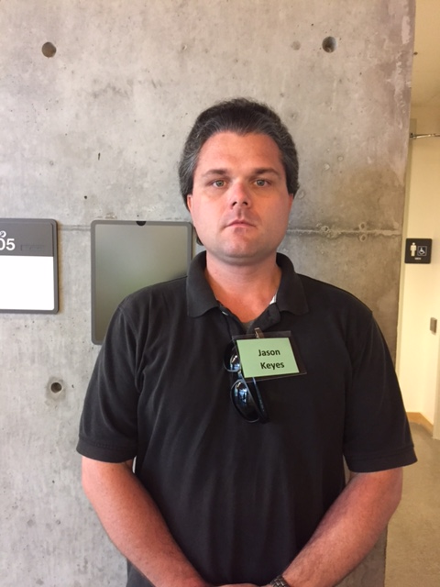
Jason Keyes

Slide 19
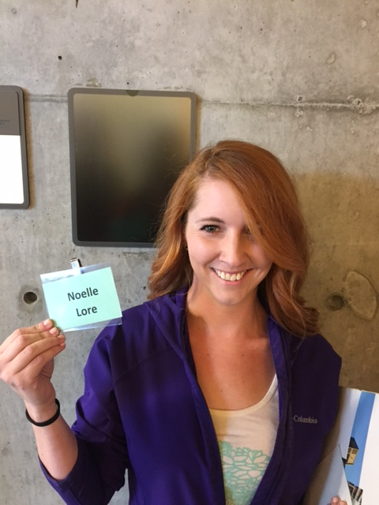
Noelle Lore

Slide 20
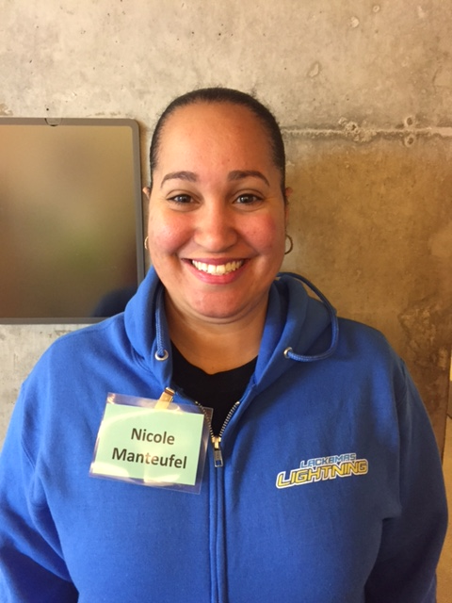
Nicole Manteufel

Slide 21
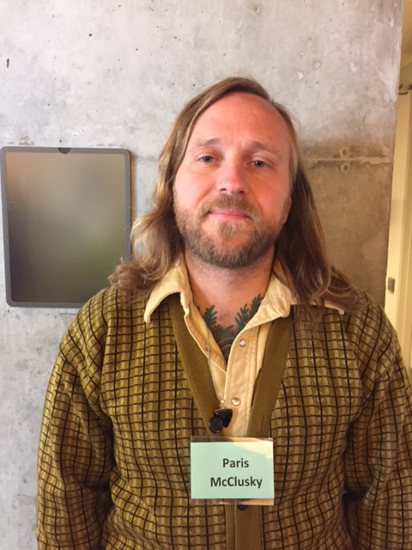
Paris McClusky

Slide 22
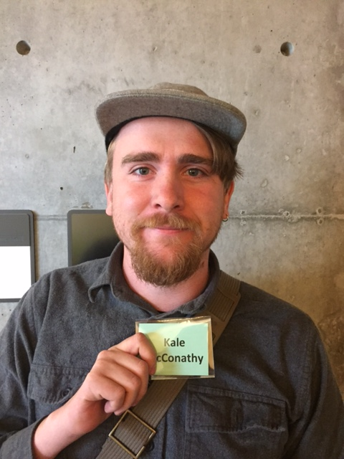
Albert (Kale) McConathy

Slide 23
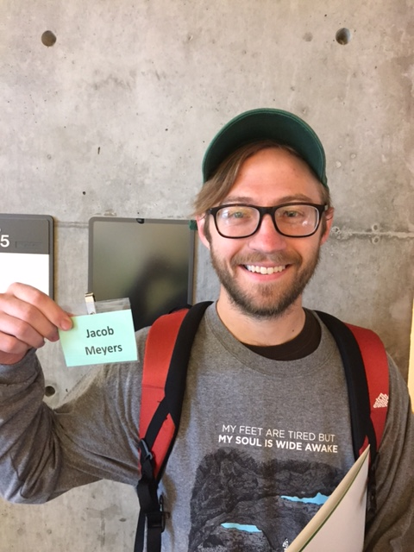
Jacob Meyers

Slide 24
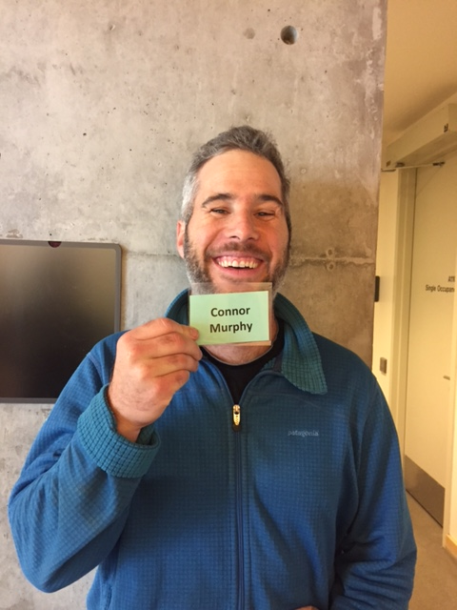
Connor Murphy

Slide 25
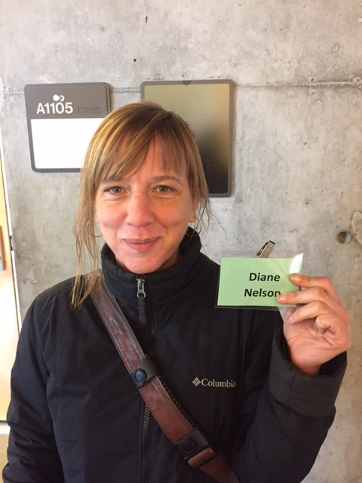
Diane Nelson

Slide 26
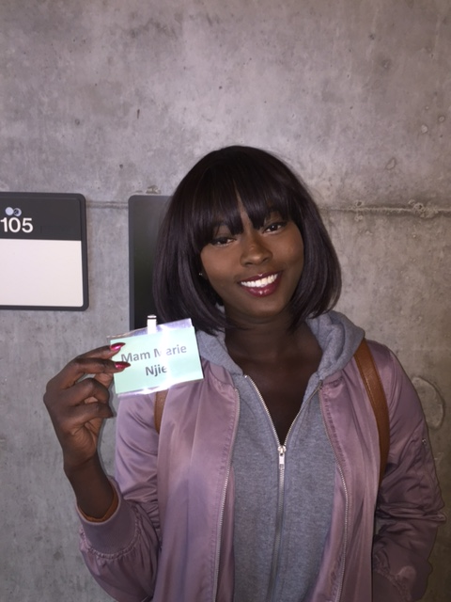
Mam Marie Njie

Slide 27
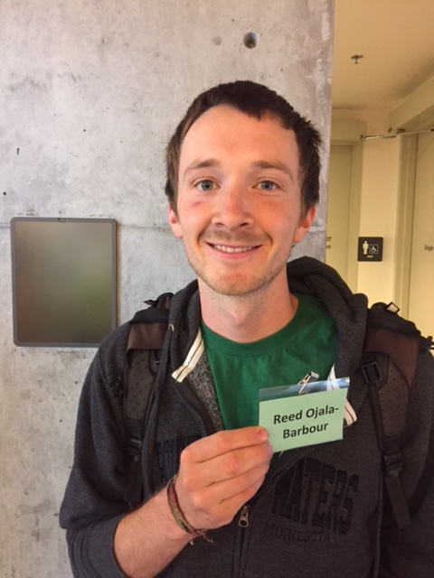
Reed Ojala-Barbour

Slide 28
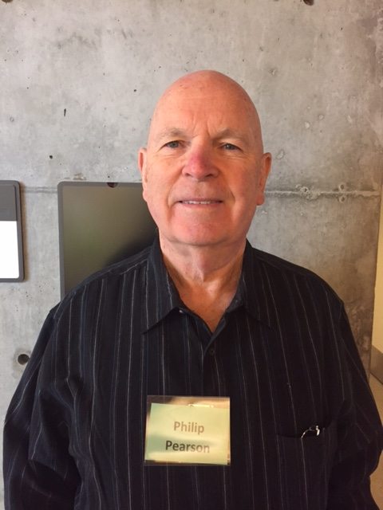
Phillip Pearson

Slide 29
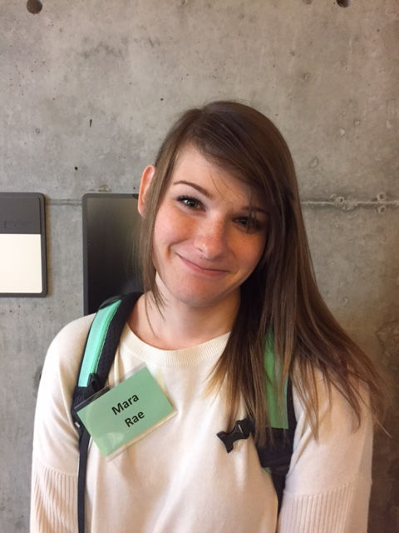
Mara Rae

Slide 30
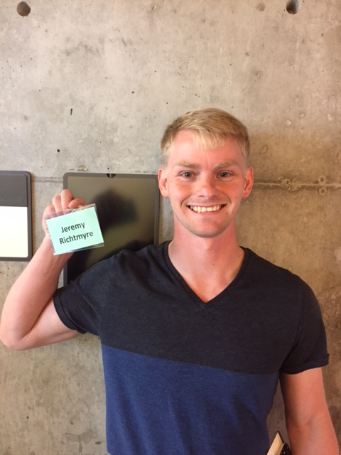
Jeremy Richtmyre

Slide 31
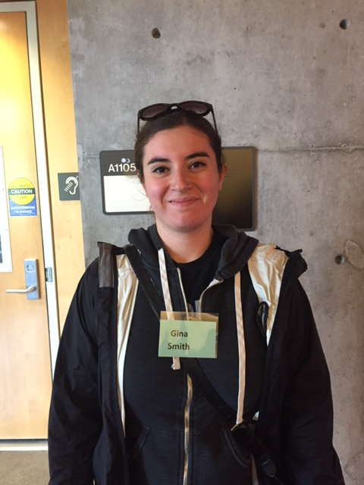
Gina Smith

Slide 32
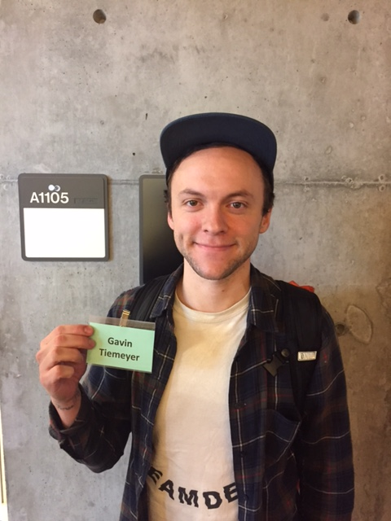
Gavin Tiemeyer

Slide 33
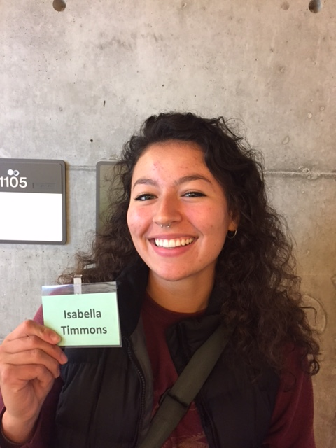
Bella (Isabella) Timmons

Slide 34
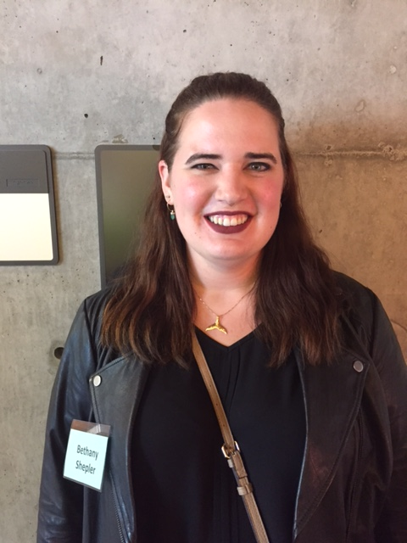
Bethany Shepler

Slide 35
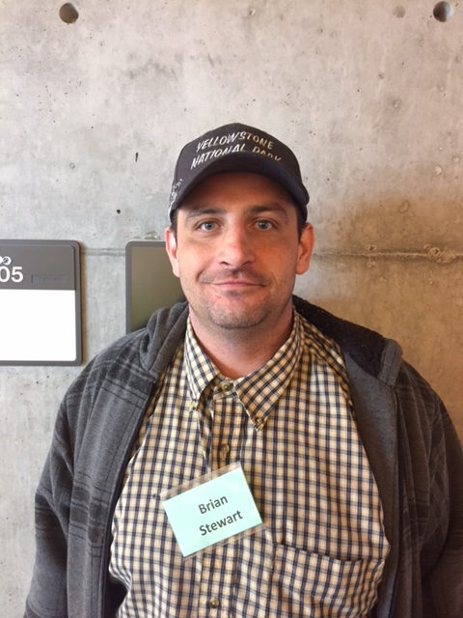
Brian Stewart

Slide 36
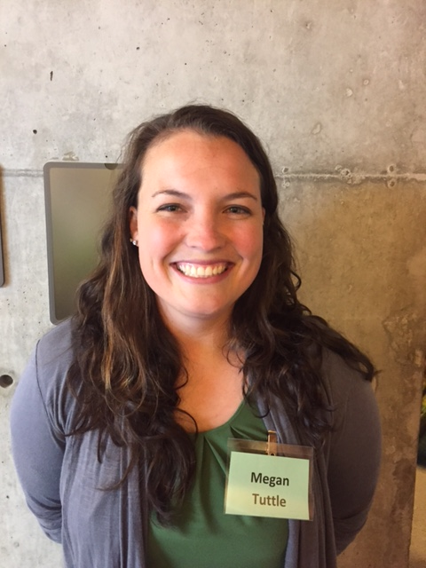
Megan Tuttle

Slide 37
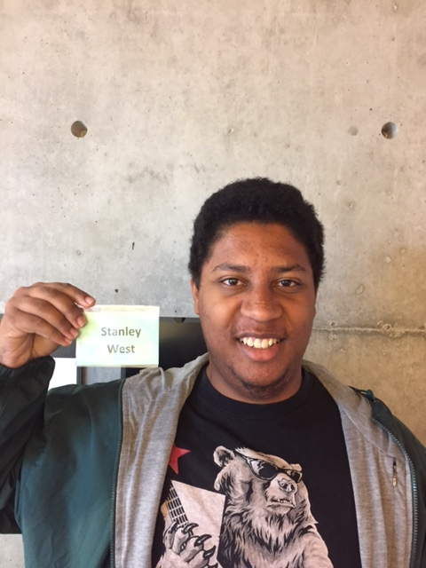
Tyson (Stanley) West

Slide 38
Not pictured:
  Katie (Katherine) Allowatt
  Tiffany Bachtel
  Santiago Gonzalez

