Slide 1
12:00-1:00 Check-In, Lunch with Faculty, Photos
1:00-1:15 Welcome/Overview
1:15-1:45 gCORE Faculty Introductions
1:45-2:45 Student Introductions
2:45-3:00 Break with snacks
3:00-4:45 Evergreen Resources
4:45-5:00 Break with snacks
5:00-5:15 MES Faculty Introductions
5:15-6:30 Student Panel
6:30 Dinner on your own
MES Orientation

Slide 2
Intros
Name
Moved from (if applicable)
Current city
Last degree
Most recent or current job
Environmental interests and topics for interdisciplinary group project

Slide 3
MES Information
MES Handbook
  Everything you need to know about MES!
  Your responsibility to review
  We hold you to these policies
MES Website
  Course schedule
  Jobs/internships
  Scholarships
  Faculty/Staff/Office directory
my.evergreen.edu
Notes:
-turn in last sheet at end of orientation
-your responsibility to review

Slide 4
MES Degree = 72 credits
32: Core classes (Tue/Thu)
  3 classes first year
  1 class Fall of final year
24: Electives (8 must be MES electives)
  8 internship/contract credits
  8 MPA (4-credit only) credits
  8 transfer credits (including special)
  Summer courses
16: Thesis
  Winter and spring quarter of final year

Slide 5
Things to Know Now
12 credits/quarter maximum
  This means one elective and one core
Waitlists
  Contact faculty
  Please drop classes or waitlists you are no longer interested in
Deadlines
  Register and pay by October 2
Course Catalog
  Has class location and books

Slide 6
More Degree Information
  Full time: 12 credits over 6 quarters
  Part-time: 8 credits or less up to 16 quarters
  Candidacy: write and present candidacy paper in second core class; review of academics to date
  Duration: Finish in 4 years
  Thesis: Must finish core classes (in order) and 12 elective credits before starting
Notes:
Part time is typically 9 quarters or 3 years

Slide 7
Financial Aid
Check my.evergreen for total awards
Tell Financial Aid office if taking more or less than 8 credits
Can request increase in loans for:
  Travel (more than 30 mi RT)
  Family care
  Computer
  Additional academic expenses
Can apply for loans at any time
Can accept or reject loans at any time
Excess checks sent out Day 1

Slide 8
Other Aid
Sustainability Fellowship
  Up to $4000 in Spring
Outside scholarships – will email out and online
MESA professional development grants
Research grants
Emergency loans
Payment plan – pay per month

Slide 9
Registration
Waitlists
  Freeze 4pm Fri of week before quarter
  Ask faculty to overenroll or wait and see if you get in due to people dropping
Deadlines
  Online – 4pm Fri of week before quarter
  Week 1 – faculty override required
  Add/drop by 4pm Friday of Week 1
Immunizations
  Turn into Registration or Health Center
  Will have hold on account W quarter if not

Slide 10
What to do if…
Online registration isn’t working
  Contact Registration & Records
You didn’t get your financial aid check
  Contact Financial Aid
You need a book list or class location
  Review online catalog
You need to find an email address
  Use global address book in webmail
You want to sign up for an internship
  Review your handbook

Slide 11
What to do if…
You need academic advising
  Talk to faculty, Kevin, or Heather
You have a question about an MES policy
  Talk to Heather or Kevin
You want to transfer a course into MES
  Talk to Kevin
You can’t find the answer in the handbook or you get a confusing answer from a campus office
  Talk to Heather

Slide 12
Communication from MES
Subscribe to MES Weekly
  Internships
  Jobs
  Conferences
Regular emails - PLEASE READ!
Core classes
MESA – student rep at fac meetings
mes-students@lists.evergreen.edu

Slide 13
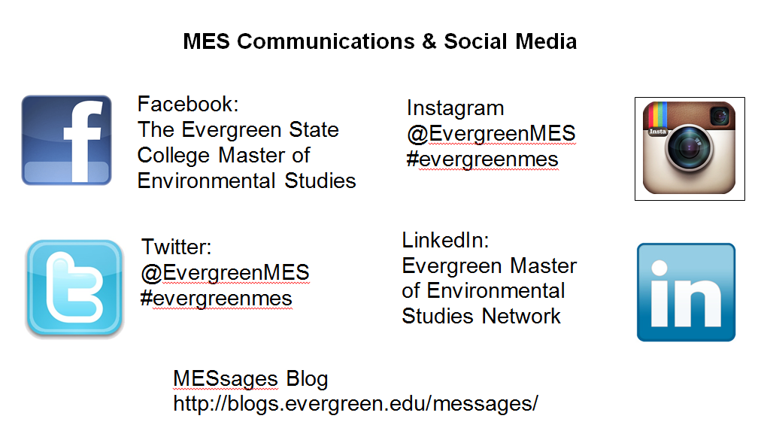
Notes:
Instagram login
evergreenmes
EvergreenMES

Slide 14
You’re Invited
Welcome Back Reception/Potluck
  Tue, Sept 27, 5-5:45
  Grad Student Lounge, Lab 1, Rm 3023
  MES provides the beverages
  Students, bring an “after school snack”, your own plate, cup, napkin, and silverware!
Randel Property Reserve Potluck
  Details to come

