Slide 1

Welcome New Students!

Slide 2
Reminders
Pay your $100 deposit by Fri, 5/5 on my.evergreen.edu
Mandatory MES Orientation – Tue, 9/19
Classes start Mon, 9/25
Rachel Carson Forum tonight!
Farm & Beach tours tomorrow

Slide 3
Who Are You?
Fall 2017 Undergrad Majors

Slide 4
More Data
Average age = 29
States represented: AR, CA, CO, GA, ID, IL, MA, MD, MN, NC, OR, PR, TN, TX,WA
Top undergrad schools:
  Evergreen
  University of Washington
  Pacific Lutheran Universit

Slide 5
Sample 2-Year Plan
12 credits for 6 quarters - 3 nights/week
72 total credits
 | F | W | Sp | Su
Year 1 | Core & Elective | Core & Elective | Core & Elective | Optional Elective
Year 2 | Core & Elective | Thesis & Elective | Thesis & Elective | Graduate!
Notes:
Bright pink page in your packet

Slide 6
1st Year Core Sequence
24 credits
Tue/Thu Night, 6-10pm
FALL: Conceptualizing our Regional Environment (gCORE)
WINTER: Ecological and Social Sustainability (ESS)
SPRING: Research Design / Quantitative Methods (RDQM)

Slide 7
2nd Year Core Sequence
24 credits
Tue/Thu nights in Fall occasional Tue/Thu in Winter/Spring
FALL: Case Studies
WINTER and SPRING: Thesis (16)
~ Original Research Project
~ Presentation

Slide 8
Electives
24 credits
Choose From:
MES electives – 4 credits each, Mon or Wed nights
Internships
Individual Study
MPA Courses
Transfer Courses
Notes:
Lists of electives on blue and green papers

Slide 9
Financial Aid
Check my.evergreen for total awards
Can apply for loans at any time
Can accept or reject loans at any time
Can request increase in loans for:
  Travel (more than 30 mi RT)
  Family care
  Computer
  Additional academic expenses
Tell Financial Aid office if taking more or less than 8 credits
Excess checks sent out Day 1

Slide 10
Other Aid
Outside scholarships – will email out and on MES Weekly
MESA professional development grants
Research grants
Emergency loans
Residency Questions – email residency@evergreen.edu
Notes:
Bright yellow page in packets

Slide 11
Summer/Fall Registration
Can take summer classes as special student and apply toward degree
Registration opens May 22 through my.evergreen.edu
  You may get on waitlist – be patient!!
  Please only sign up for your top choice elective
Add/drop online through September 22
Immunization form
  Turn into Registration or Health Center
  http://www.evergreen.edu/health/health/immunizations
Notes:
I’ll send an email reminder out about this, too!
Special Student add/drop forms – need to contact faculty about taking the course, and register during the first week of class
Find CRN in class description – show website

Slide 12
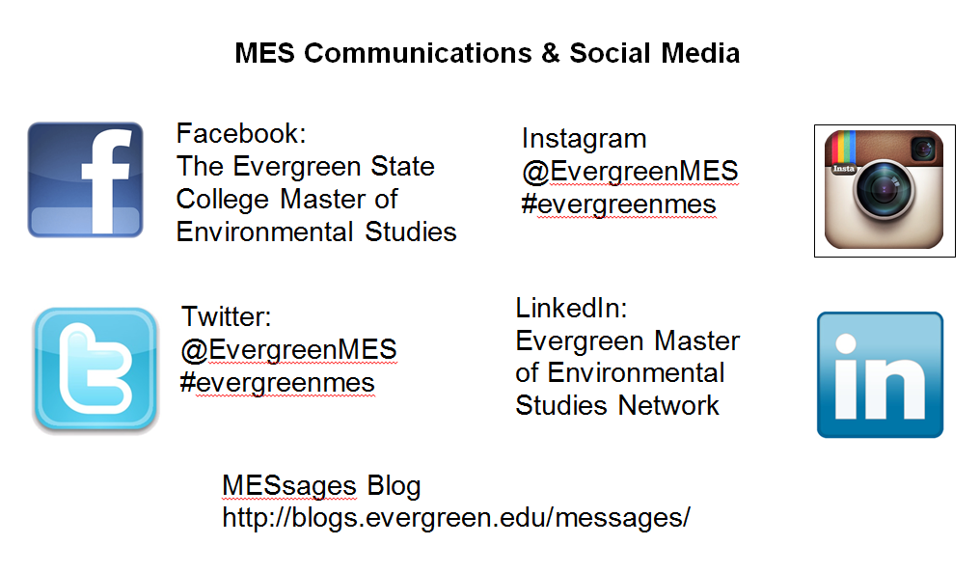
Notes:
If you haven’t yet, join the 2017 MES Cohort FB Group!

Slide 13
Jobs and Internships
Subscribe to MES Weekly
  Internships
  Jobs
  Conferences
  Events
Regular emails - PLEASE READ!
CODA – on campus jobs
Notes:
Please check your Evergreen email regularly, and/or have it forwarded to another account with more storage

Slide 14
Reminders
Pay your $100 deposit by Mon, 4/16 on my.evergreen.edu
Mandatory MES Orientation – Mon, 9/17
Classes start Mon, 9/24
Please sign up for weekend activities today

Slide 15
Questions
Questions for new admits:
What drew you to the MES program? What class are you most interested in and why?
What questions do you still have? Is there anything you are nervous about?
Questions for current students:
What advice would you give to a new student?
How did you choose your internship/elective/thesis?
What are interactions among the students in the program like?

