Slide 1
Cover letters
Thesis Workshop
Winter 2023

Slide 2
Agenda
Introduction​ to Cover Letters
Resumes / Cover Letters / Application
How to Cover Letter
Primary goals​
Summary​

Slide 3
Primary goals for your cover letter
Personalized and highly tailored to the job description
Argues for how your skills and experiences are relevant for a position
Expands on resume
Organized by skills, not chronological
Conveys enthusiasm and personality

Slide 4
Resume
Cover Letter
Application
Drafted in first person, past tense, active voice
Scannable
Elevates hard skills with measurable outcomes
Information is dense and easy to find
Experience can be organized in reverse chronological order or by experience type
Drafted in first person, present tense, active voice
Highlights your soft skills such as your values and accomplishments from a personal perspective
No lists, information is presented in paragraphs
Demonstrates your writing skills and interest in the position
Clarifies any questions that you anticipate from the hiring committee
Organized by skills instead of chronologically
Is an application offered as part of the process?
Information entered in reverse chronological order
Information is provided to give Human Resources the information they need for their database in the order they need to present it to the hiring committee
Include every piece of information from each job to meet the minimum qualifications so your application can be moved forward

Slide 5
YOUR COVER LETTER IS THE SPACE TO EXPLAIN WHERE YOU ENVISION YOUR FUTURE!

Slide 6
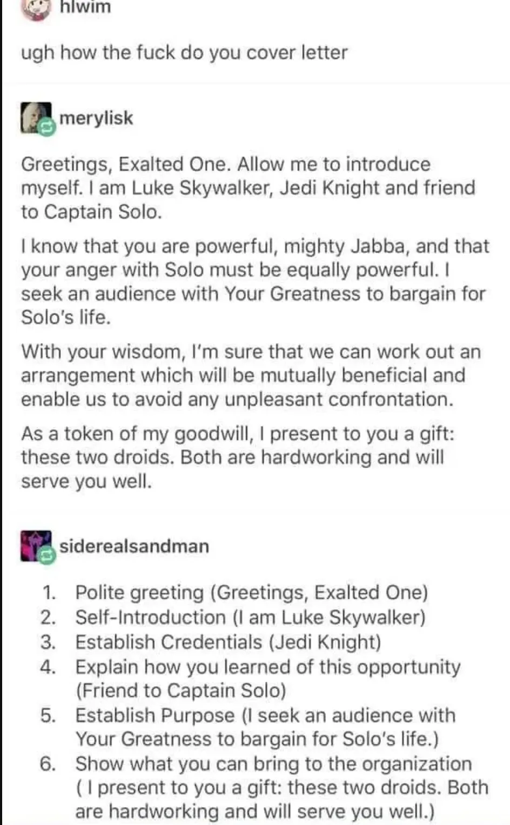
How the Heck do you cover letter?

Slide 8
Core themes and objectives What do you want the hiring committee to know about you? Strategy: use your core themes in your cover letter to organize your skills and tell a story about who you are as an employee and reflect qualities the committee is seeking in applicants. Examples:
1
Great interpersonal communication skills, team-oriented, collaborative
2
Problem solver, resourceful, can handle challenging circumstances
3
Equity-minded approach to the workplace, works to create inclusive environments where everyone feels valued and experiences belonging

Slide 9
Argument structure to craft a compelling cover letter
Claim
evidence
Summary
Strategy
Launch
Synergize scalable
e-commerce
Disseminate standardized metrics
Craft of research 117 argument structure claims evidence, aknowledege and response
Foster holistically superior methodologies
Deploy strategic networks with compelling
e-business needs

Slide 10
Opening Paragraph Example
I am writing to express my interest in the Assistant Habitat Connectivity Biologist position with Washington Department of Transportation because I believe in WSDOT’s multi-pronged approach to integrating habitat connectivity into the state’s transportation system. Historically, I have sought out, and worked with, wildlife connectivity initiatives, including work on the Coast to Cascades Connectivity Analysis with the Washington Wildlife Habitat Connectivity Working Group (WWHCWG), and I am eager to continue to advance State efforts to minimize wildlife-vehicle collisions. I would bring experience managing conservation programs in Washington, academic research on landscape ecology, and ongoing collaborative work on State connectivity to your Department, and would appreciate your consideration for this position.

Slide 11
Example: Showing your response to core responsibilities
Takuma Hayashi​​
Mirjam Nilsson​​
President​
Chief Executive Officer​
Rajesh Santoshi​
VP Marketing​

Slide 12
Example
ROI​
Niche markets​
Supply chains​
Envision multimedia-based expertise and cross-media growth strategies​
Visualize quality intellectual capital​
Engage worldwide methodologies with web-enabled technologies​
Pursue scalable customer service through sustainable strategies​
Engage top-line web services with cutting-edge deliverables​
Cultivate one-to-one customer service with robust ideas​
Maximize timely deliverables for real-time schemas​

Slide 13
Example: Conclusion paragraph
At Contoso, we believe in giving 110%. By using our next-generation data architecture, we help organizations virtually manage agile workflows. We thrive because of our market knowledge and great team behind our product. As our CEO says, "Efficiencies will come from proactively transforming how we do business."​

Slide 14
Questions?
Averi Azar
averi.a.azar@evergreen.edu​
360 742-8746
Kevin Francis
francisk@evergreen.edu

